Slide 1

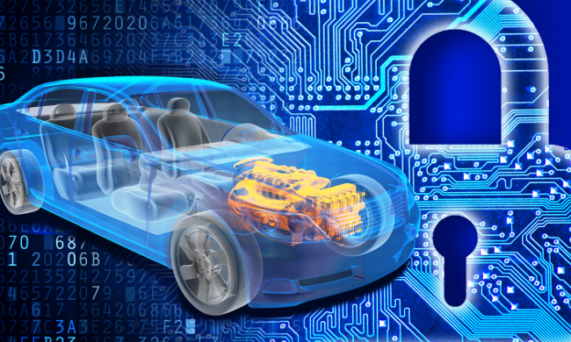
Autonomous and Connected Cars as Data Repositories
2017 IT.Can Conference
October 23, 2017.
St. Andrew’s Club and Conference Centre

Slide 2
aGENDA
What is the “Connected Car”?
  Definition
  The Changing Vehicle
The privacy conundrum of the connected car
  Connected car through a privacy lens
  Mitigating controls
The connected car ecosystem
  Technologies and key players
  Commercial agreements and risk allocation
Tackling connected car challenges
  Global cooperation and best practices
  Initiatives in US, Europe, Canada

Slide 3
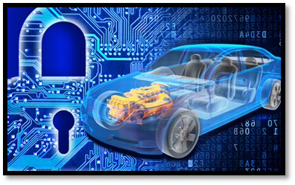
Why technology matters to automakers

Slide 4
WHAT IS THE “CONNECTED CAR”

Slide 5
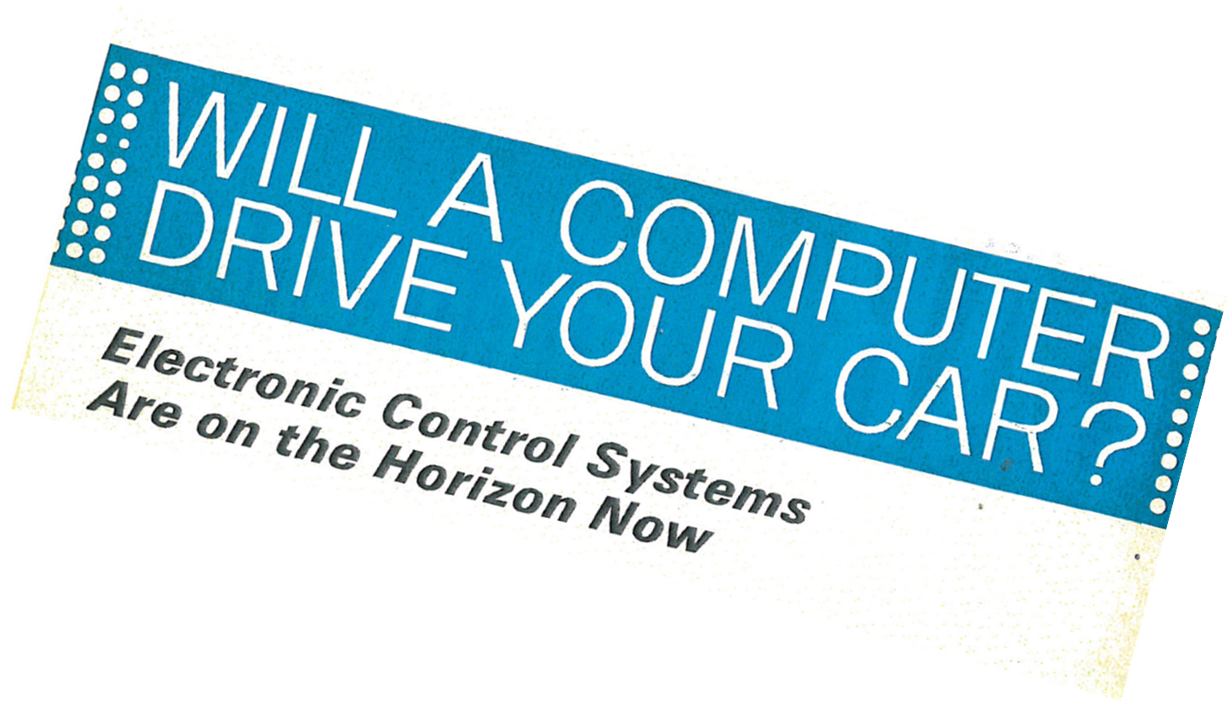
A magazine headline from the recent past

Slide 6
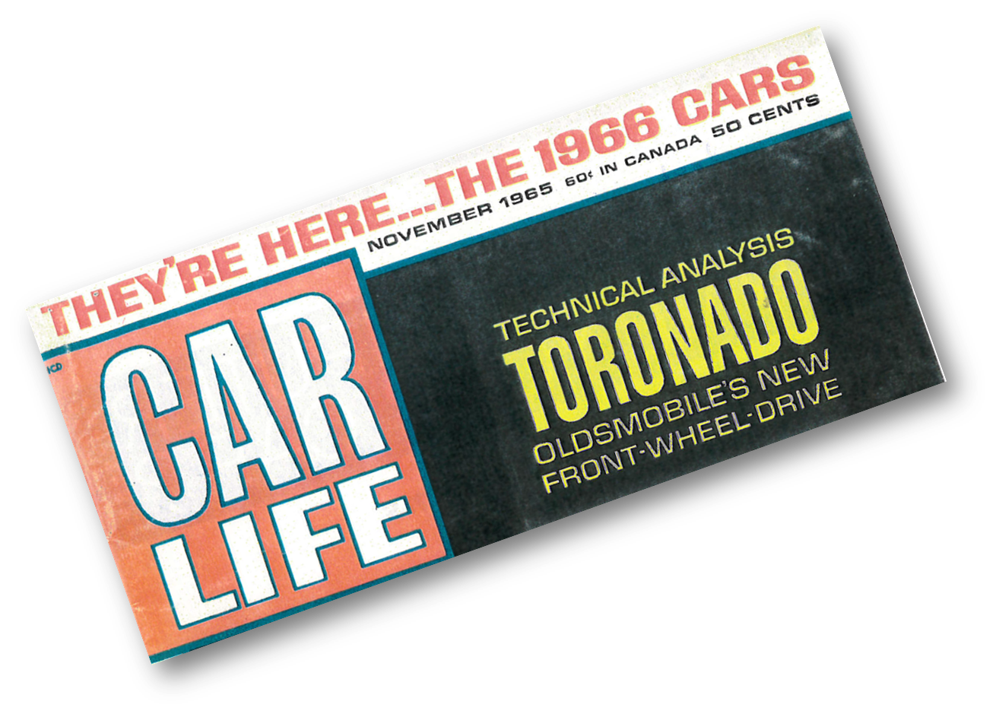
… or not so much!

Slide 7
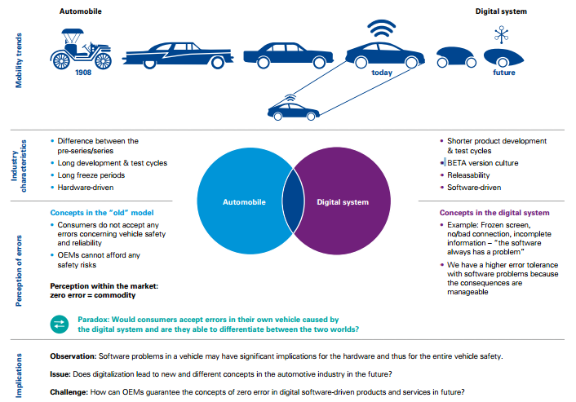
The Changing Vehicle
Source: KPMG .com GAES 2017

Slide 8
THE CHANGING VEHICLE

Slide 9
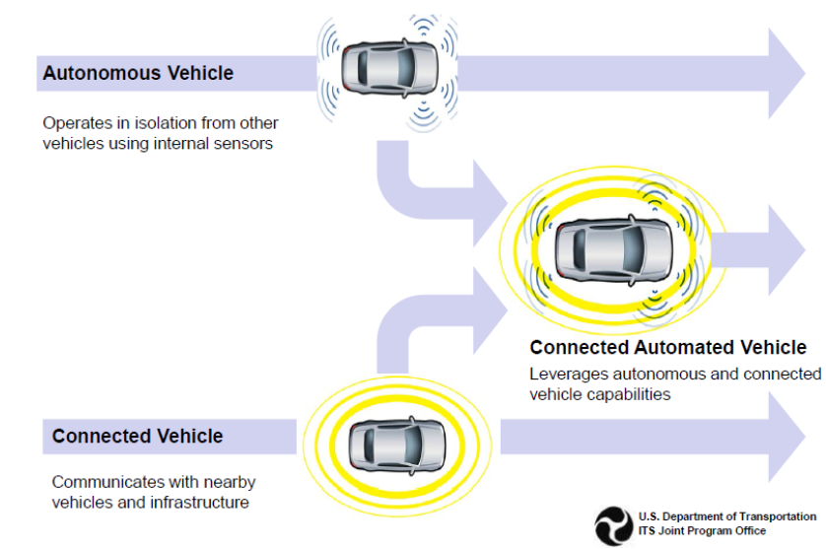
Connected vs. Automated

Slide 10
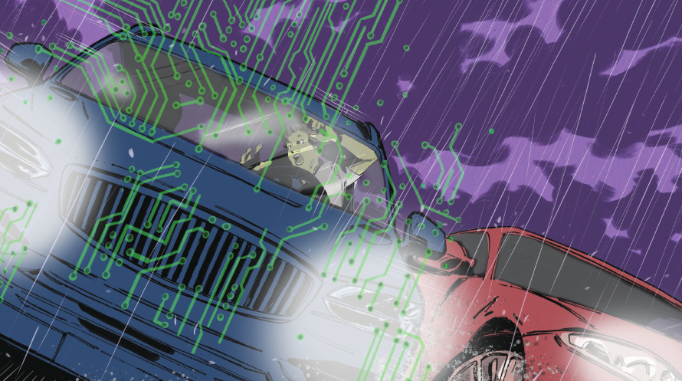
“How long ‘ til we get there?”
“Soon electronic chauffeurs will take us wherever we want to go, whenever we want, in complete safety – so long as we do not need to make any left turns across traffic. Changing road surfaces are a problem, too. So are snow and ice. It will be crucial to avoid traffic cops, crossing guards and emergency vehicles. And in suburban environment where pedestrians are likely to run out in front of the car, we should probably just walk or take the subway.”
- Steven Shladover
California Partners for Advanced Transportation Technology
Notes:
Half of the cost of a new commercial or military aircraft goes towards software verification and validation
Decisions in aircraft can be made in 10s of seconds with vehicles – fractions of seconds with no errors
Code will be orders of magnitude more complex than what it takes to fly a plane
Fully automated vehicles 2075

Slide 11
TYPES OF
Connectivity
V2V / V2I / V2X
Contemplates:
Environment
Condition of the vehicle
Traffic Management
Infrastructure
Consumer Conveniences
Contemplates:
In-car conveniences
Infotainment systems
GPS
Customer behaviour
Source: The Black Box Institute

Slide 12
What “connectivity” do consumers want?
Source: J.D. Power, 2015

Slide 13
Why do automakers want the technology?
Source: BI Intelligence

Slide 14
Big data brings
New opportunities

Slide 15
SO much data! so many uses!
  Volume, velocity, variety:
  vehicle performance data, location data, voice and data communications, web browsing, personal contacts and schedules, infotainment systems,
  And so on, and so on…
  Many purposes:
  usage-based insurance, enhanced safety, lower carbon emissions location-based services, fleet management, traffic efficiencies, repossession, marketing, And so on, and so on…

Slide 16
Why do Regulators want the technology?
Source: BI Intelligence

Slide 17
Why technology matters to regulators
2015 US NHTSA revised report
24 million reported vehicle crashes
33,000 fatalities
3.9 million injuries
$836 billion economic loss

Slide 18
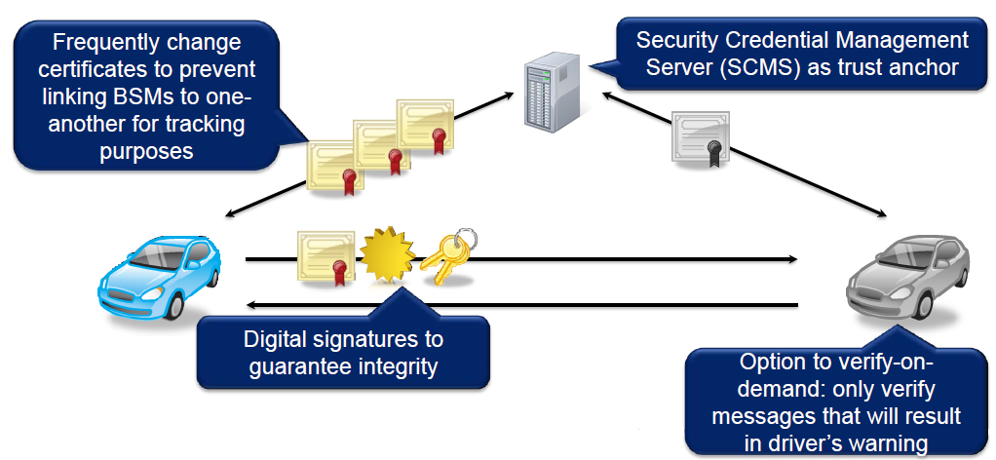
Security and Privacy in the connected car
Source: TrustPoint Innovation

Slide 19
Security vs. PrivacY
Security
Need to validate that Basic Safety Message (BSMs)
are from real cars
Prevent attackers from creating fake messages to change traffic patterns or create a road hazard
Privacy
Can’t make it easy to track personal cars
Each BSM contains exact position information
Data is sent unencrypted to enable fast response time
No unique information about the car or the owner
Certificate changes every 5 minutes
Cycle through 20 certificates every week
Every message is digitally signed
(but not encrypted)
Linkage values allow for “misbehavior detection” and revocation
Source: TrustPoint Innovation

Slide 20
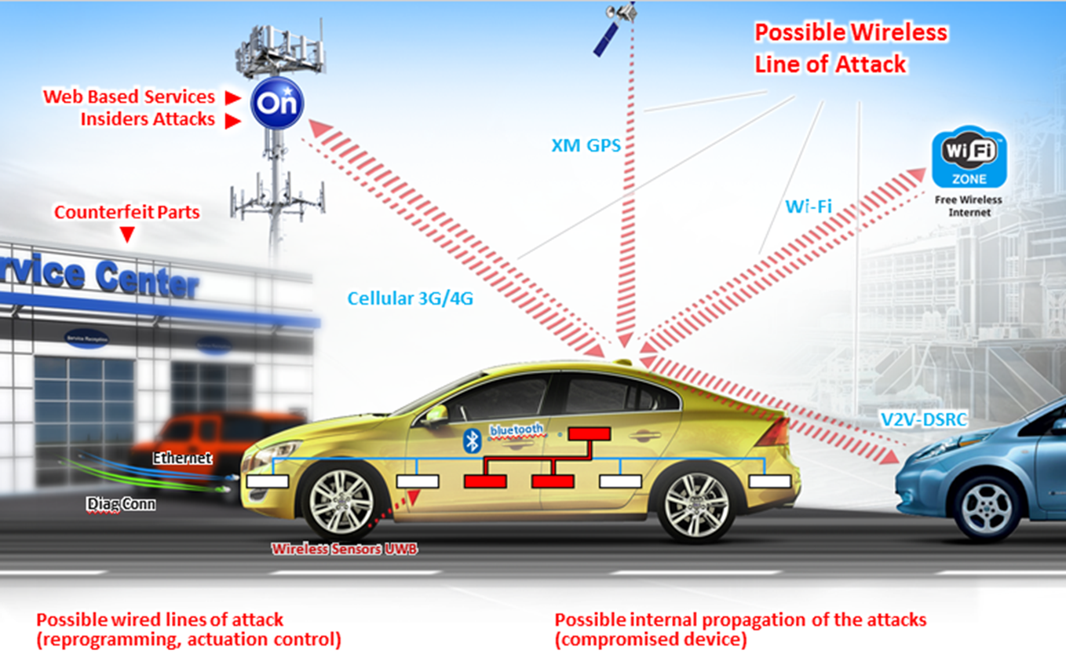
Connected = security/ privacy risk vectors
Source: TrustPoint Innovation

Slide 21
The privacy conundrum

Slide 22
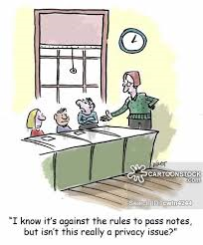
Privacy and security
Privacy = choice over what happens to info about me
Security = protecting the information
Security is integral to privacy. Privacy legislation specifically requires methods of protection must include physical, organizational and technological measures

Slide 23
Privacy legislation fundamentals
Personal information (PI) = any information related to an identifiable individual
    Any information that can be used to distinguish or that is linked to the individual
Private sector privacy legislation applies where an organization collects, uses or discloses PI the course of commercial activities

Slide 24
Privacy legislation fundamentals
While the company may have physical control of the PI, decisions about how to collect, use and disclose PI should reflect individual consent and personal preferences
PI should not be collected, used or disclosed without consent or in contravention of the individual’s reasonable expectations
Can’t refuse to deal because won’t consent to unnecessary collection, use or disclosure
of PI
Organizations may collect, use or disclose PI only for purposes that a reasonable person would consider appropriate in the circumstances

Slide 25
Privacy lens on connected cars
car as a zone of privacy (extension of home)
privacy is about choice - but every car is equipped
data can be linked to the vehicle owner/user - can be used not only to improve safety, systems and features, but also to track and profile customers for targeted marketing purposes
data from telematics and infotainment systems can reveal personal lifestyle, habits and preferences

Slide 26
Privacy lens on connected cars
Transparency – providing people with a basic understanding on how their personal information will be used in order to gain informed consent
Limiting use plus consent – the use of that information only for the declared purpose for which it was initially collected, or purposes consistent with that use
Minimization – limiting the personal information collected to what is directly relevant and necessary to accomplish the declared purpose and the discarding of the data once the original purpose has been served
Appropriate use – an organization may collect, use or disclose personal information only for purposes that a reasonable person would consider are appropriate in the circumstances

Slide 27
The Connected Car Ecosystem

Slide 28
Connected car is part of technology suite
Source: Ernst & Young

Slide 29
COMMERCIAL
AGREEMENTS
Until a post-driver/owner ecosystem takes form, stakeholders (such as manufacturers, dealers, software developers, etc.) can try to address unresolved issues through commercial agreements to minimize risk as regulatory progress in Canada is lagging
Things to consider in commercial agreements are:
  Expressly addressing ownership over data (as between consumers/manufacturers/service providers/other stakeholders – particularly in multi-user and multi-ownership scenarios)
  Establishing clear parameters for the scope of information to be collected, the permitted use of same, the possible ancillary uses that may arise (e.g., will collector have right to license data out to 3Ps, develop collateral products/services, how will competition be impacted?)

Slide 30
CommERCIAL
AGREEMENTS
Cont’d
  Apportioning liability where data handled jointly (i.e., who is at fault when one actor in a “chain” of data sharing/processing mishandles data or breaches privacy legislation);
  Indemnities, damages, remedies
  Allocating risk/liability as between manufacturer, software developer, dealer/servicer for data/software defects? (e.g., costs associated with software flaw resulting in corrupted or inaccurate data relied on for servicing)
  Addressing potential consumer/user or servicer misuse of software or data (e.g., ensuring contracts now account for potential jail-breaking or unwanted digital/software modifications; e.g., ensuring data shared with independent service providers is handled appropriately and only used as permitted);

Slide 31
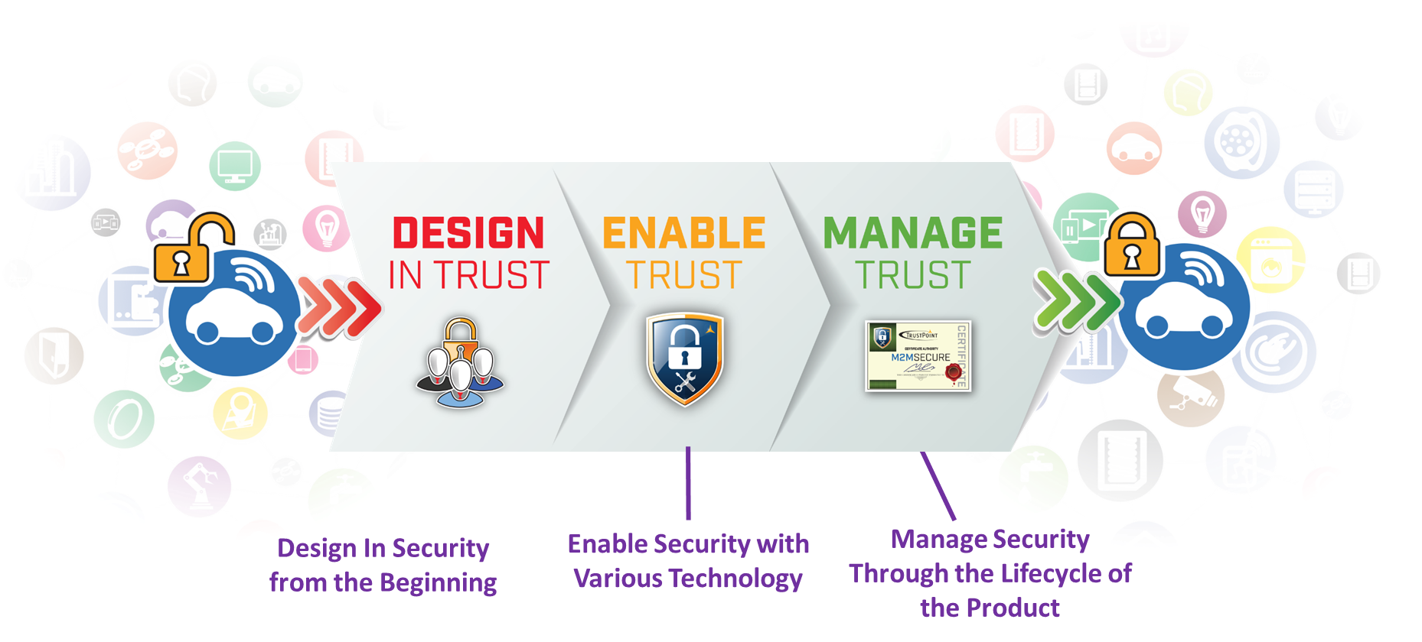
Tackling connected car challenges
Source: TrustPoint Innovation

Slide 32

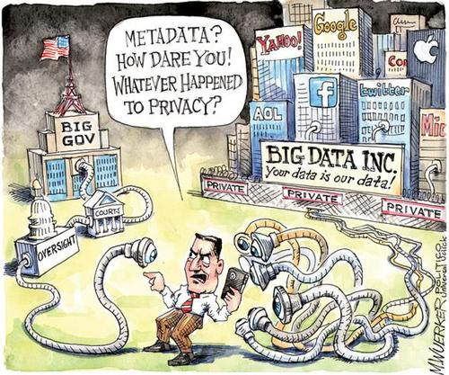
Whose Data Is It, Anyway? Data ownership is an issue that remains in flux with multiple stakeholders having potential claims:
  manufacturers
  dealers
  servicers
  insurers
  app developers
  wireless carriers
  Rental/car share/passenger fleet companies
Some jurisdictions in the U.S. have legislated driver/consumer ownership over “event data recorder” (EDR) or “black box” data

Slide 33
Given the volume and monetary value of vehicle generated data, questions of ownership may need to be settled to provide for clearer rights as between various stakeholders;
According to Intel, automated/connected cars will generate 4TB of data (in 1.5 hours) – over six times the data an average user generates daily through PCs, mobile devices, and/or wearables;
Until the regulation of automated/connected vehicle data is definitively dealt with, the ownership, collection, use, and monetization of data will have to be dealt with as it has been – through commercial agreements, existing privacy legislation, cybersecurity/safety regulation, and, when occasion calls for it, common law principles

Slide 34
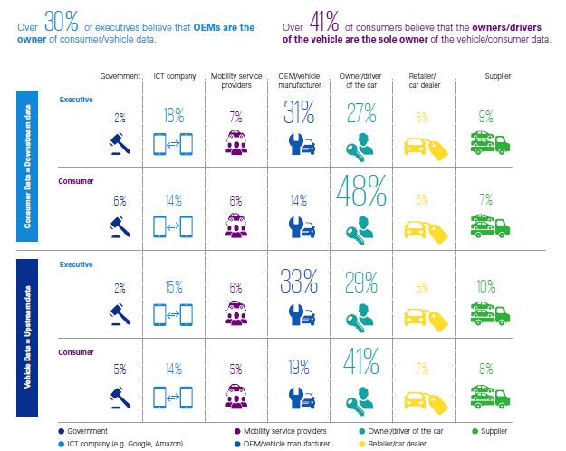
Data ownership – a difference of opinion
Source: KPMG .com GAES 2017

Slide 35
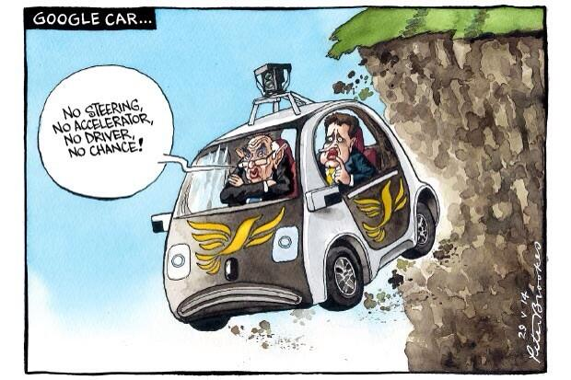
TRANSITION PERIOD
Answers we formulate in the next 2-5+ years are unlikely to carry the day indefinitely – data rights will need to be re-visited until automated/connected vehicles reach their “end state”

Slide 36
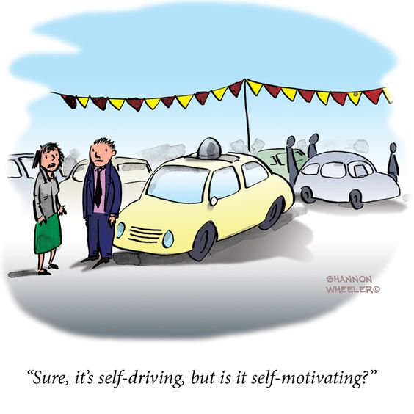
TRANSITION PERIOD
A post-driver/owner future? Many expect that full automation will usher in an era of subscription based fleet services taking personal vehicle ownership out of the equation
In a post-driver/owner model, questions arise as to who the remaining key data stakeholders will be:
                will dealers have any role?
                will independent service providers exist or will fleets be maintained by OEM/fleet owners to protect proprietary software/tech?
                what data will matter then? why?

Slide 37
Tackling connected car challenges

Slide 38
Where is Cv Work being undertaken?
International
      G7 Transport Ministers – CV/AV Working Group
      Regulatory Cooperation Council – CV Work Plan, Motor Vehicle Safety
      American Association of State Highway and Transportation officials (AASHTO) – CAV Executive leadership team
      V2I Deployment Coalition (V2IDC)
Domestic
      Transportation Association of Canada (TAC) CV/AV Working Group
      Canadian Council of Motor Transportation Administrators (CCMTA) Av Working Group
      Council of Ministers Responsible for Transportation and Highway Safety (COMT) – Policy and Planning Support Committee (PPSC) CV/AV Working Group
Source: Transport Canada

Slide 39
GENERAL COMMENTS
While ownership issues remain in flux, privacy rights and safety regulations will step-in to guide data use… eventually
Privacy legislation: will continue to impact the manner in which consumer information can be used in the automotive context (much in the way that data generated from mobile devices, wearable tech, apps, etc. is regulated)
Safety regulation: will also impact the manner in which data is collected and stored and the manner in which software is operated/managed given its potential implications on passenger safety in the event of real-time breaches

Slide 40
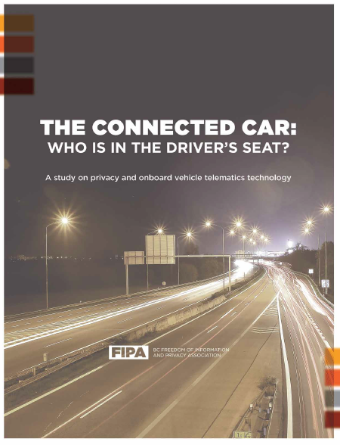
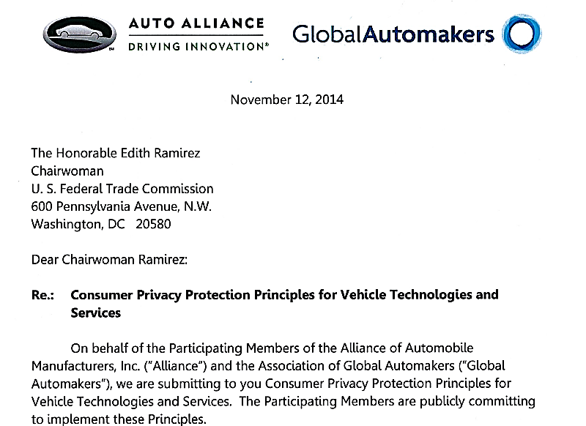
BUT… Different jurisdictions, different rules

Slide 41

Canada’s Position on AV/CV’s
“Canada is working with the US to enable cohesion across borders; cross-ministerial work is taking place to advance AV/CVs; money from the federal budget earmarked for AI will go to AVs, and safety would be balanced so as not to stifle innovation.”
The Hon. Marc Garneau
Minister of Transport
April 19, 2017

Slide 42
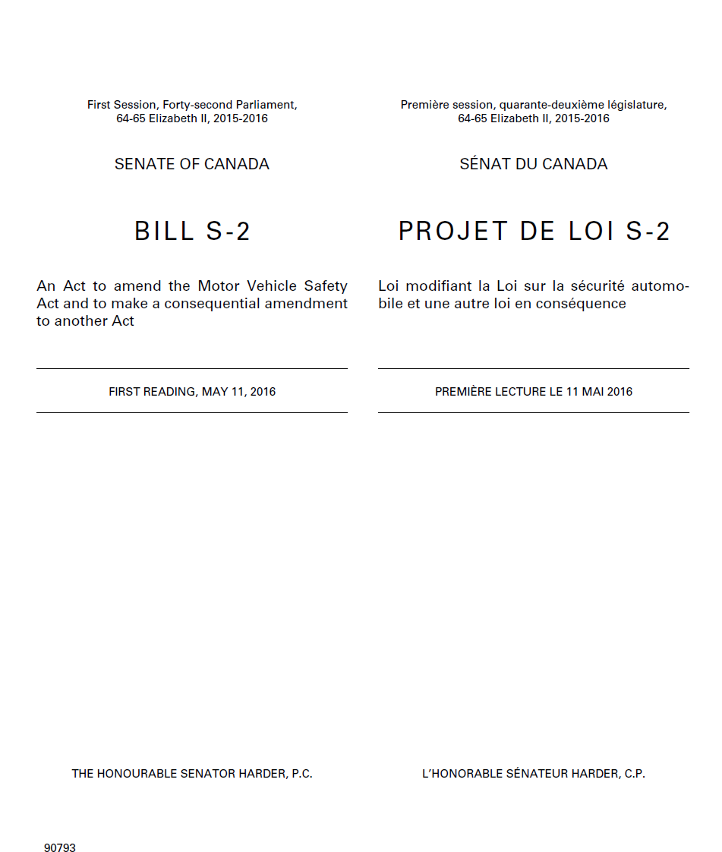
Canada’s Position on AV/CV’s
S2- (MVSA Amendments)
currently before HoC has
provisions to facilitate CV
AV technology

Slide 43
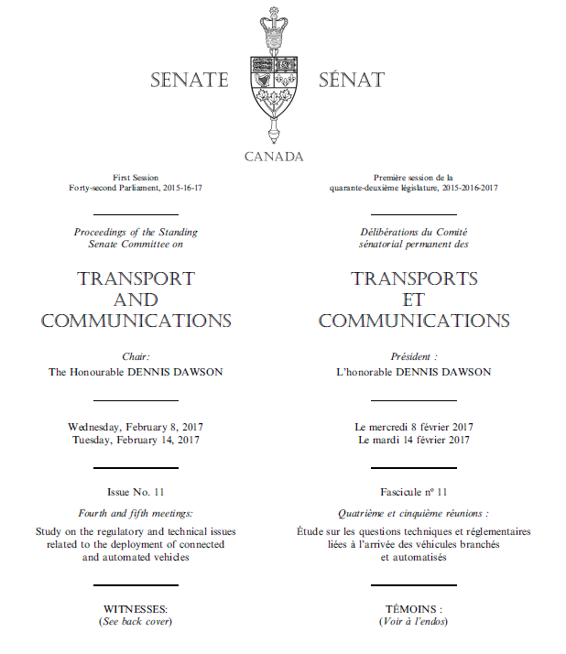
Senate currently studying CVs/Avs

Slide 44

CANADIAN DEVELOPMENTS –
SAFETY
What to expect:
  NHTSA is a good prognosticator of what to expect in Canada
  Assuming Transport Canada adopts a similar approach regarding cybersecurity, software vulnerabilities could become a federally regulated component of AVs/CVs;
  Cybersecurity vulnerabilities were responsible for 1.5 million vehicle recalls in the U.S. in 2015;
  While cybersecurity guidelines are aimed at safeguarding passenger safety, guarding against vulnerabilities will notionally protect data generated and collected by AVs/CVs;

Slide 45
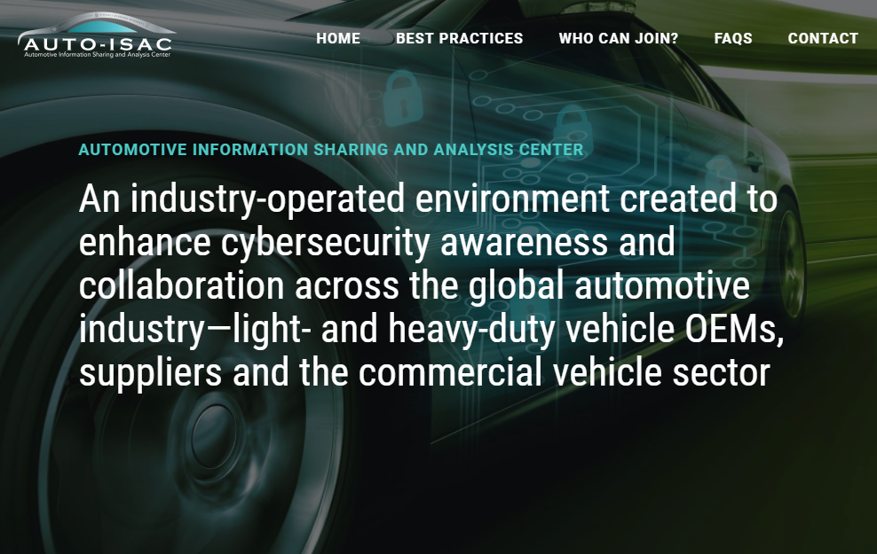
U.S. DEVELOPMENTS
August 2015 – Auto ISAC established by automakers to create a global information sharing community to address vehicle cybersecurity risks.
Auto-ISAC operates a central hub for sharing, tracking and analyzing intelligence about cyber threats, vulnerabilities and incidents related to the connected vehicle.
Notes:
Information Sharing and Analysis Centers (ISACs) were created as a result of Presidential Decision Directive 63 (PDD-63) in 1998. The directive requested the public and private sector create a partnership to share information about threats, vulnerabilities, and events to help protect the critical infrastructure of the United States. PDD-63 was updated in 2003 with Homeland Security Presidential Directive 7 (HSPD-7) to reaffirm the partnership mission.

Slide 46
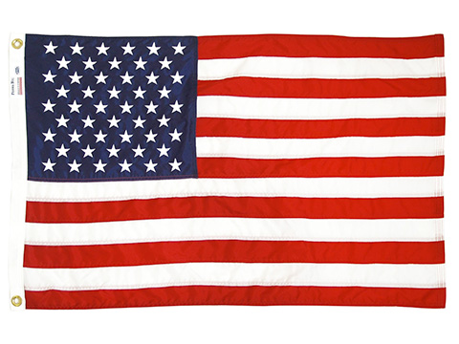
U.S. DEVELOPMENTS
              Sept. 2016 – US Department of Transportation issued the Federal Automated Vehicles Policy (Policy) as a guidance to speed up laying the regulatory foundation for connected and autonomous vehicles
In relation to consumer privacy and cybersecurity, the Policy suggests the following practices/principles be followed by manufacturers:
  Provide consumers with clear and accessible privacy policies/notices
  Offer consumers choice with regards to data collection, use, sharing, retention, especially identifying data
  Collect and retain data only for as long as necessary
  Permit consumers to review their data to ensure integrity and accuracy
  Audit internal departments on a regular basis to ensure compliance with applicable state and federal privacy and data security laws

Slide 47
U.S. DEVELOPMENTS
Oct. 2016 – NHTSA releases Guidance on Cybersecurity Best Practices for Modern Vehicles
  The Guidance advises layered solutions and risk-based prioritized identification and protection of critical vehicle controls and personal data;
  In addition to product development, the Guidance suggests best practices for researching, investigating and testing and validating cybersecurity measures such as self-audits to determine vulnerabilities in supply chain of operations;
  The Guidance also promotes the development of vulnerability reporting/disclosure policies to enable external cybersecurity researchers to disclose vulnerabilities to organization manufacturing and designing vehicle systems.

Slide 48
U.S. DEVELOPMENTS
June 2, 2017 - The Federal Trade Commission (FTC) and the NHTSA are hosting a workshop to examine the consumer privacy and security issues posed by automated and connected motor vehicles
Topics to be covered include:
  The types of data vehicles with wireless interfaces collect, store, transmit, and share
  Potential benefits and challenges posed by such data collection
  The privacy and security practices of vehicle manufacturers
  The role of the FTC, NHTSA, and other government agencies regarding privacy and security issues related to connected vehicles
  Self-regulatory standards that might apply to privacy and security issues related to connected vehicles.

Slide 49

E.U. DEVELOPMENTS
January 2017: The European Union Agency for Network and Information Security (ENISA) released a report examining cybersecurity and provided a list of recommendations and good practices, such as:
  Improving information sharing among industry actors;
  Achieving consensus on technical standards for good practices;
  Clarifying cyber security liability among industry actors;

Slide 50
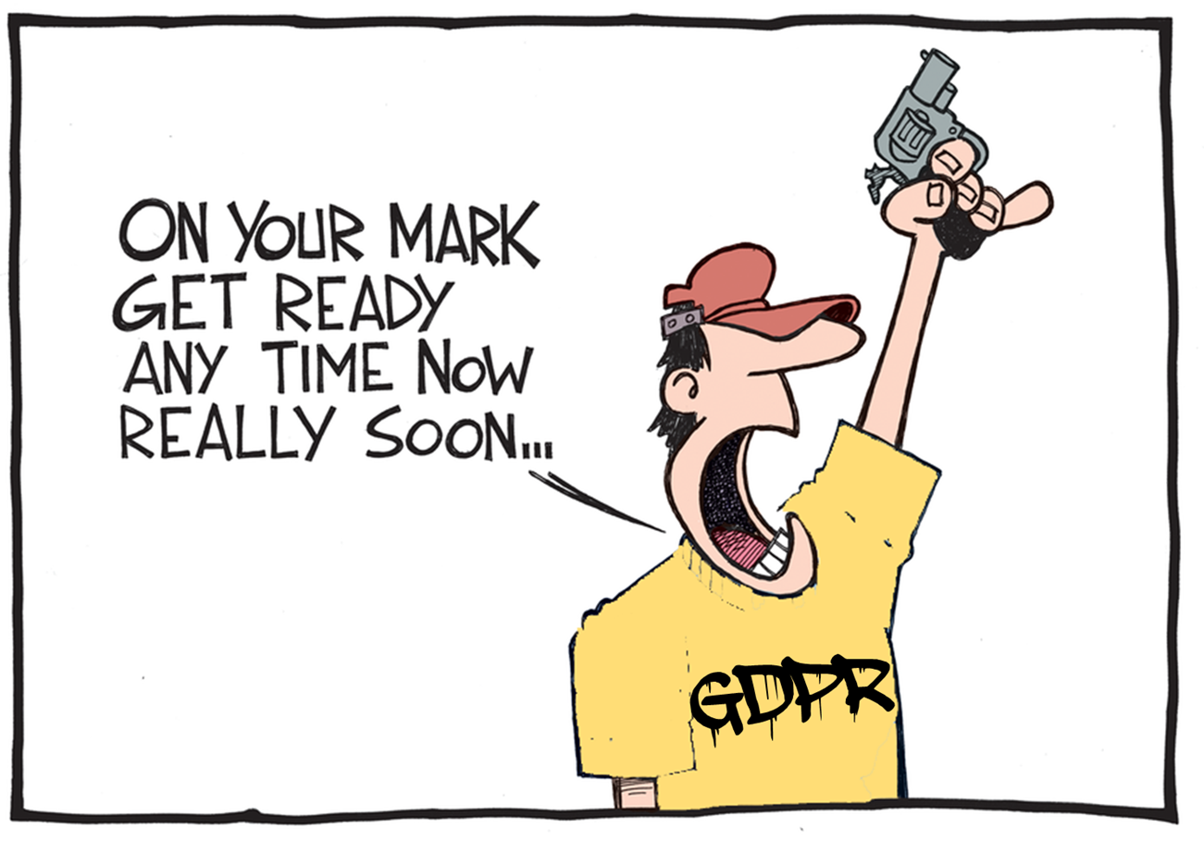
E.U. DEVELOPMENTS
2018: The EU General Data Protection
Regulations (GPDR) Comes into Effect
  The GPDR applies to any manufacturer that could conceivably handle data belonging to or related to EU citizens
  Non-EU manufacturers dealing with data of
  EU citizens will need to be in compliance
  with the GPDR such as:
    The Data Processing Register
    which formalizes a tool used to formally
    document and register data being collected
    and processed (even if this data is transferred
    outside of the EU)
    The Data Breach Register
    which records all instances of
    breach in relation to EU citizen data

Slide 51

Questions?
David Adams, President ,
Global Automakers of Canada
dadams@globalautomakers.ca

