Slide 1


INTERMEDIARY ACCOUNTABILITY IN THE DIGITAL AGE
October 29, 2018
Richard Austin Dr. Emily Laidlaw
Deeth Williams Wall LLP Faculty of Law, University of Calgary

Slide 2
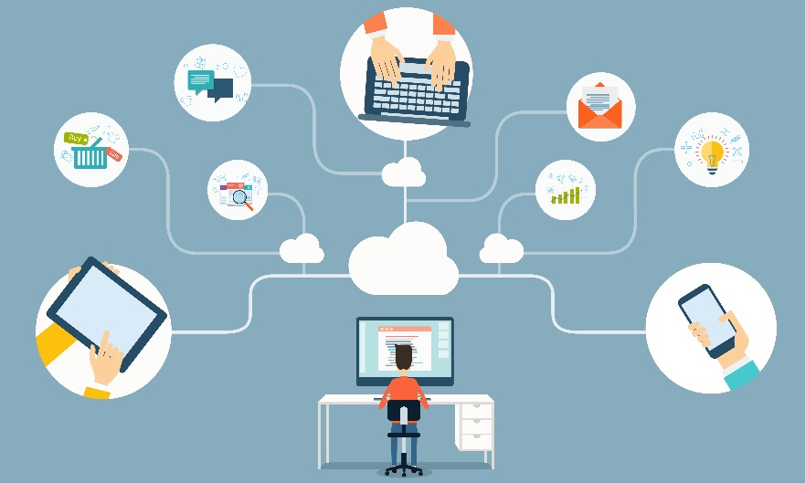
Agenda
1. Introduction to Internet Intermediaries
2. Online Reputation
Cambridge Analytica and Facebook
Competition Law
2

Slide 3
1. Introduction to Internet Intermediaries
“The term ‘internet intermediaries’ commonly refers to a wide, diverse and rapidly evolving range of service providers that facilitate interactions on the internet between natural and legal persons. Some connect users to the internet, enable processing of data and host web-based services, including for user-generated comments. …Importantly, they may carry out several functions in parallel, including those that are not merely intermediary. Internet intermediaries also moderate and rank content, mainly through algorithmic processing, and they may perform other functions that resemble those of publishers. As a result, different regulatory frameworks can apply, respectively, to their intermediary roles and to their other functions.”
Council of Europe, Brief Overview of the Roles and Responsibilities of Internet Intermediaries
Internet Intermediaries
Internet access and service providers (ISPs) | Data processing and web-hosting providers
Internet search engines and portals | e-commerce intermediaries
Internet payment systems | Participative networking platforms
3

Slide 4
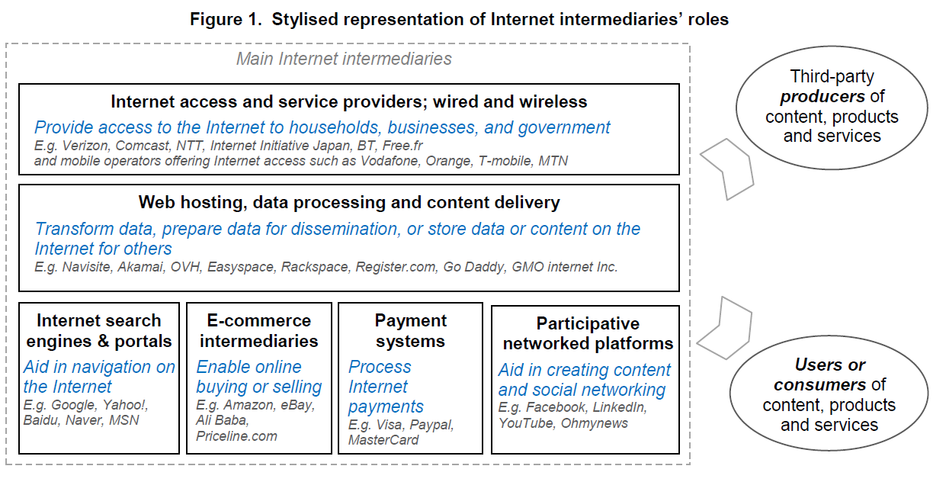
    Organization of Economic Cooperation and Development, The Economic and Social Role of Internet Intermediaries, 2010
4

Slide 5
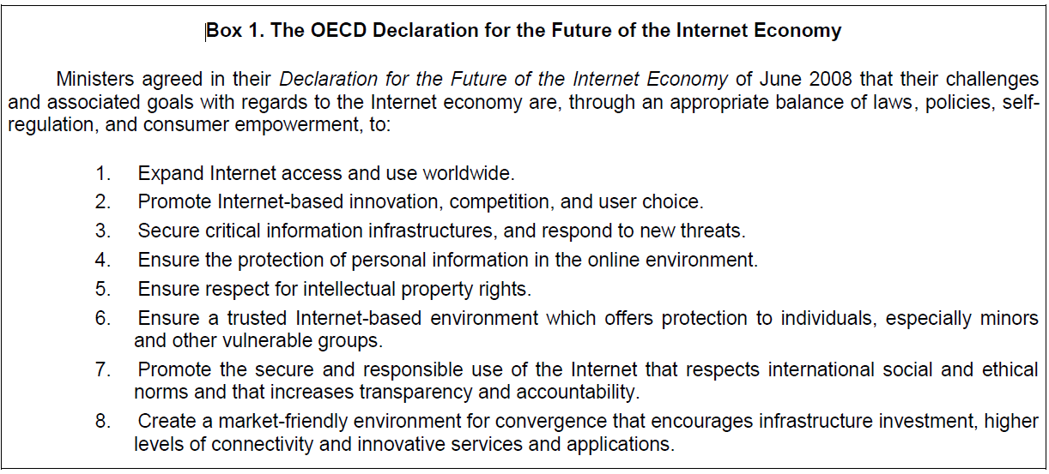
The Internet Economy
    Organization of Economic Cooperation and Development, The Economic and Social Role of Internet Intermediaries, 2010
5

Slide 6
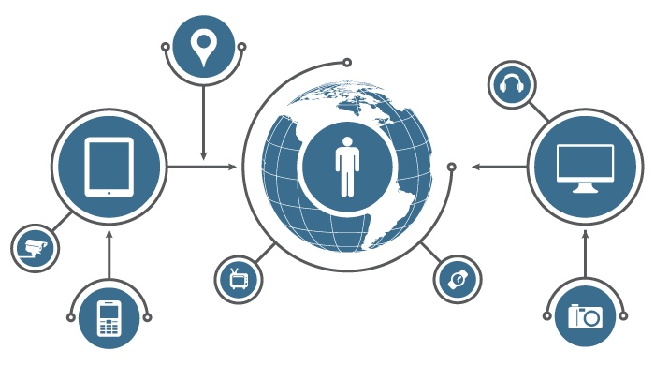
Intermediary Accountability
Intermediaries originally subject to limited regulation, e.g. U.S. safe harbour protections under Communications Decency Act and Digital Millenium Copyright Act
  “The United States success in developing the Internet intermediaries sector confirms the legislative reasoning
  behind the enactment of both the CDA and the DMCA. Industry observers generally indicate that an important
  reason for the success of U.S. intermediaries on a global scale is due to the space for innovation and application
  created by these safe harbors. Consequently, any changes that would diminish the robustness of the safe
  harbors would injure the U.S. economy.”
        Dippon, Christian, Economic Value of Internet Intermediaries and the Role of Liability Protections, 2017 at 4
Increasing pressure to regulate Internet Intermediaries coming from:
  Expansion and omniscience of Internet economy
  Economic weight of intermediaries
  Social issues and incidents
  Political and legal pressure
6

Slide 7
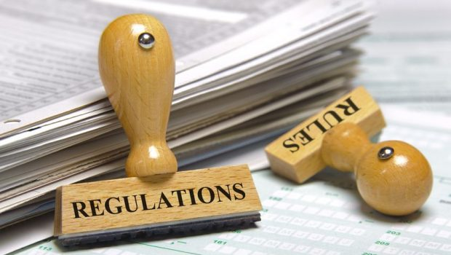
The choice is not between regulating or not regulating. If there is a binary choice (and there are often many shades in between) it is between settled laws of general application and fluctuating rules devised and applied by administrative agencies or regulatory bodies; it is between laws that expose particular activities, such as search or hosting, to greater or less liability; or laws that visit them with more or less onerous obligations; it is between regimes that pay more or less regard to fundamental rights; and it is between prioritising perpetrators or intermediaries.
Smith, Graham, Regulating the internet: intermediaries to perpetrators, June 5, 2018
7

Slide 8

2. Online Reputation
How do you solve reputational problems?
  Reputation means something to everyone.
  Key differences
    SMEs vs large corporations vs individuals
    Evolving role of intermediaries
    Types of speech
    Types of harm
8

Slide 9
Online Reputation cont’d
SCENARIO:
A business or individual is defamed online and it goes viral. It ends up in search results.
1. What are the responsibilities of intermediaries?
2. What challenges does it highlight about resolving online reputational harms?
9

Slide 10
Issues to Explore
Content Takedown
Youth
Complex and Conflicting Laws
Privacy versus Defamation
10

Slide 11

Issue 1: Content Takedown
11

Slide 12
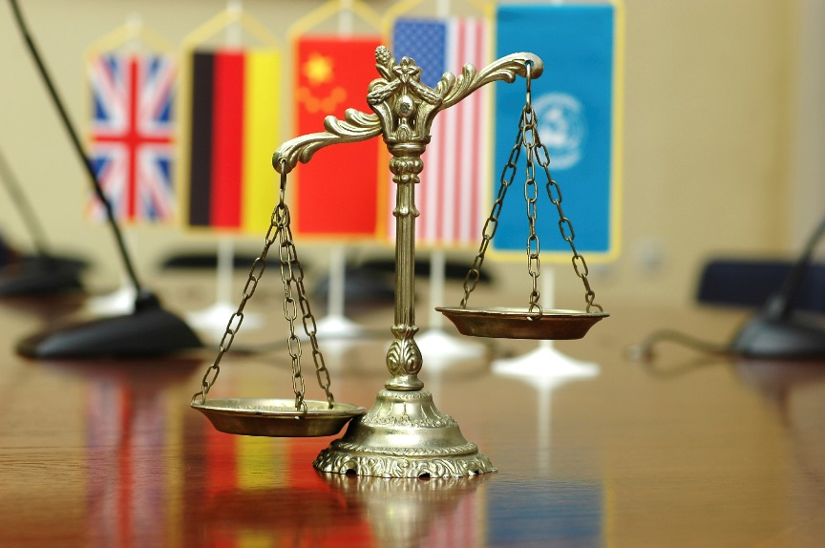
Issue 2: Complex and Conflicting Laws
12

Slide 13

Issue 3: Privacy and Defamation overlap
13

Slide 14
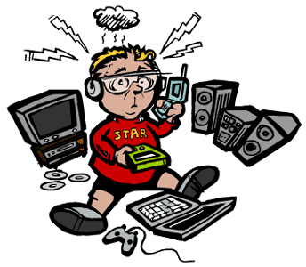
Issue 4: Youth
14

Slide 15
3. Cambridge Analytica and Facebook
Aleksandr Kogan, data scientist at Cambridge, developed a survey app, "This Is Your Digital Life".
App required Facebook login credentials, used an informed consent process, for research in which 270,000 Facebook users agreed to complete a survey in exchange for $4.
Facebook's design allows the App to collect, in addition to the personal information of those who agreed to take the survey, personal information of all the people in those users' Facebook social network.
Reports suggest that Cambridge Analytica acquired personally identifiable information of 87 million Facebook users.
Cambridge Analytica used this data to determine what kinds of political campaign advertisements would be most effective in persuading a particular person in a particular location.
15

Slide 16
Cambridge Analytica and Facebook cont’d
In 2015, when Facebook learned of the situation, it removed Kogan’s App and demanded that he and all parties he had given data to destroy the data.
In March 2018, the Guardian and the New York Times publish articles stating Cambridge Analytica still possessed the data and that it had used the data to influence voters in the US and the UK.
U.S. $37 Billion drop in market capitalization of Facebook in March 2018 when Cambridge Analytica situation becomes public
Investigations into Facebook by:
  Office of the Privacy Commissioner of Canada
  U.S. Federal Trade Commission
  United Kingdom’s Information Commissioner’s Office
Cambridge Analytica files for insolvency proceedings and closes operations on May 1, 2018
16

Slide 17

Cambridge Analytica and Facebook Issues
Whether Cambridge Analytica’s use of personal information was for an inappropriate purpose generally (PIPEDA, s. 5(3))
    Intermediaries should not disclose personal data to a third party unless required by law or requested do to so by a judicial or other competent authority whose decisions are subject to judicial review, that has determined that disclosure is consistent with law.
            Council of Europe, Brief Overview of the Roles and Responsibilities of Internet Intermediaries
Transparency
Responsibility for use of personal information in complex, multi-party transactions (gaps in legislative frameworks)
17

Slide 18

Cambridge Analytica and Facebook Issues cont’d
Availability of effective remedies under Canadian privacy legislation:
  Reactive versus proactive
  Availability of fines
  Jurisdictional issues
Content Moderation:
    Any interference by intermediaries with the free flow of information and ideas should be based on clear and transparent policies and be limited to specific legitimate purposes, as determined by law, through instruction by a competent authority, or in accordance with the company’s own content restriction policies or codes of ethics. When restricting access to content in line with their own content-restriction policies, intermediaries should do so in a transparent and non-discriminatory manner.
            Council of Europe, Brief Overview of the Roles and Responsibilities of Internet Intermediaries
18

Slide 19
4. Competition Law
Challenges
Combination of:
  Big Data (mass collection of data, algorithms and artificial intelligence);
  Intersection of competition law and policy, privacy and consumer protection.
Policy
Competition Law
Consumer Protection
Privacy
19

Slide 20
Competition Issues
How do these challenges play out in competition law context?
Among others:
  Abuse of dominance
  Anti-competitive Agreements
  Deceptive Marketing
BEWARE OF FALSE CLAIMS
20

Slide 21

Issues to explore in Big Data
How should market power be assessed?
What factors are critical to assess efficiency and anti-competitive effects?
What is deceptive marketing in an era of big data?
21

Slide 22
List of References
Council of Europe, Roles and Responsibilities of Internet Intermediaries available at https://rm.coe.int/leaflet-internet-intermediaries-en/168089e572
Dippon, Christian, Economic Value of Internet Intermediaries and the Role of Liability Protections, 2017 at https://cdn1.internetassociation.org/wp-content/uploads/2017/06/Economic-Value-of-Internet-Intermediaries-the-Role-of-Liability-Protections.pdf
Organization of Economic Cooperation and Development, The Economic and Social Role of Internet Intermediaries, 2010 at www.oecd.org/internet/ieconomy/44949023.pdf
Smith, Graham, Regulating the internet: intermediaries to perpetrators, June 5, 2018 at http://blogs.lse.ac.uk/mediapolicyproject/2018/07/03/regulating-the-internet-intermediaries-to-perpetrators/
22

Slide 23

QUESTIONS?
?
Richard Austin Dr. Emily Laidlaw
Deeth Williams Wall LLP Faculty of Law, University of Calgary
raustin@dww.com emily.laidlaw@ucalgary.ca 416 941 8210 403 220 7071

