Slide 1
Case Studies in Agile Software Development:
Choosing the Right Project & Choosing the Right Contract
John Beardwood
2016 IT.CAN 20th Annual Conference
Roundtable 8 (How to Draft in the Age of Agile vs. Waterfall)
October 25, 2016

Slide 2
Introduction
A recent survey of development and IT professionals shows that agile is now the norm.
HP survey of 601 software developers/IT professionals, re their co’s:
  77%: "pure agile" or "leaning towards agile"
  9%: "pure waterfall" or "leaning towards waterfall”
  24%: hybrid approach
[State of Performance Engineering 2015-16: TechBeacon]
Compare with 2012 Survey: 35% favoured agile
However, neither customer knowledge nor applicable development contracts have caught up to this reality

Slide 3
Introduction
Must be the Right Project
  Advocates: “liberating”; fast, efficient & creative
  Detractors: undisciplined hacking; less robust, buggier s/w
  However, Agile is neither “good” nor “bad” on its own - depends on the projects for which it is being used: it will not be appropriate for certain projects
Must be the Right Contract
  Waterfall contract framework does not sit comfortably with Agile projects

Slide 4
Introduction
In this presentation we will review two case studies:
Case Study #1: Choosing the Right Project
  De Beers UK Limited vs. Atos Origin IT Services UK Limited
Case Study #2: Choosing the Right Contract

Slide 5
Case Study #1: Choosing the Right Project

Slide 6
A. Background
  De Beers UK Limited vs. Atos Origin IT Services UK Limited (2010)
Example of failed system development/ implementation project, where Agile was applied to wrong project
High Court decision:
  Claimant: De Beers ("DB", then Diamond Trading Company ("DTC")).
  Defendant: Atos Origin IT Services(“Atos”)
2006: DB decides to develop software system to support diamond supply chain management. Existing systems were out of date
2007
  DB tenders software contract: Atos won.
  Atos carries out Initiation and Analysis Phase ("IAP") to investigate & analyse business req’mts so can enter into fixed price contract.

Slide 7
A. Background
Dec 2007: Atos dumps Agile approach and adopt Waterfall
Jan – Feb 2008: series of “fast track req’mts gathering workshops” are required to implement Waterfall
  Unexpectedly generate far more req’mts = more development, & impacts technical architecture.
Atos: cannot deliver by June (delivery date) or October 2008.
DB. Unacceptable. Will not pay due to delays & quality of work.
May 2008: Atos claims progress of work is delayed by
  lack of co-operation from DB;
  very significant increases in scope of the work
  non-payment of fourth invoice.
June 2008: Atos suspends all further work.

Slide 8
B. Why did project fail?
Evidence was unclear, but delay most likely caused by 4 factors:
Atos: Lack of understanding of the business
  Insufficient resource commitment: too few business analysts working on understanding DB’s business (to a lesser extent, also on DB’s side.)
  Insufficient pre-contract due diligence: Extended post-contract time was req’d to establish DB’s req’mts - complexity of DB’s diamond sorting/aggregating processes was not fully appreciated at outset by Atos.

Slide 9
B. Why did project fail?
DB: Failure to communicate business requirements
  Lack of availability of key personnel within DB:
    were not attending required workshops
    generally not available to provide info to Atos
  DB was still undecided as to what kind of IT system it wanted implemented, in certain areas

Slide 10
C. Problem #1: Wrong Project
Atos internal, contemporary report “The DTC Problem” is classic description
Applying the Agile Project Checklist to the Project:
  “DTC was originally intended to be developed agile-style… It became apparent that this wasn't going to work. This is for several reasons:
  • The application is much larger than was originally thought, in terms of function points. [Not good for large-scale development.]
  • The application is much more integrated and complex than was originally thought: a huge end-to-end multi-country workflow, with many of the same business concepts and sub-processes popping up at many points in the workflow and many "wrinkles" in the detail of the processes. [Not good for large-scale development.]
  • The customer is demanding, particularly on the technical side, and this did not fit well with an agile approach to build.” [Not good for order-based development culture.]

Slide 11
C. Problem #2: Switching to Waterfall Mid-Project
  Report continues:
  Accordingly the decision was taken to move towards a much more waterfall-style approach. However, this was not reflected in the team organisation, or in the definition of artefacts to be produced.
  As soon as arrived I observed that build team organisation was still divided into functional silos [i.e. iterative teams]
  we have started "specialising" so as to be able to provide the specific system support such a large and complex system requires. [i.e. moving from Agile well rounded, experienced programming role, to Waterfall specialization model]
  the workflow work … has exposed a massive gap. We have signed-off business functional req’mts but we have no definition of what system is to be built [i.e. we have no specifications.]

Slide 12
C. Agile Problem #2: Switching to Waterfall Mid-Project
  Report continues:
  In short, what is missing is systems analysis. This seems to be something of a lost art (within Atos Origin at any rate), & I am at a loss to understand why. To build a system of this size/ complexity it is an essential activity, & doing it now will undoubtedly pay for itself in the long term & address many painful risks. But of course, it casts the current plan into outer darkness & will undoubtedly go down like a bucket of cold sick with DTC.

Slide 13
D. Conclusion
Points to pitfalls of choosing wrong methodology & then trying to fix by switching mid-project
Therefore, should ensure correct methodology is adopted in the first place
Postscript to Debeers:
  DB entitled to recover £4.4 million to cover costs of an alternative replacement system BUT had to deduct £3 million costs DB would have incurred had Atos not terminated the contract
  nobody came out looking good

Slide 14
Case Study #2: Choosing the Right Contract

Slide 15
A. Issues re Scoping
Large agile implementation project
High-level business case, with description of final system implemented
Implementation Agreement executed
System to be developed & implemented by:
  Releases (e.g. R1, R2, etc.), broken into
  Phases: i.e. Inception; Development; Stabilization; Deployment and Support)
  Two SOWS: (1) Inception SOW, & (2) System Delivery SOW
    Inception SOW: generates System Delivery SOW, which delivers rest of Phases

Slide 16
A. Issues re Scoping
Where are the requirements expressed?
  1st: In detailed list scheduled in agreement…but then
  2nd: In the Inception SOW…but then
  3rd: In the System Delivery SOW
Agile Rationale: vendor does not yet know what reqmts can deliver for each Release until do work in Inception SOW to generate those req’ts.
Impact: don’t have reqmts settled at:
  signing of agmt, or
  beginning of each Release as each is signed off
= “floating scope” issue
= customer doesn’t know if will accomplish goals

Slide 17
B. Issues re Payment
If requirements are floating, what about payment?
If accept as principle that agile development will not provide certainty as to outcomes, then payment structure should be flexible enough to line up exactly with outcomes which are achieved
EVM, if used correctly is a good tool to achieve this

Slide 18
B. Issues re Payment
Formulae
  Variables
  Planned Value: valuation of planned work, based on cost budget for work completion in time period
  Actual Cost: the total actual cost in time period
  Earned Value: pre-defined “earning rules”/ to quantify achieved work during given period.
  Calculations
  Schedule Variance (Earned Value minus Planned Value)
  Cost Variance (Earned Value minus Actual Cost)
  Cost Performance Index (Earned Value divided by Actual Cost)

Slide 19
B. Issues re Payment
Metrics: Using Story Points
Story points are form of EVM, linking payment to value earned
Right Way: allocate to system stories based on both:
  value to the customer, and
  vendor work effort,
Wrong Way: agmt had story points:
  allocated solely by vendor work effort, not value earned.
  not related to payment
  in effect, they simply became a work estimation tool for vendor
Rather, payment was milestone-based.
But floating scope presents milestone challenges

Slide 20
Conclusion

Slide 21
Conclusion
Successful Agile projects are dependent on two key factors:
  Ensuring that this is the right project for Agile.
  Ensuring that this is the right contract for an Agile project
Re the contract, need to ensure that:
  neither party has “cherry-picked” only those elements of the Agile structure which best suit them
  the contract reflects actual workings of the Agile project
Notes:
i.e. great as an Xtreme sport, not so good as a recipe for achieving project success

Slide 22
Conclusion
Perhaps most important, the business teams need to ensure that they choose the right methodology for the right project
As Debeers evidenced:
  applying the wrong methodology to a development project is like trying to fit a square peg in a round hole
  switching methodologies mid-project is like trying to pull out and replace the jammed peg, while in free-fall
Notes:
i.e. great as an Xtreme sport, not so good as a recipe for achieving project success

Slide 23
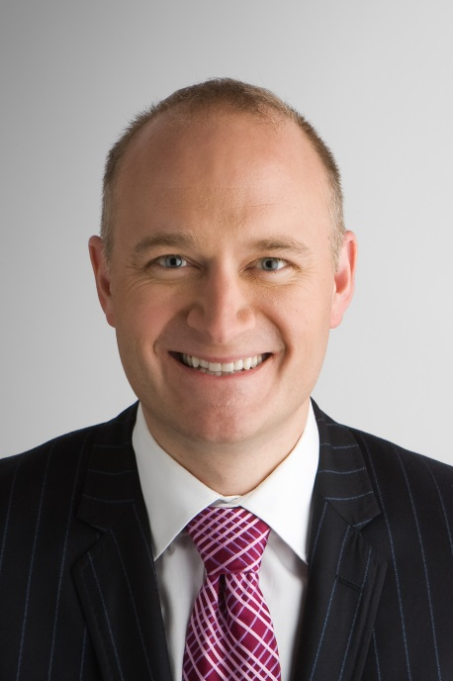
Biography
John Beardwood Partner 416.868.3490 jbeardwood@fasken.com
John Beardwood is Co-Chair of the Technology and Intellectual Property Practice Group, with his practice emphasizing on outsourcing and procurement, technology and privacy law related matters. John is regularly listed among the world's preeminent internet and e-commerce lawyers in Who's Who Legal, Chambers, The Best Lawyers in Canada, the Legal 500, and Lexpert. Who's Who Legal - The International Who's Who of Business Lawyers has identified John as being both one of the two most highly nominated Canadian lawyers in the guide, and one of the ten "most highly regarded individuals" globally.

