Slide 1
2018 CAN-TECH LAW 22nd Annual Conference
Intellectual Property Update for Technology Practice:
Trademarks & Domain Names

Slide 2
Update on Upcoming Changes to Trademark Law (Bill C-31)
What is Bill C-31?
When will it take effect?
Key change?
Elimination of use requirement for registration
Practical Recommendations?
Audit, Compare and File
Consider conducting more clearance searches
Other important changes?

Slide 3
Streamlining Trademark Litigation?
Conventional Litigation (i.e. Action)
Process: pleadings, discovery and trial
Streamlined Litigation (i.e. Application)
Process: application, affidavits, hearing
Advantages
Faster and less expensive
Disadvantages
No discovery

Slide 4
Streamlined TM Litigation cont…
Difficulty proving damages without discovery
Trans-High v. Hightimes, 2013 FC 1190
Application + Reference = Even better way?
Group III v Travelway, 2017 FCA 215
FCA finds a likelihood of confusion and refers question of damages back to Federal Court
“Federal Court may wish to consider whether a reference is appropriate to facilitate this determination”
Proceeding by way of application, “should not be a bar to proceeding by way of reference.

Slide 5
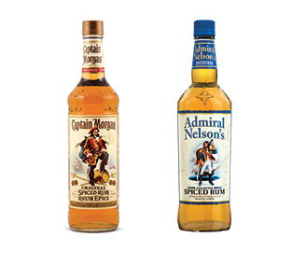
Importance of Trade Dress Protection
What is Trade Dress?
Registrability?
Diageo Canada v Heaven Hill Distilleries, 2017 FC 571

Slide 6

Availability of Global Injunctions
Google v. Equuestek, 2017 SCC 34
Background
Importance

Slide 7
Deceptive Search Results
Vancouver Community College v Vancouver Career College, 2017 BCCA 41
Background
Deceptive domain name
Deceptive internet advertising
Time for assessing confusion
Initial impression

Slide 8
TM Rights Needed for Domain Name Complaint
PicMonkey v Whois Privacy Services, DCA-1808-CIRA
Dispute over domain name <picmonkey.ca>
CIRA Domain Name Dispute Resolution Policy
Proposed use TM application not sufficient
Earlier use of TM may be sufficient

