Slide 1
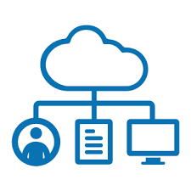
What is the “Cloud”?
“Cloud computing is a model for enabling ubiquitous, convenient, on-demand network access to a shared pool of configurable computing resources (e.g., networks, servers, storage, applications and services) that can be rapidly provisioned and released with minimal management effort or service provider interaction” – NIST Definition

Slide 2
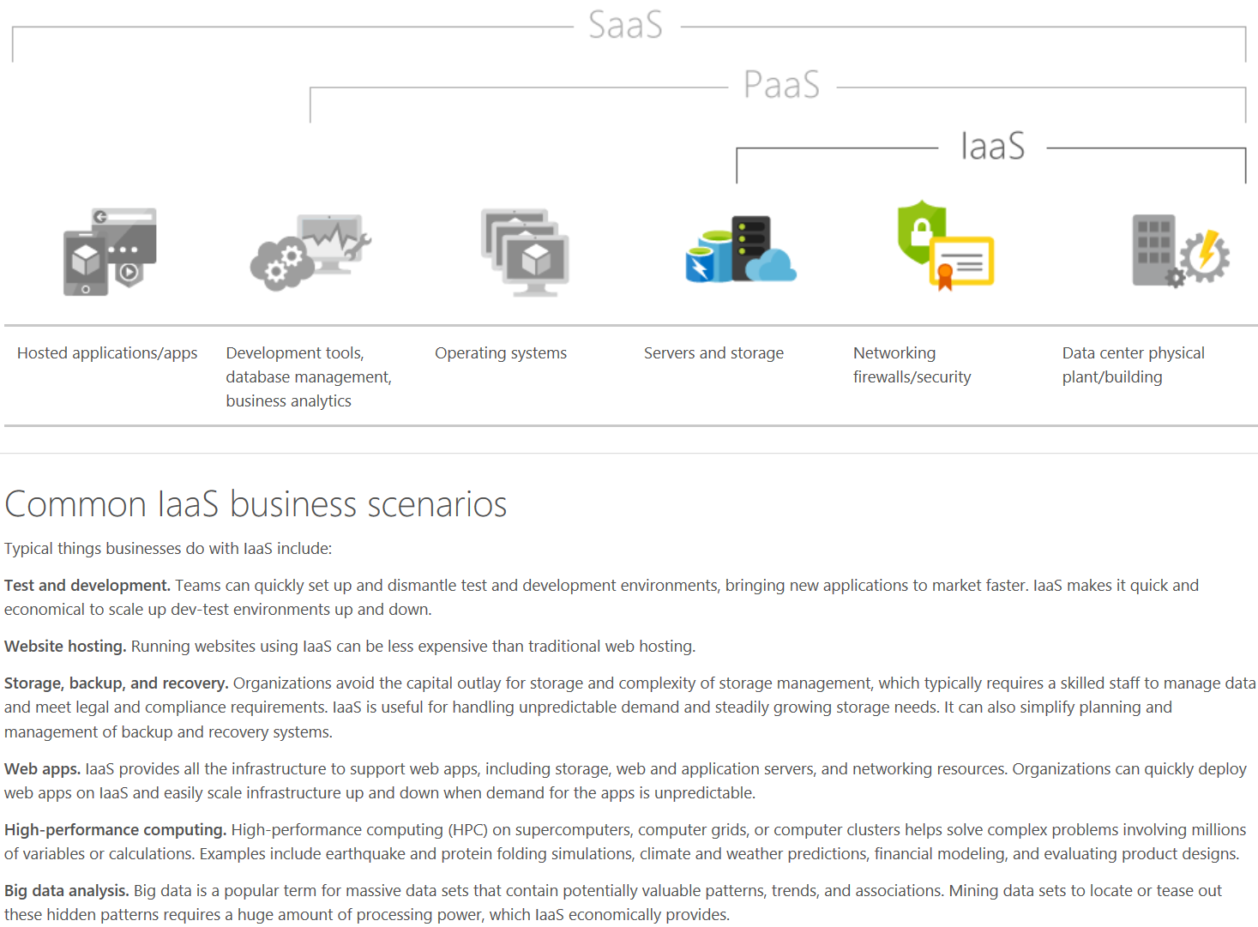
What is the Cloud - IaaS

Slide 3
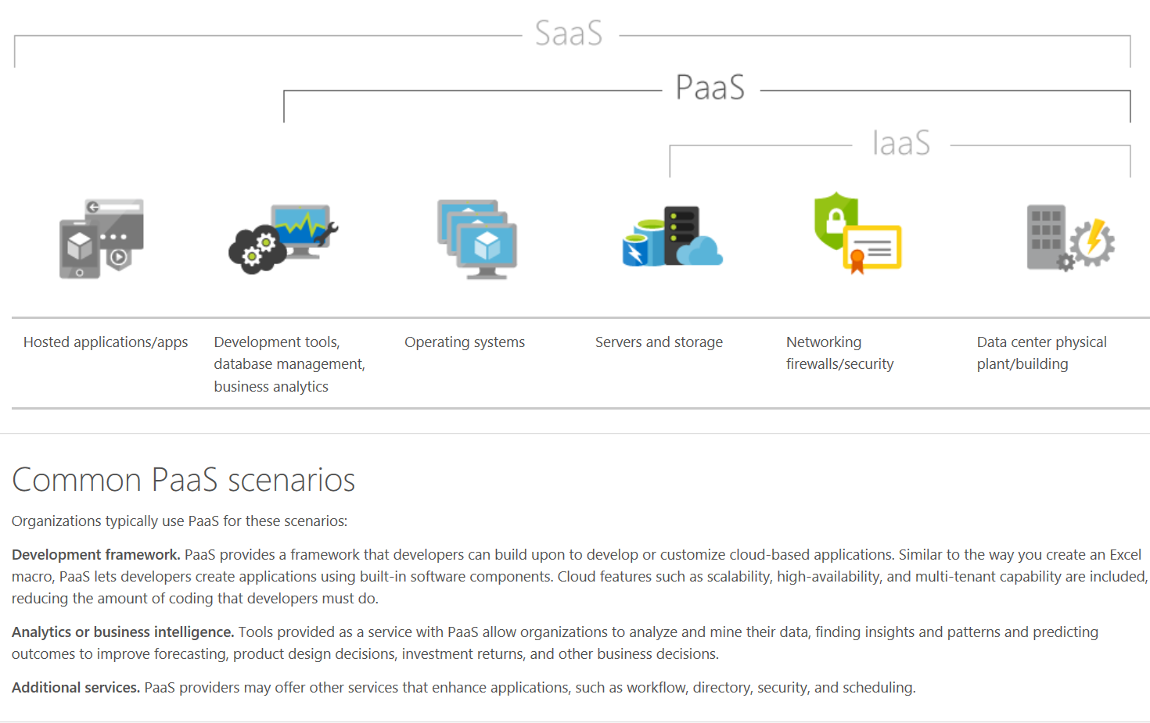
What is the Cloud - PaaS

Slide 4
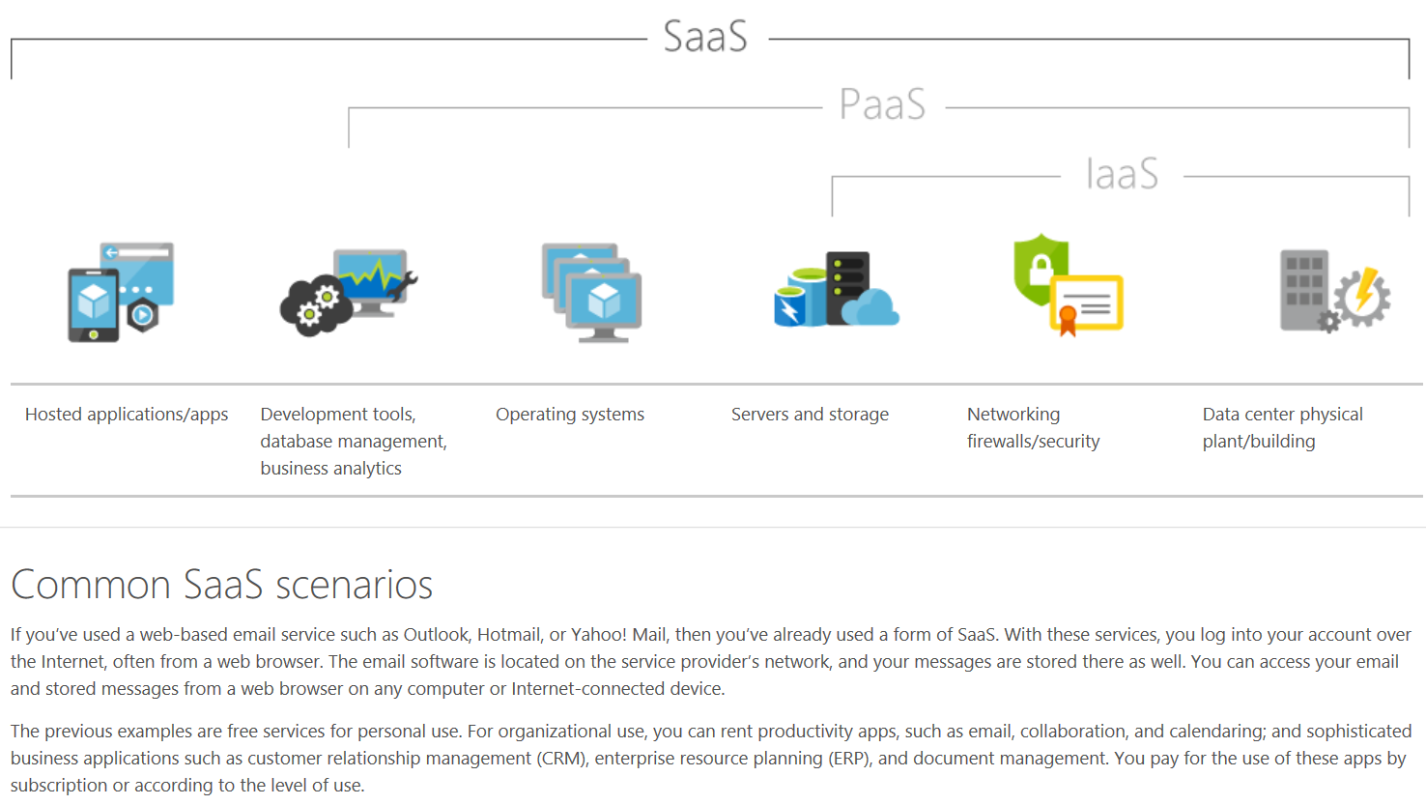
What is the Cloud - SaaS

Slide 5
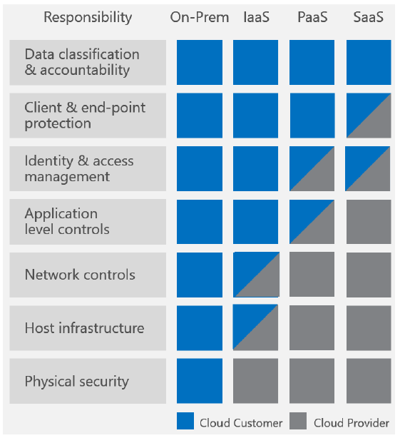
Shared Responsibility

Slide 6
Public Cloud Service Providers
Priceadards
Audit
Security Policy
Breach Notification
Scalablendards
Currentndards
Pay for what you use
Decrease in-house infrastructure
Easy to scale up or down
Makes “pilots” possible
Always being updated
6
Loss of control and oversight
Customer becomes dependent on third parties (difficult to “bring back” in house)
May raise new regulatory issues (“material outsourcing”)

Slide 7
Emerging Company Service Providers (1/2)
Several factors influence the approach taken on legal issues when entering into cloud service agreements:
Bargaining Power
Public vs. Private Cloud
Multi-tenant vs. Dedicated Environments
White label vs. Service provider branded
B2B vs. B2C
Geographic Scope of Service
MSP / Reseller Use?

Slide 8
Emerging Company Service Providers (2/2)
Given bargaining power imbalance, the focus during contract preparation and negotiation must be on key issues, which include:
Data - Rights to use and retain
Customer data vs. generated data
Flowing through terms
Limiting liability vis-à-vis end users
Describing the Service
What’s in vs. what’s out
SLA and Support Levels
Accommodating changes as service evolves
De-identified data
Terms from third party software vendors and service providers
Set expectations
Important cost consideration

Slide 9
Financial Institutions and the Cloud
FI’s must adhere to OSFI Guideline B-10 in Canada and the OCC’s Bulletin 2013-29 in the United States.
OSFI set out its expectations with respect to cloud arrangements and B-10 in its Feb 29, 2012 letter:
“Information technology plays a very important role in the financial services business and OSFI recognizes the opportunities and benefits that new technology-based services such as Cloud Computing can bring; however, FRFIs should also recognize the unique features of such services and duly consider the associated risks.
As such, and in light of the proliferation of new technology-based outsourcing services, OSFI is reminding all FRFIs that the expectations contained in Guideline B-10 remain current and continue to apply in respect of such services. In particular, FRFIs should consider their ability to meet the expectations contained in Guideline B-10 in respect of a material arrangement, with an emphasis on i) confidentiality, security and separation of property, ii) contingency planning, iii) location of records, iv) access and audit rights, v) subcontracting, and vi) monitoring the material outsourcing arrangements.”

Slide 10
Cloud: Key Areas of Negotiation for FI’s
Customer Requirement | Issues for Cloud Deals
Change Control | Customer wants to control changes (eg. mandatory regulatory requirements) whereas Supplier offers a standardized service offering.
Location of Services/Location of Data | Customer wants approval rights over locations and locations to be listed in the agreement. Supplier wants freedom to use global resources and location of data to be fluid (or unknown).
Audit Rights | Customer wants on site access, access for regulators. Supplier and supplier subcontractors are not always willing to provide access.
Subcontracting | Customer's right to approve material subcontractors, flow through of audit and information security terms. Supplier wants flexibility in their subcontracting arrangements.
Privacy and Security | Customer specific standards and policies vs. Supplier’s own standards and policies. Security incident and breach notification requirements.
Limitation of Liability | In today’s environment privacy and security breach limitations are more significant.

Slide 11
FI Perspective: Termination Issues
Flexible termination rights for Customer
Limited termination rights for Supplier
Obligation to return data on termination without significant fees
Obligation for Supplier to provide termination and transition assistance under all termination scenarios.

Slide 12
Fact Scenario #1
A customer is thinking about moving certain workloads to the cloud which contain its most sensitive data. The customer has identified a business case to proceeding with the migration to a public cloud service provider, but wants to make sure the proper security requirements are in place, and has sent its standard “Security Schedule” to the cloud provider to attach as an addendum to their standard agreement. The schedule contains many important issues that the customer would like assurances on, particularly:
Specifics around security controls and processes
Service level commitments
Limitation on use of subcontractors without the customer’s consent
Prescriptive commitments, obligations, and rights in the event of a security/data breach
What can the customer expect as a response, and what should the customer be looking for from the public cloud service provider?

Slide 13
Fact Scenario #2
A customer is thinking about trying an innovative customer relationship management service that is provided by an up and coming emerging company. The customer received the service provider’s standard form of SaaS Agreement and in reviewing, customer’s legal counsel has highlighted the following terms:
The customer is responsible for use of the CRM Service by all users it gives access to, including unauthorized use
The customer’s use is subject to separate third party terms, which are not referenced in the agreement
What should the customer request from the service provider, and what should the service provider be considering in its response?
Notes:
Draft notes – Other input and discussion is welcome
On the first issue:
Consideration must be given to:
Who the customer can grant access to.
Internal employees
Consultants
Can the sales leads being tracked log in and interact with the service?
What can go wrong
E.g., A user uploads sales lead information that he/she had no consent to collect?
If there is a forum or messaging tool, what if it is used for unlawful or unethical purposes?
Does the Customer have an ability to notify its users on what is considered unauthorized use, or agree to any terms of use?
Arguably, as between the service provider and customer, customer has more control over who is given access to the service and what those users do (e.g., through their employment agreements)
If appropriate, the Service provider could water down the obligation (e.g., only responsible for certain unauthorized use)
The Service Provider may also mitigate some risk by including a Terms of Use that all users must agree to when logging in for the first time
On the second issue:
Third party software and services are often embedded or integrated with into a SaaS service
E.g., a payment processing provider
Some of which require accounts to be created separately (or in an integrated behind the scenes manner)
Terms applicable to the use of such software and services will necessarily apply
The question is, which such terms need to be flown down to the users?
Customer will arguably want to know
Service provider should try to accommodate this in some way, whether by:
Specifying third party services used on its site, with links to appropriate terms,
Referencing terms in the agreement itself, or
Including them in the order process online or when third party software and services are enabled

Slide 14
Fact Scenario #3
A federally regulated institution is negotiating a Software-As-Service agreement with a large vendor. The SaaS solution is a critical platform for the FI and is a material outsourcing arrangement. The Vendor will have access to personal information of the FI’s customers. The FI provides its standard outsourcing agreement to the Vendor. The Vendor returns the agreement with the following markups:
The Supplier would like equal termination rights to the FI (termination for convenience, termination for bankruptcy etc.).
The Supplier does not want to allow the FI to have consent over modifications to the Service and is not willing to be obligated to make mandatory changes for the FI.
The Supplier would like to limit its liability for privacy and security breaches to 12 months of fees paid under the Agreement.
The Supplier does not agree to audit rights in relation to its subcontractors and does not agree to flow down contractual obligations to its subcontractors.
What are negotiation strategies available to the FI?

