Slide 1
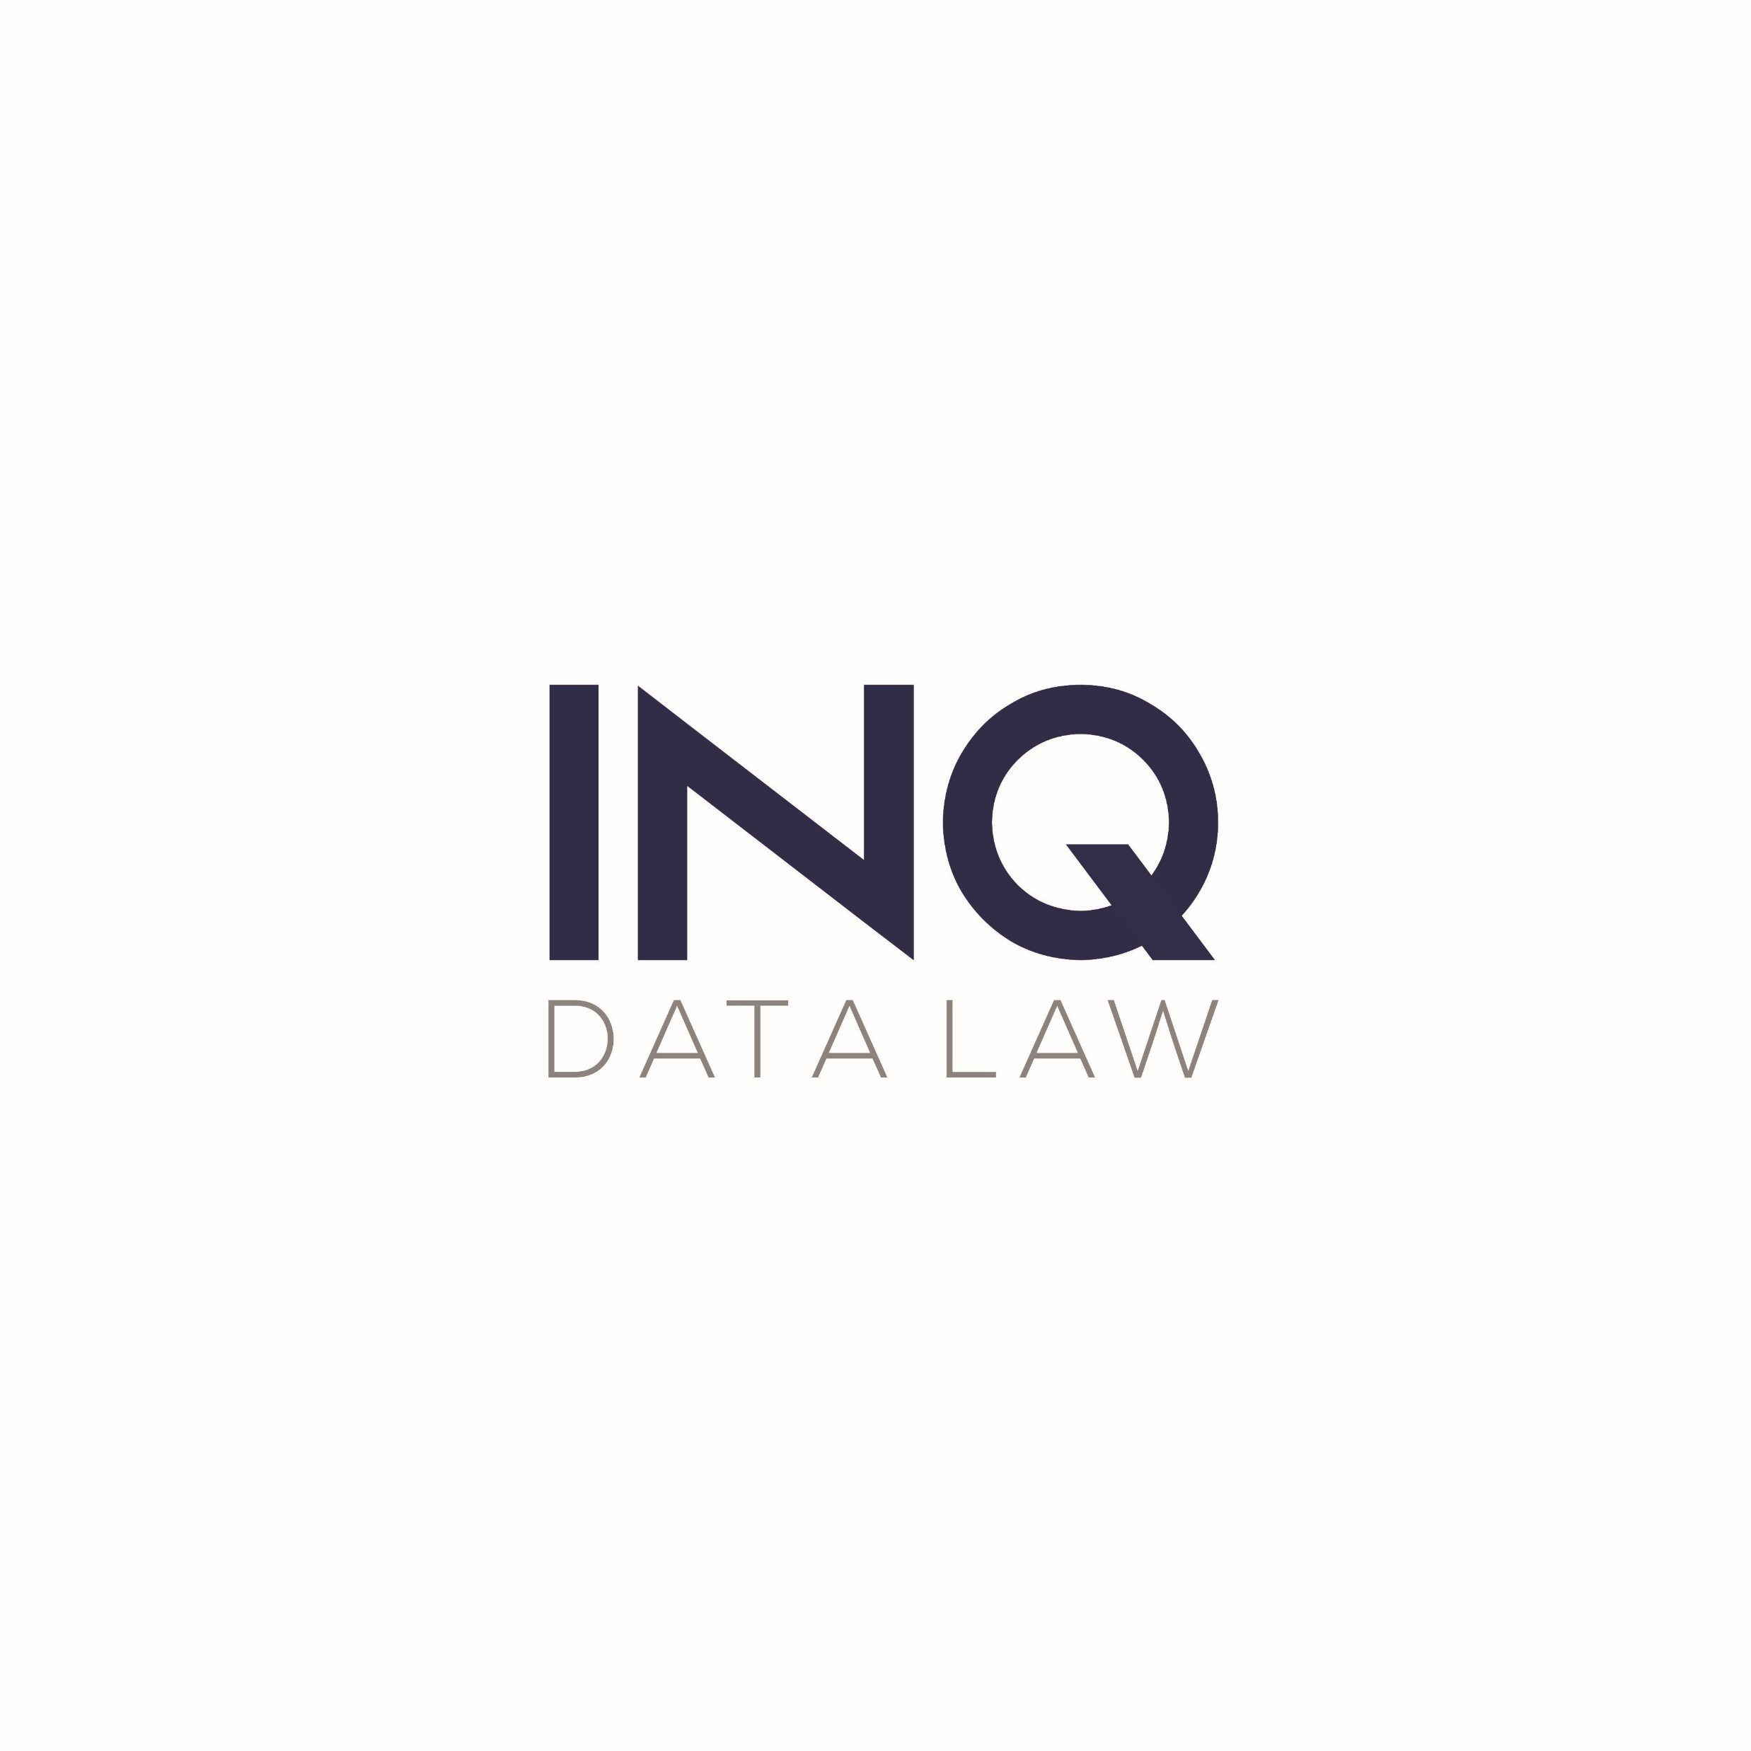
Are You AI Ready?
EMERGING ISSUES IN THE LAW AND ETHICS OF AI
An AI Legal Risk Matrix
For Responsible Innovation
Carole Piovesan
Partner & Co-Founder

Slide 3
Microsoft’s 10-K SEC filing (20180630)
“We are building AI into many of our offerings and we expect this element of our business to grow. We envision a future in which AI operating in our devices, applications, and the cloud helps our customers be more productive in their work and personal lives. As with many disruptive innovations, AI presents risks and challenges that could affect its adoption, and therefore our business. AI algorithms may be flawed. Datasets may be insufficient or contain biased information. Inappropriate or controversial data practices by Microsoft or others could impair the acceptance of AI solutions. These deficiencies could undermine the decisions, predictions, or analysis AI applications produce, subjecting us to competitive harm, legal liability, and brand or reputational harm. Some AI scenarios present ethical issues. If we enable or offer AI solutions that are controversial because of their impact on human rights, privacy, employment, or other social issues, we may experience brand or reputational harm.”

Slide 4
Drivers of AI Regulation
TRUST: slow and low adoption Only 16% of all businesses reporting using AI technologies – a number that has remained stagnant over the last four years. Companies in highly regulated industries (self-driving cars, healthcare) face unique challenges to stay compliant. 82% of Americans believe that “robots and/or AI should be carefully managed”, comparable results in EU. 65% of respondents don’t trust that companies have their best interests when it comes to AI.
EXPOSURE: reputational, legal challenge Tyndaris case: unconventional actions by AI produce unintended outputs. Amazon HR case: bias in datasets may cause legal and reputational risk. Uber and Tesla cases: AI “failure” has devastating consequences.
CONTROLS: new regulations and policies EU Commissioner will pass AI regulation in the first 100 days of her presidency. Algorithmic Accountability Act and Bot Disclosure and Accountability Act (U.S. Senate Bills). Canadian Directive on Automated Decision Making. Regulation in certain sectors already exists (e.g. autonomous vehicles) as does regulation for certain uses (e.g. facial recognition). Bias and explainability are key issues for policy makers and lawyers. Numerous governmental and industry principles and standards existing and emerging.

Slide 5
Framework for Ethical AI
Fairness
Accountability
Transparency
Data security & Privacy
Reliability & Safety

Slide 6
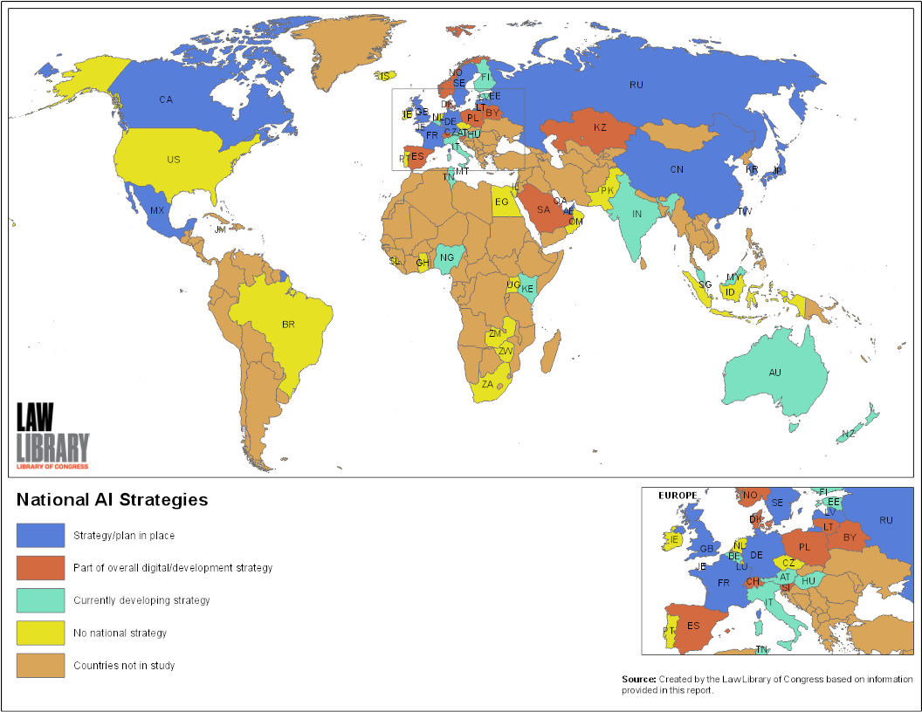
Majority of countries studied have a partial or full AI strategy

Slide 7

Canada’s Leadership on Ethical AI
Canada was the first country to launch such a national AI strategy in 2017.
Canada’s G7 presidency:
    “…a shared vision of human-centric artificial intelligence for innovation and economic growth, and released a statement that confirms the need to safeguard privacy.”
On June 7, 2018, the governments of Canada and France released a joint statement on AI calling for:
    “the creation of an international study group that can become a global point of reference for understanding and sharing research results on artificial intelligence issues and best practices.”
On December 6, 2018, Canada hosted the first G7 Multi-stakeholder Conference on Artificial Intelligence and announced an International Panel on Artificial Intelligence.
In May 2019, Canada released a Digital Charter that re-asserts Canada’s national values in a digital economy.

Slide 8
References
Tim Fountaine, Brian McCarthy, Tamim Saleh, Building the AI-powered Organization, Harvard Business Review (July - August 2019) at p. 62.
Thomas Beardsworth and Nismant Kuman, Who to Sue When a Robot Loses Your Fortune, Bloomberg News (May 5, 2019).
Pew Research Centre, Americans and Cybersecurity, (January 26, 2017).
Andrew Ng, Landing AI, AI Transformation Playbook How to lead your company into the AI era.
Baobao Zhang and Allan Dafoe, Center for the Governance of AI, Future of Humanity Institute, University of Oxford, Artificial Intelligence: American Attitudes and Trends (January 2019).
Pega, Consumers Failing to Embrace AI Benefits, Says Research, (June 4, 2019).

Slide 9
 | INQ DATA LAW 405-1200 Bay Street Toronto, ON T: 416-967-7100 ext. 1-229 E: cpiovesan@inqdatalaw.com

