Slide 1
Drafting in the AI World Data
Sam Ip, Technology Group
sip@osler.com

Slide 2



The Jargon
Drafting in THE AI World: DATA
Artificial Intelligence
Any technique that enables computers to mimic human behaviour.
Artificial Intelligence
Machine Learning
Subset of AI techniques that use statistical methods to enable machines to improve with experiences
Machine Learning
Subject of Discussion
$$\sum_{i=0}^{n}{x}$$
Deep Learning
Subset of ML that makes the computation of multi-layer neural networks feasible.
Deep Learning

Slide 3
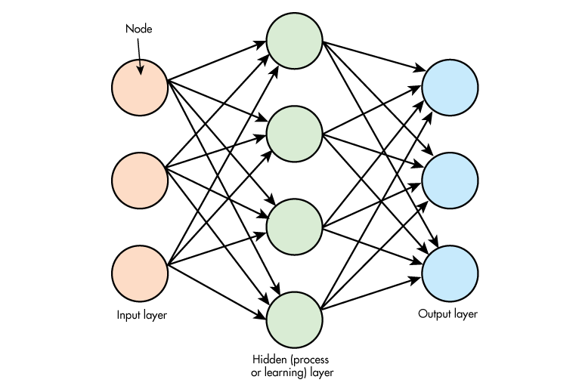

Machine Learning Components: Common Data Inputs and Outputs
Drafting in THE AI World: DATA
INITIAL INPUT
DATA TRANSFORMATION
MACHINE LEARNING PROGRAM
FINAL OUTPUT
Price projection
or
Image tagging
or
Customer analysis
or
…other Prediction Output Data
Customer Input Data
Provider Pre-Existing Data or Third Party Data
Provided Generated
Data
3

Slide 4
Starting Point: Unpacking Common and Broad Definitions of Customer Data to Engage in Meaningful Data Discussions Re: AI
Drafting in THE AI World: Data
“Customer Data” means any and all information, data, materials, works, expressions or other content that are (a) uploaded, submitted, posted, transferred, transmitted or otherwise provided or made available by or on behalf of Customer for Processing by Service Provider, including through the Hosted Services, or (b) collected, downloaded, or otherwise received by Provider for Customer at the written request of Customer. All output, copies, reproductions, improvements, modifications, adaptations, translations, and other derivative works of, based on, derived from, or otherwise using any Customer Data will be deemed Customer Data.
Note: Definition provided for illustrative purposes only.

Slide 5
Definitional Framework for Considering AI Data Issues
Drafting in the AI World: Data
Data Category | Sample Definitions
“Customer Input Data” | Data that is uploaded, submitted, posted, transferred, transmitted or otherwise provided by Customer to Provider under this Agreement.
“Prediction Output Data” | The final output Data from the processing of Customer Input Data by Provider.
“Provider Generated Data” (often aggregated and non-identifiable) | Data: (1) generated by Provider in connection with this Agreement, including Data that is generated through the Processing of Customer Input Data; and (2) does not contain any Customer Input Data, personal information, or any Data that otherwise identifies Customer or its customers.
“Provider Pre-Existing Data” | Data created, generated, collected or obtained by Provider prior to or outside of this Agreement.
Note: Definitions provided for illustrative purposes only.

Slide 6
AI Drafting Considerations Related to Data
Drafting in the AI World: Data
Methodical Evaluation of Considerations by Data Categories
Other Data-Related Considerations (data management and protection; reps, warranties and indemnities; termination and transition; emerging approaches to PI)
Data Category | Sample Considerations
“Customer Input Data” | What data is being provided by Customer (e.g., is it non-identifiable data, PI, sensitive information)? What use-rights should be granted to Provider (e.g., will the AI solutions evolve and improve with use)? What assurances and quality measures do Providers need from Customers re: this data?
“Prediction Output Data” | What is the prediction data? What rights does each party expect to have? What performance requirements or service levels are necessary?
“Provider Generated Data” | What data is being generated and how are they being generated (e.g., “de-identified and aggregated)? What rights does each party have to this data and what assurances are provided if this data contains sensitive or personal information?
“Provider Pre-Existing Data” | What data is contributed by Provider and what are the sources? What assurances do Customers need from Providers re: this data?
Notes:
- “ownership construct” to data not always helpful; more productive to talk about use rights.

Slide 7
For More Information Sam Ip (sip@osler.com), Technology Group

