Slide 1
Drafting in the AI World Ownership/IP Issues
Michael Scherman
McCarthy Tétrault

Slide 2
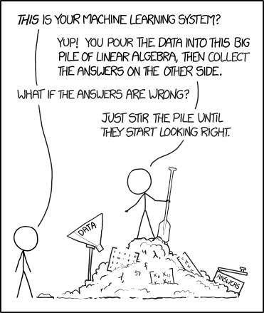
In other words….
Source: XKCD.com

Slide 3
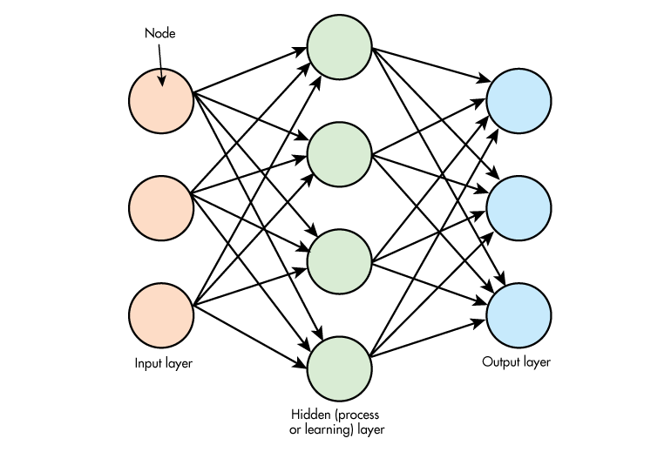
Machine Learning Components
INPUT
MACHINE LEARNING PROGRAM
OUTPUT
Data₁
Data₂
Price projection
or
Image tagging
or
Customer analysis
or
….whatever
Data₃
Data₄
Data₅
Data₆

Slide 4
Input & Output IP Issues
Input
Assess what IP rights/restrictions can exist in the dataset (e.g. copyright, database rights, trade secret, contractual prohibitions)
Method of access/possession to input datasets will depend on above and the sensitivity of data
Output
Uncertainty over authorship/inventorship
Again, assess what IP rights might exist in the output and draft accordingly
When drafting, consider categories of data and rights of use (permitted purposes vs prohibitions on use):
Raw input data
Aggregated/anonymized/deidentified input data
Raw output data (insights, predictions)
Aggregated/anonymized/deidentified output data

Slide 5

IP in the Machine Learning Program
Input
Prediction
Parameters (weights, vectors, coefficients, biases, attributes)
Learner

Slide 6
IP in the Machine Learning Program
Two primary areas where valuable IP will reside in a machine learning program:
The un-trained model
The mathematical model in the machine learning program will often require massive amounts of data to “train”
Ownership and use rights in respect of the untrained model are generally agreed along traditional lines
The “learned elements”
These include the parameters such as the weights, vectors, coefficients, biases, attributes, and other elements that result from applying the datasets to the model (which are often provided by the customer or a third party)
Ownership and use rights in respect of the learned elements is often a source of contention!

Slide 7
Unique Considerations with the “Learned Elements”
New and valuable IP → When created using a unique/large/proprietary dataset, the learned elements may significantly increase the accuracy/value of the model
Competition concerns → The value in the datasets can be transferred/unlocked in the learned elements and (unknowingly?) made available to competitors
Division may not be: (a) possible; (b) commercially feasible → From a technical or commercial perspective, the learned elements may become a “fixture” to the underlying model rather than a “chattel”

