Slide 1


Competition Law and Big Data
Anthony Durocher
Deputy Commissioner, Monopolistic Practices Directorate
2018 CAN-TECH LAW
October 30, 2018
Strengthening competition to drive innovation

Slide 2
Disclaimer
The views and opinions expressed in this presentation are entirely those of the speaker and do not represent any policies or positions of the Commissioner of Competition, the Competition Bureau or the Department of Justice of Canada. Any mistakes and all omissions are entirely those of the presenter.

Slide 3
Outline
Overview of Competition Law in Canada
Competition Act
Competition Bureau
Big Data and Competition
Climate
Key Considerations
Cases
Privacy

Slide 4
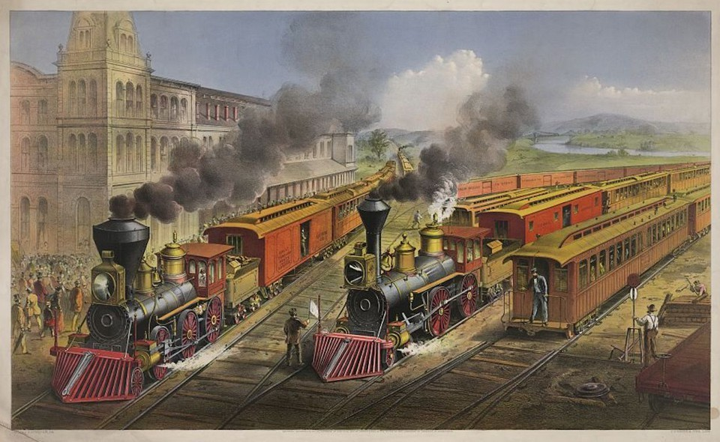
Competition Law in Canada
1889: Canada becomes first country to adopt a national competition law
Combines Investigation Act (1911)
1986: Competition Act
2008: Competition Policy Review Panel

Slide 5
Role of Competition Law
Why are competition laws important?
Competition underpins a robust economy
Competitive market forces lead to economic efficiency, productivity and growth
“A considerable economic literature documents the central role of innovation in driving productivity growth and the importance of competition in driving innovation. Greater competition is the key to increasing productivity and prosperity.”
- Competition Policy Review Panel, Compete to Win (2008)

Slide 6
Key Provisions
Mergers
Notification
Substantial lessening or prevention of competition
Abuse of Dominance
Anti-competitive conduct by dominant firms
Cartels
Criminal offense
Deceptive Marketing
Representations that are false and misleading

Slide 7
Competition Bureau
Independent law enforcement agency
Headed by the Commissioner of Competition
Administration and enforcement of the Competition Act
We are enforcers, not adjudicators
Evidence-based enforcement
Role of the Competition Tribunal and Courts

Slide 8
The Investigative Process
Starting Point
Complaints
Notification (mergers)
Immunity and leniency program (cartels)
Media monitoring
Determining the Facts
Voluntary requests for information
Formal powers
Outcomes
Consensual resolution
Competition Tribunal
Other

Slide 9
Big Data – What is it?
“Data” is easy to define
Factual info used as a basis for calculation or reasoning
“Big Data” is harder to define; it lacks a single consensus definition
Volume
Variety
Velocity

Slide 10
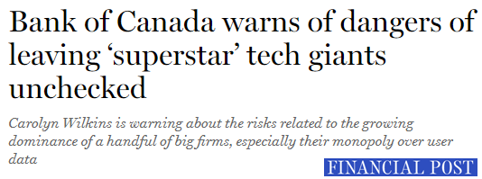

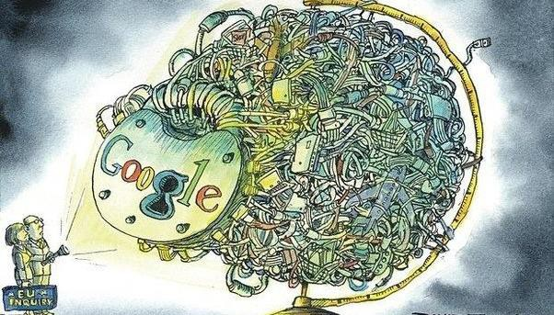
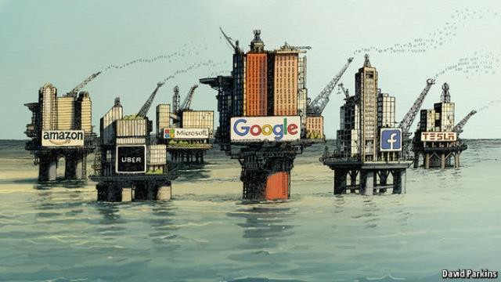

Climate - “Big is bad” Debate
Growing concern about power of large tech firms
Big Data collection and (mis)use is large part of this concern
Google dominates search. But the real problem is its monopoly on data”
- The Guardian, Apr 2015
The Economist, Sept 2016
“Can the tech giants be
stopped?”
- The Wall Street Journal, July 2017
“The world’s most valuable resource is no longer oil, but data…The data economy demands a new approach to antitrust rules”
- The Economist, May 2017
10

Slide 11
Some Prominent Concerns
Use of Big Data can make large tech firms unassailable
AI and algorithms can facilitate collusion
Emerging trend – populism and hipster antitrust
Competition law’s “narrow economic focus” is increasingly seen as problematic by those who perceive “gaps”

Slide 12
The Bureau’s Big Data Paper
Discussion paper published in September 2017
How should Big Data should affect competition law enforcement in Canada?
Consultation
Key themes released in February 2018

Slide 13
Takeaways from the Big Data Paper
Déjà vu
Humility
Guiding analytical principles remain valid
Enforcement framework remains intact
Chicken little

Slide 14
Takeaways from the Big Data Paper
The Bureau’s Big Data Paper also acknowledges that:
Competition analysis of big data will not necessarily be straightforward
Big data matters may require specialized tools and methods which may be less familiar to competition law enforcement
As new guidance is provided by the Tribunal and the courts, the Bureau's approach may need to adjust accordingly

Slide 15
Analytical Considerations for Enforcement
Platform Markets
Intermediation
Zero-monetary price
Network effects
Barrier to entry
Efficiency considerations
Non-price effects
Rivalry on innovation, quality, service, etc.

Slide 16
Noteworthy Cases
Europe Commission
Google decisions (under appeal)
Shopping (2017)
Android (2018)
Amazon investigation (ongoing)
Canada
Google investigation (2016)
Toronto Real Estate Board (2018)
Other
Germany - Facebook investigation (ongoing)
Australia – digital platforms inquiry (ongoing)

Slide 17
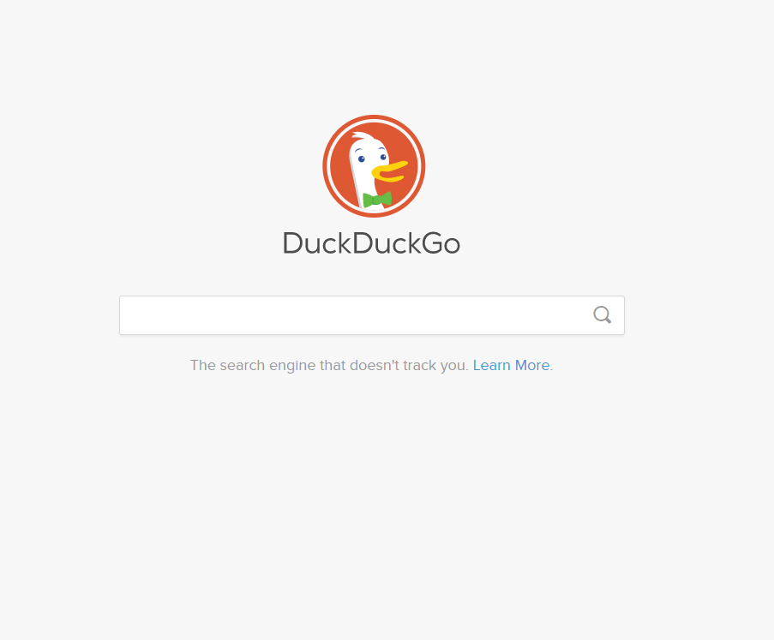
Privacy and Competition
Privacy as a dimension of competition
We don’t store your
personal information. Ever.
Our privacy policy is simple: we don’t collector share any of your personal information.
We don’t follow you around with ads.
We don’t store your search history. We therefore have nothing to sell to advertisers that track you across the internet.
We don’t track you in or out of private browsing mode.
Other search engines track your searches even when you’re in browsing mode. We don’t track you – period.
Competition considerations with privacy regulations: GDPR and beyond

