Slide 1
Cybersecurity Risk Management
Presentation by Vanessa Henri, LL.B., LL.M. for CAN-TECH, October 29 2019

Slide 2


Cybersecurity, Privacy and Data Protection
CYBERSECURITY
PRIVACY
Data protection

Slide 3
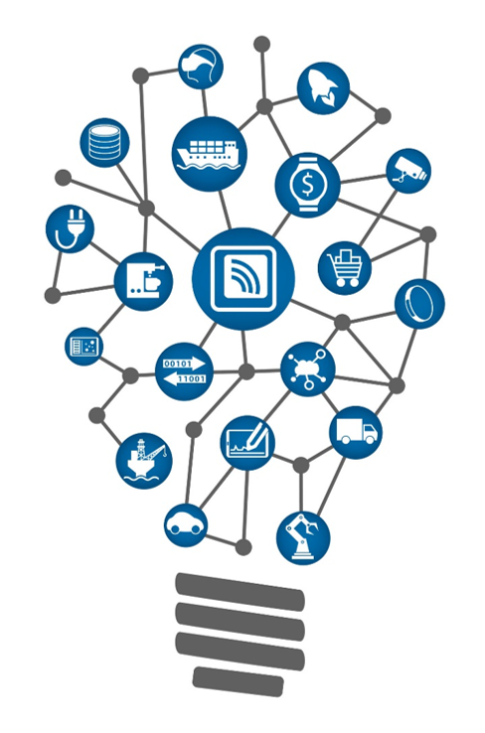

Cybersecurity Risks - Trends
SB-327 Information privacy: connected devices
To be enacted in Jan 2020
Any device that connects ”directly or indirectly” to the Internet must be equipped with “reasonable security features” that:
Prevent unauthorized access, modification, destruction or information disclosure
If the device is accessible outside local area network with password;
Unique password required for each new device entering network
Notes:
In the realm of IoT, any connected device lacking in security features will inevitably present huge risks to the whole IoT network. With the interconnectedness of devices, access to sensitive data is significantly easier, as it only takes one unsecured network to facilitate access to the entire system.
A lot of criticism came with the new California bill, notably that it suggests adding “good” features to enhance security rather than encouraging designing of systems which are more robust. This is seen as a temporary fix only.
The Bill will result in every IoT device sold in California to come with a password unique to that device, or include a way to generate new authentication credentials before accessing it for the first time
This was an interesting read: https://www.lexology.com/library/detail.aspx?g=dba2b1f9-7e42-4b7c-bcae-3bd052a939b3

Slide 4
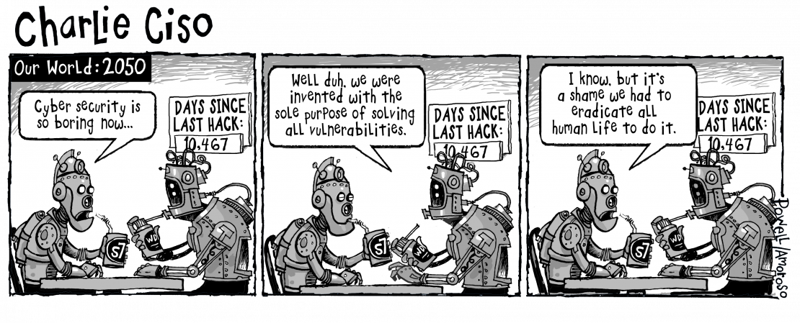
Cybersecurity Risks – Trends
AI and ML
Cryptocurrencies
Robotics
Drones
5G
Ransomware
Social Engineering
Supplier chain poisoning
Notes:
Ransomware story:
A malware, known as "Ryuk," attacked three hospital in Ontario. This malware attacks computer networks but remains invisible to average users for weeks or months. During that time, it collects information about the organization and its perceived ability to pay a ransom. When the hospitals noticed the malware, they had to shut down their systems for a few days – this was quite a hassle that slowed down the system, as patient information had to be taken down by hand. Full story: https://www.cbc.ca/news/technology/ransomware-ryuk-ontario-hospitals-1.5308180

Slide 5

Three pillars of risk management
Contracts
Risk Management
Project Level
Enterprise Level
Cyberinsurance

Slide 6

Contracts
End-User License Agreements (EULA)
Acceptable Use Policy
Terms of Service
Saas Agreement
Master Services Agreement
Master Subscription Agreeement
Licensing Agreement

Slide 7

Contracts
Key points of negotiation
Data breach risks and indemnity
Vendor due diligence requirements
Audit clauses
Appropriate warranties
Privacy Policy

Slide 8
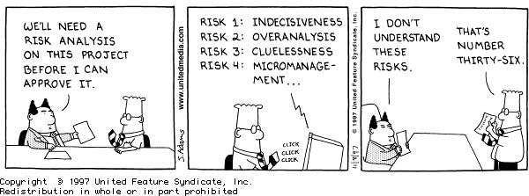
Risk management – Project Level
Privacy Impact Assessments (PIAs)
De-identification tests and other technical testing
Privacy by design in Software Development Life Cycle (SDLC)

Slide 9

Risk Management- Project Level
Privacy laws may pose challenges for emerging technology projects
Can blockchain comply with data privacy laws?
Principles of privacy legislation seem incompatible with immutable and decentralized nature of blockchain
Ex. GDPR: Who would be the controller?
Lawful basis for processing personal data: to whom consent is given?
Right to erasure and rectification?
Thorough privacy risk analyses are essential to new projects
Notes:
For blockchain and distributed ledgers, it may be difficult to determine who fall under the role of the controller, since there isn’t typically just one person or entity that fits the definition and can readily exercise the obligations of a controller - many persons or entity may contribute and/or control the personal data that is added to the chain or ledger. This article goes over many challenges: https://www.blockchaintechnews.com/blogs/the-challenges-of-applying-data-privacy-regime-to-blockchain/

Slide 10
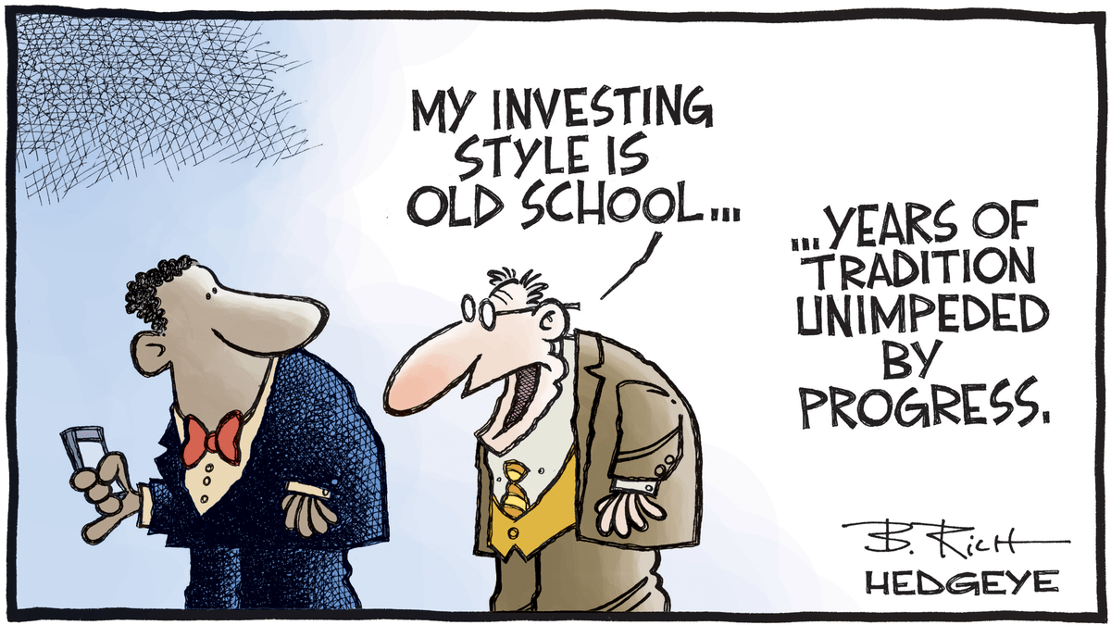
Risk management - Enterprise
Notes:
ISO/IEC 27000-series are published by the International Organization for Standardization (ISO) and the International Electrotechnical Commission (IEC)

Slide 11
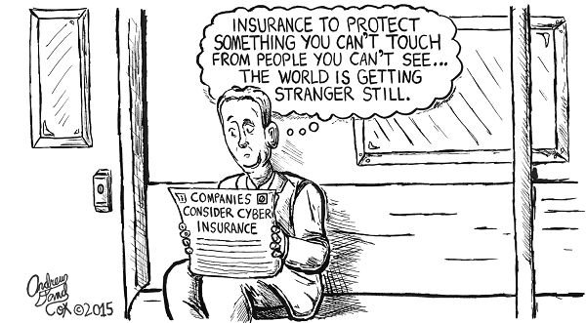
Cyber-insurance

Slide 12

Vanessa Henri
Startup and Emerging Technology Lawyer, LL.B., LL.M., CDPO
+1 514 397 7497
vhenri@fasken.com
Cette photo par Auteur inconnu est soumis à la licence CC BY-SA

