Slide 1

GDPR 18 MONTHS IN: KEY TAKEAWAYS
Elisa Henry, National Co-Leader, Privacy and Data Protection
October 29, 2019

Slide 2
Introduction
Compliance Trends: Non-EU Companies
Territorial Scope
Developing Stories
Brexit
Privacy Shield – Schrems II
Fines From DPAs Escalating Quickly

Slide 3
One Year In*
of Europeans have heard of the GDPR
Data breach notifications sent
Queries and complaints received by DPAs
67%
89,271
144,376
*as of May 25, 2019
Source: European Data Protection Board

Slide 4
Compliance Trends: Non-EU Companies
As of now…
Only 34% of non-EU companies consider that they are fully or very compliant with GDPR; 25% believe GDPR does not apply to them at all
Compared to EU companies, non-EU companies are having a harder time with:
Gathering explicit consents
Fulfilling subject access requests
Breach notification requirements
Mandatory DPO requirement
Many non-EU companies have not identified a lead supervisory authority (Art. 56)
Many non-EU companies have not appointed an EU representative (Art. 27)
Source: IAPP-EY Annual Privacy Governance Report 2019

Slide 5
Compliance Trends: organizations with limited customer base in the EU
Focus on mapping, external facing documentation, third party management and data subject rights requests
Appoint a GDPR “champion”
Perform a Data Mapping to evaluate risk (number of clients located in the EU; marketing outreach to the EU etc.)
Review of external facing materials, including website content and external facing privacy policy
Amend existing agreements with third parties handling personal data
Standard privacy language included in new agreements with third parties handling personal data
Include GDPR compliance requirements in vendors’ qualification process (questionnaire, audit,
certification requirements)
Adapt internal processes to respond to data subject rights requests: structuring databases to locate EU data, automating processes, update of procedures, training customer facing personnel
Training legal, compliance, procurement teams

Slide 6
Territorial Scope
Draft guidelines from the European Data Protection Board (“EDPB”) 3/2018
Adopted on November 16, 2018
Establishment criterion (Art. 3(1))
Establishment in the EU: threshold is low
Processing of personal data “in the context of the activities of” an establishment
Location of processing does not matter
Targeting criterion (Art. 3(2))
Data subjects must be in the EU at the moment the relevant trigger activity takes place
Applies regardless of whether payment by data subject is required
Monitoring (i.e. cookies, internet of things, CCTV, etc.)
Considerations to determine if “directing an activity”

Slide 7
Territorial Scope
Draft guidelines (continued)
Designating an EU representative (Art. 27)
Obligation of controllers and processors unless exemption applies (Art. 27(2))
Must inform data subjects of identity of representative in the EU
Cannot be the DPO
Must be established in one of the Member State where the service offered is available
Maintain record of processing activities (joint obligation with controller or processor)

Slide 8
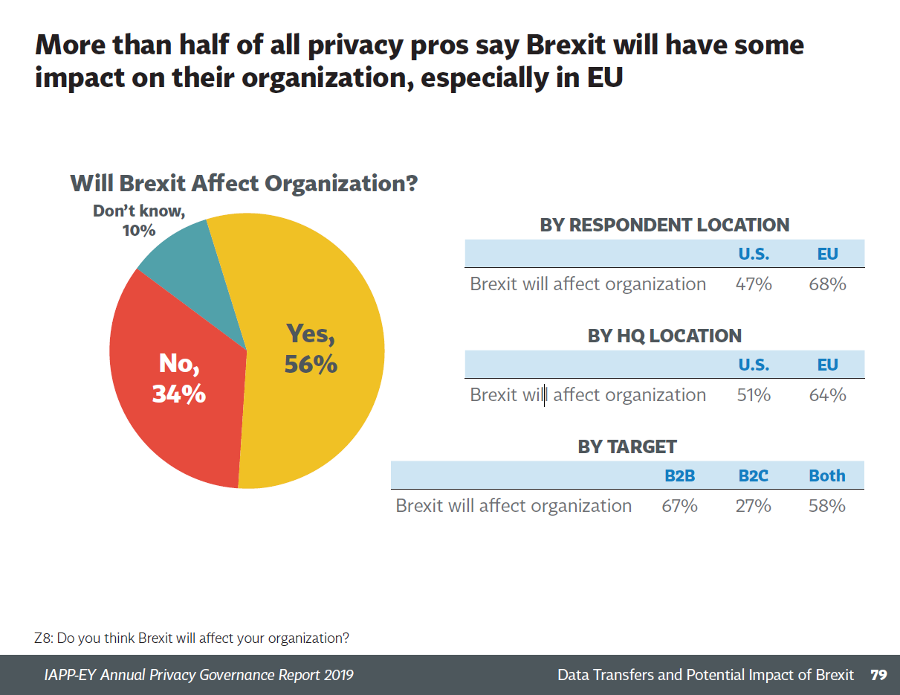
Developing Stories
Brexit

Slide 9
Developing Stories
Brexit
UK intends to incorporate GDPR into domestic law
UK will become a “third country” for GDPR purposes, i.e. transferring data for processing
Broad impact: 52% of organizations surveyed in the US transfer data from the EU to the UK
Many non-EU entities with primary EU establishment in UK
UK is currently top choice: 24% of those surveyed (followed by the Netherlands and Ireland)
55% don’t plan to move after Brexit
Source: IAPP-EY Annual Privacy Governance Report 2019

Slide 10
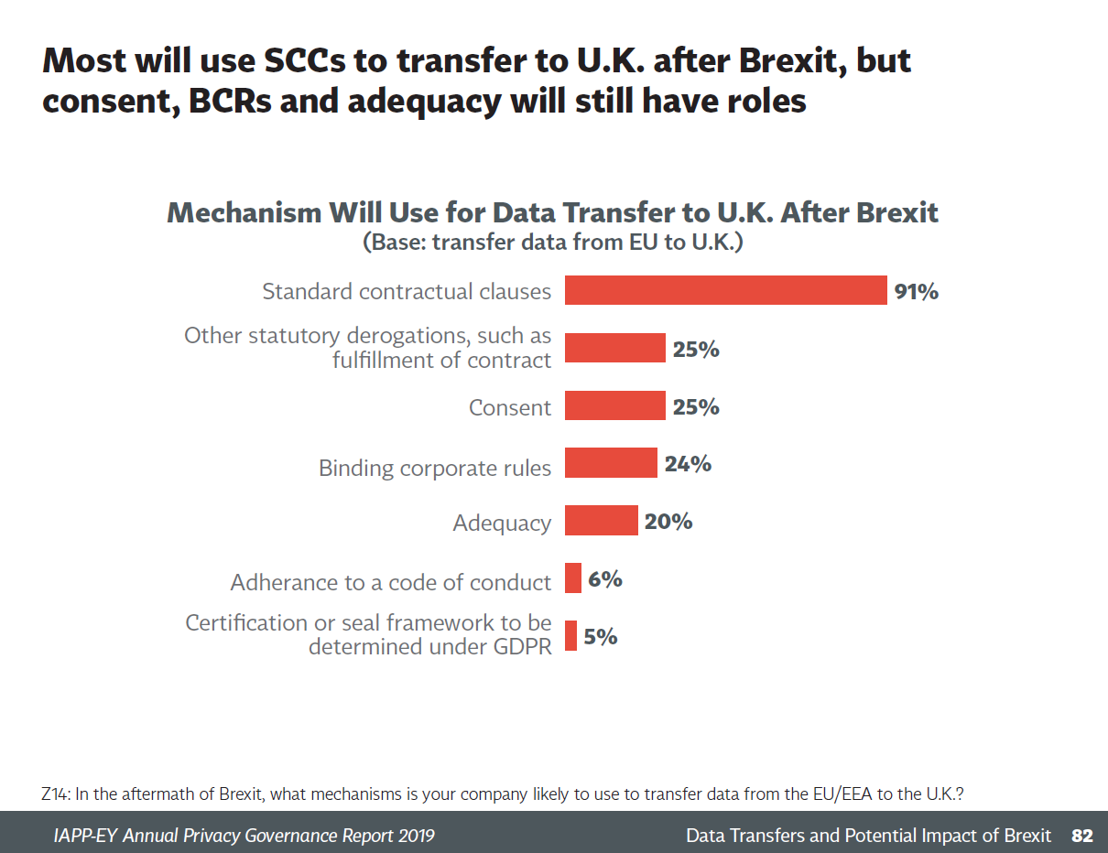
Developing Stories
Brexit
Standard Contractual Clauses (SCC)
Currently using in anticipation
Plan to continue to use SCC after Brexit
But challenged before ECJ
Adequacy decision?
Source: IAPP-EY Annual Privacy Governance Report 2019

Slide 11
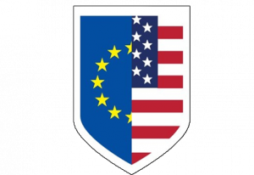

Developing Stories
Privacy Shield - Schrems II

Slide 12
Developing Stories
Privacy Shield - Schrems II
Privacy Shield case: Case T-738/16 Quadrature du Net and others v. Commission
Challenge by French digital rights group La Quadrature du Net before the General Court of the EU
Challenges whether Privacy Shield provides adequate protection for EU citizens’ data
Hearings suspended until after Schrems II
Schrems II: C-311/18 Data Protection Commissioner v. Facebook Ireland & Schrems
Challenges validity of transfers of personal data to the U.S. under SCCs
Heard by the Court of Justice of the European Union (CJEU) on July 9, 2019
Possible repercussions for SCCs and EU-US Privacy Shield
Decision expected end of 2019/early 2020
Both Privacy Shield and SCCs could be invalidated

Slide 13
Developing Stories
Fines from DPAs Escalating Quickly
Data Protection Authorities (DPAs) not afraid of issuing large fines
Google
Fined €50 million by French CNIL for lack of transparency, inadequate information and lack of valid consent for personalized advertising
British Airways
Proposed £183 million fine from UK ICO for security failures following breach
Marriott International
Proposed £99 million fine from UK ICO for security failures following breach
Data brokerage company
~€220,000 fine from Polish DPA for violating the information obligation
PricewaterhouseCoopers
Fined €150,000 by Hellenic DPA (Greece) for unauthorized processing of employee data

Slide 15

Elisa Henry
Partner
National Co-Leader, Privacy and Data Protection
514.954.3113
EHenry@blg.com

