Slide 1

Privacy Plenary Session
CAN-TECH Annual Conference
Eloïse Gratton and Elisa Henry
October 29, 2018

Slide 2
Agenda
Is PIPEDA still adequate?
Right to be forgotten
Breach Notification Obligations
Consent (new OPC guidelines, secondary uses, big data, AI)

Slide 3
GDPR Adequacy?

Slide 4
Introduction
EU personal data can be transferred from the EEA to non-EEA countries which are recognized as providing an adequate level of protection without additional safeguards or authorizations
Concept of equivalence
Essential equivalence
Data protection framework (protection, oversight and redress mechanisms)
Adequacy referral from Article 29 Working Party of Feb. 6 2018
content of the applicable rules
means for ensuring that the rules in place are effective in practice
legal framework re: access of public authorities to personal data (surveillance)

Slide 5
Adequacy of PIPEDA
Adequacy decision of PIPEDA of 2001 will expire in 2020
January 2017 communication from the European Commission:
Canada’s adequacy status is ‘partial’, in that it covers only PIPEDA, and all future adequacy decisions will involve a comprehensive assessment of a country’s privacy regime, including access to personal data by public authorities for law enforcement, national security, and other public interest purposes

Slide 6
Content requirements
PIPEDA appears to meet most content requirements of the Adequacy Framework (definition of PI, purpose limitation, lawfulness and fairness of processing, data accuracy and minimization, storage limitation, data security, transparency etc.) except:
Concepts of data processor, data controller, recipient – but in the Japan adequacy decision, no distinction either which was not considered problematic since all organisations are subject to the same set of rules, which is the case under PIPEDA
Concept of sensitive data v. special categories of data (broader)
Restrictions on onwards transfers to recipients who do not provide an adequate level of protection
Right to erasure, objection, data portability, automated decision-making and profiling

Slide 7
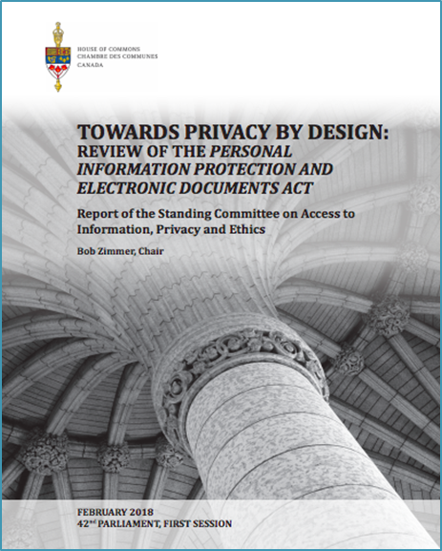
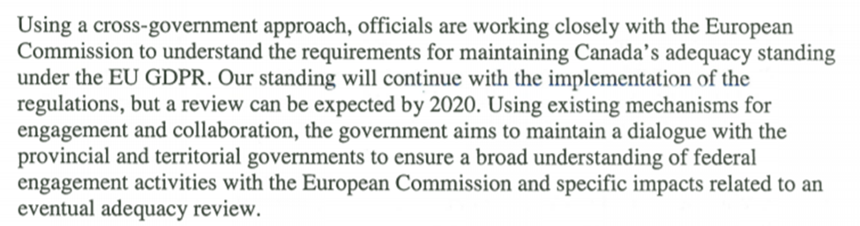
Procedural requirements
PIPEDA meets most procedural requirements of the Adequacy Framework except:
OPC should have all the necessary and available powers and missions to ensure compliance with data protection rights and promote awareness
Existence of effective and dissuasive sanctions can play an important role in ensuring respect to rules
Standing committee on Access to Information, Privacy and Ethics Report of February 2018
Calls for increased powers
Response of the Minister of Innovation, Science and Economic Development of June 2018

Slide 8
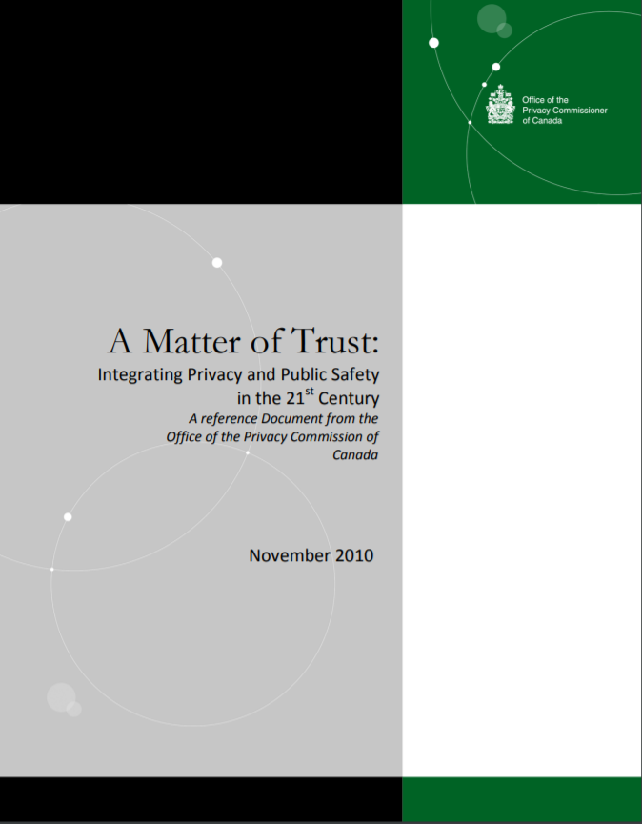
Law enforcements and national security access to personal data
Standing committee on Access to Information, Privacy and Ethics - Report of February 2018:
European Data Protection Supervisor: the EU is not in a hurry to “put Canada on top of our decisions. (…) [T]he restrictions, exceptions, and derogations for law enforcement are more important than design and default.
Charter of Rights and Freedoms - R v. Oakes:
Necessity: there must be a clearly defined necessity for the use of the measure, in relation to a pressing societal concern (in other words, some substantial, imminent problem that the security measure seeks to treat),
Proportionality: that the measure (or specific execution of an invasive power) be carefully targeted and suitably tailored, so as to be viewed as reasonably proportionate to the privacy (or any other rights) of the individual being curtailed,
Effectiveness: that the measure be shown to be empirically effective at treating the issue, and so clearly connected to solving the problem, and finally,
Minimal intrusiveness: that the measure be the least invasive alternative available (in other words, ensure that all other less intrusive avenues of investigation have been exhausted).
Review and oversight: the Security Intelligence Committee (SIRC) reviews in detail the operational activities of the Canadian Security and Intelligence Service (CSIS) and the Communications Security Establishment Commissioner reviews in detail the activities of the Communications Security Establishment (CSE), both with specific references to protecting privacy.
The Criminal Code imposes terms of imprisonment up to five years for unauthorized interception of private communication

Slide 9
Quebec
Quebec regime (PIPPS and art. 35 to 41 of the Civil Code) not recognized as adequate under the Directive as per June 4, 2014, Opinion 7/2014 of the Article 29 Working Party
Need to clarify the territorial scope of the Quebec Act viz PIPEDA (regarding interprovincial and international transfers)
Transparency : identification of the person responsible for the protection of personal information in the organisation must be made available to the individual concerned
Must clarify the notion of sensitive information and provide a higher level of protection for sensitive data
No model contract or other binding mechanisms in order to guarantee a comparable level of protection for onward transfers – for all data protection principles

Slide 10
Right to be forgotten

Slide 11


Right to be forgotten
Google Inc. v. Agencia Espanola de Proteccion de Datos

Slide 12
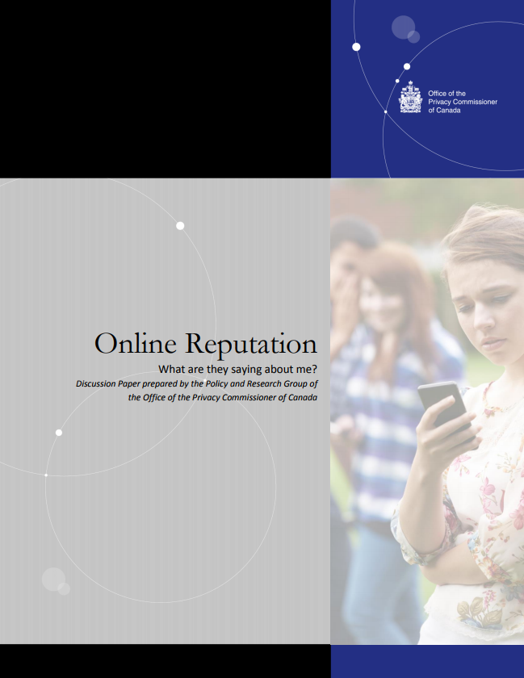
OPC public consultation in 2016

Slide 13
OPC Draft Position on online reputation (jan. 2018)
“Pursuant to paragraph 4(1)(a), PIPEDA applies to “every organization in respect of personal information that … the organization collects, uses or discloses in the course of commercial activities.”
In our view, by indexing webpages containing personal information, and returning links to those pages in search results, search engines are collecting, using and disclosing personal information within the meaning of PIPEDA. When users search for information about an individual by name, search engines can create a detailed profile of all relevant information concerning that individual and return that information to the user. (…)
Although most search engines are free, most also display advertisements alongside search results. The ability of search engines to sell this advertising space would not exist were it not for the search service they provide. The two functions have been described as “inextricably linked”. Thus, there also seems little doubt that search engines collect, use and disclose personal information “in the course of commercial activities”.”

Slide 14
OPC Draft Position on online reputation (jan. 2018)
“If an individual is able to successfully challenge the accuracy, completeness or currency (that is, the extent to which the information is up-to-date) of the results generated by a search for their name (because, for instance, the information at one or more of the returned results is demonstrably inaccurate, incomplete or up-to-date) then, per Principle 4.9.5, the results returned should be amended accordingly. The most obvious means to make such an amendment is to de-index the offending result and remove the link; however, in some situations, other solutions (such as lowering the ranking of a result, or flagging it as inaccurate or incomplete) may also be appropriate.
It will be important, though, to consider whether a successful challenge has been made out in light of Principle 4.6.1, which states that the extent of accuracy, completeness and currency required depends on purpose for which the information is to be used, and on the interests of the individual. For instance, a single inaccurate statement or the omission of a single fact, within an otherwise wholly accurate webpage, may not warrant de-indexing of the page – particularly where the inaccuracy or omission does not materially impact the interests of the individual. This must be considered on a case-by-case basis, and should take into account the public interest in the information remaining accessible.”

Slide 15
Responses…
“(…) the report’s conclusions stand at odds with the majority of responses generated by the Privacy Commissioner’s consultation. The feedback from leading Internet services, media companies, academics, and civil society groups cautioned against creating a right to be forgotten in Canada. Without a foundation for its approach arising from the consultation, participants can be forgiven for wondering whether the report’s recommendations were a foregone conclusion.
(…)The report also suggests that rather than de-indexing a link, search engines might instead be asked to lower the rank of a search result or flag the result as inaccurate or incomplete. This would vest editorial power in search engines they have generally been reluctant to assume. While algorithmic decision making is far from neutral and deserves greater scrutiny, using privacy law to justify intentionally obscuring results by lowering ranks transforms information intermediaries into knowledgeable publishers.”

Slide 16
Responses…
“With all due respect, this view seems inconsistent with current case law. In 2010, the Federal Court in State Farm Mutual Automobile Insurance Co. v. Canada (Privacy Commissioner) ruled that an insurance company that collected personal information on behalf of an individual it was representing in a law suit was not collecting that information in the course of commercial activity. This was notwithstanding the fact that the insurance company was a commercial business (…).
The same reasoning applies to search engines. Yes, Google makes a lot of money, some of which comes from its search engine functions. However, the search engines are there for anyone to use, and the relevant activities, for the purposes of the application of PIPEDA, are those of the users. If a private individual carries out a Google search for his or her own purposes, that activity does not amount to the collection of personal information in the course of commercial activity. If a company does so for its commercial purposes, then that company – and not Google – will have to answer under PIPEDA for the collection, use or disclosure of that personal information. The view that Google is on the hook for all searches is not tenable.”

Slide 17
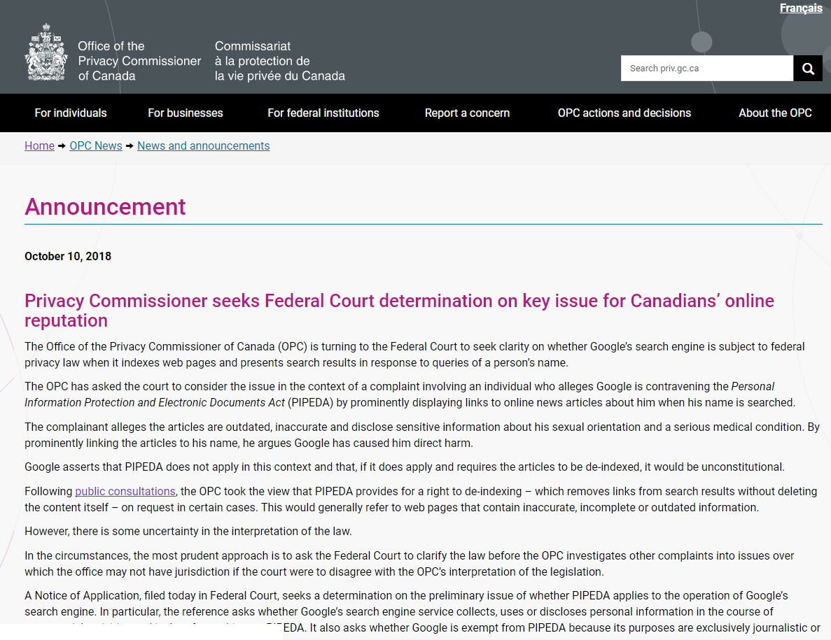

Next steps?

Slide 18
Data Security Breach Obligations

Slide 19
Introduction
Focus on PIPEDA breach of security safeguards (“BSS”) obligations.
Effective November 1, 2018.
Reporting to Office of Privacy Commissioner (“OPC”).
Notification to affected individuals, organizations and government institutions.
Record keeping.
Similar obligations imposed by other statutes/regulations, common/civil law, or contract.
Preparing for compliance.

Slide 20
PIPEDA BSS Obligations – Statutory Framework
Personal Information Protection and Electronic Documents Act (“PIPEDA”).
Private sector personal information protection statute.
Applies to handling of personal information in the course of commercial activities, except in British Columbia, Alberta and Quebec (which have “substantially similar” laws).
Applies to federally regulated organizations throughout Canada, and to transfers of personal information across borders for consideration.
Digital Privacy Act (2015).
Amended PIPEDA to add BSS obligations (not in force) and other provisions.
Order in Council – BSS obligations in force on November 1, 2018.
Breach of Security Safeguards Regulations (March 27, 2018).
OPC draft guidance and breach reporting form published September 18, 2018.

Slide 21
PIPEDA BSS Obligations – Stated Purpose
“Mandatory breach reporting allows individuals who are affected by a breach to take immediate action to protect themselves against further compromise that may lead to fraud, identity theft, humiliation, loss of employment or other forms of significant harm.
… will help mitigate harm to individuals who are affected by a data breach, and will increase the protection of Canadians’ personal information in general by encouraging better data security practices.”

Slide 22
PIPEDA BSS Obligations – Three Key Concepts
“breach of security safeguards”
“… the loss of, unauthorized access to or unauthorized disclosure of personal information resulting from a breach of an organization’s security safeguards [required by PIPEDA] or from a failure to establish those safeguards”.
“significant harm”
“… significant harm includes bodily harm, humiliation, damage to reputation or relationships, loss of employment, business or professional opportunities, financial loss, identity theft, negative effects on the credit record and damage to or loss of property”.

Slide 23
PIPEDA BSS Obligations – Key Concepts
“control”
BSS obligations apply to personal information under an organization’s “control”.
The term “control” is not defined in PIPEDA.
Reflects the Accountability principle:
“An organization is responsible for personal information under its control …”
“An organization is responsible for personal information in its possession or custody, including information that has been transferred to a third party for processing.”
OPC draft guidance: There may be more than one organization in control of the same information. OPC expects BSS reports from all organizations (i.e. both data collectors and data processors) involved in a breach, to provide a “complete overview” of the breach.

Slide 24
PIPEDA BSS Obligations – Risk Assessment
Assessment of “real risk of significant harm” (“RROSH”) is required for application of reporting and notification obligations.
PIPEDA:
“The factors that are relevant to determining whether a breach of security safeguards creates a real risk of significant harm to the individual include: (a) the sensitivity of the personal information involved in the breach; (b) the probability that the personal information has been, is being or will be misused; and (c) any other prescribed factor [none at this time].”
OPC’s draft guidance recommends that an organization develop a framework for assessing the real risk of significant harm, to ensure that all breaches are assessed consistently.

Slide 25
PIPEDA BSS Obligations – Report to OPC
If (1) there is a breach of security safeguards involving personal information under an organization’s control; and (2) it is reasonable to believe that the breach creates a real risk of significant harm to an individual, then the organization must report the breach to the OPC as soon as feasible after the organization determines that the breach has occurred.
The report may be sent to the OPC by any secure means of communication.
An organization may submit to the OPC any new information the organization becomes aware of after the organization submits its initial breach report.
No exceptions for small organizations or small breaches.

Slide 26
PIPEDA BSS Obligations – Report to OPC
An initial breach report to the OPC must include:
a description of the circumstances of the breach and, if known, the cause;
the day on which, or the period during which, the breach occurred or, if neither is known, the approximate period;
a description of the personal information that is the subject of the breach to the extent that the information is known;
the number of individuals affected by the breach or, if unknown, the approximate number;
a description of the steps that the organization has taken to reduce the risk of harm to affected individuals that could result from the breach or to mitigate that harm;
a description of the steps that the organization has taken or intends to take to notify affected individuals of the breach; and
the name and contact information of a person who can answer, on behalf of the organization, the OPC’s questions about the breach.

Slide 27
PIPEDA BSS Obligations – Notice to individuals
If (1) there is a breach of security safeguards involving personal information under an organization’s control; and (2) it is reasonable to believe that the breach creates a real risk of significant harm to an individual, then the organization must notify the individual of the breach as soon as feasible after the organization determines that the breach has occurred, unless giving notice is otherwise prohibited by law.
Notification must be conspicuous and given directly to an affected individual except in prescribed circumstances in which indirect notification is required. It should not be “overly legalistic”. It should be “easily understandable”.
Direct notification must be given to an affected individual in person, by telephone, mail, email or any other form of communication that a reasonable person would consider appropriate in the circumstances.

Slide 28
PIPEDA BSS Obligations – Notice to individuals
Indirect notification must be given to an affected individual if: (a) direct notification would be likely to cause further harm to the affected individual; (b) direct notification would be likely to cause undue hardship for the organization; or (c) the organization does not have contact information for the affected individual.
Indirect notification must be given by public communication or similar measure (e.g. website notice) that could reasonably be expected to reach the affected individual.
A notice to an affected individual must “contain sufficient information to allow the individual to understand the significance to them of the breach and to take steps, if any are possible, to reduce the risk of harm that could result from it or to mitigate that harm”.

Slide 29
PIPEDA BSS Obligations – Notice to individuals
The Regulations require the following information be included in a notice to an affected individual:
a description of the circumstances of the breach;
the day on which, or period during which, the breach occurred or, if neither is known, the approximate period;
a description of the personal information that is the subject of the breach to the extent that the information is known;
a description of the steps that the organization has taken to reduce the risk of harm that could result from the breach;
a description of the steps that affected individuals could take to reduce the risk of harm that could result from the breach or to mitigate that harm; and
contact information that the affected individual can use to obtain further information about the breach.

Slide 30
PIPEDA BSS Obligations – Other Notices
If an organization notifies an individual about a breach of security safeguards under the BSS obligations, then the organization must give notice of the BSS to any other organization, government institution or part of a government institution that the notifying organization believes may be able to reduce the risk of harm that could result from the breach or mitigate that harm, or if any of the prescribed conditions [none yet] are satisfied.
OPC draft guidance suggests notice to law enforcement (in appropriate circumstances), payment processors and banks.

Slide 31
PIPEDA BSS Obligations – Record-Keeping
An organization must keep and maintain a record of “every breach of security safeguards involving personal information under its control”. (Not limited to breaches that create a real risk of significant harm to an individual.)
The record must contain any information that enables the Commissioner to verify the organization’s compliance with the breach reporting and notification obligations.
OPC draft guidance – include a brief explanation of why the breach was determined to not pose a RROSH.
An organization must maintain the record of a breach for 24 months after the day on which the organization determines that the breach has occurred.
An organization must provide the record to the Commissioner on request.

Slide 32
PIPEDA BSS Obligations – Enforcement
OPC may investigate an alleged contravention of BSS obligations, based on a complaint or on OPC’s own initiative, and publish report of findings and publicly disclose information discovered during investigation.
OPC may disclose to a government institution (e.g. law enforcement) breach-related information relevant to a violation of law.
After OPC concludes an investigation, a complainant affected by a breach of BSS obligations may apply to Federal Court for an award of damages (including damages for humiliation) and other behavioural remedies.
An organization’s knowing contravention of reporting, notification (to individuals, but not to organizations or government institutions) and record-keeping obligations is an offence punishable by a fine of up to $100,000.

Slide 33
PIPEDA BSS Obligations – Compliance Challenges
Timing: When will an organization be considered to have “determined” that a personal information security breach has occurred?
Indirect Notification: What financial costs or other circumstances will constitute “undue hardship” to an organization to justify indirect notification? Is indirect notification always required if direct notification to any affected individual is unsuccessful (e.g. email or postal mail notification is undeliverable/rejected)?
Withholding/Delaying Reporting and Notification: In what circumstances (if any) may an organization delay reporting or notification of a personal information security breach, or withhold information about a breach?

Slide 34
Other Reporting/Notification Obligations
Alberta Personal Information Protection Act includes personal information security breach reporting/notification obligations. A report to the Alberta OIPC must include a risk assessment. Alberta OIPC has issued guidance.
B.C. Personal Information Protection Act and Quebec private sector personal information protection statute do not include personal information security breach reporting/notification obligations. Amendments to add those obligations are expected to maintain “substantially similar” designation.
Other Statutes/Regulations: Securities laws – reporting issuer continuous disclosure obligations. Investment Industry Regulatory Organization of Canada proposed amendments to IIROC Rules.

Slide 35
Other Reporting/Notification Obligations
Contractual Obligations – confidentiality or data protection obligations, PCIDSS compliance obligations (payment card merchant agreements), insurance policy notification obligations, express/implicit privacy policy obligations.
Common/civil law duty to warn individuals/organizations so they may avoid or mitigate reasonably foreseeable harm.
Other considerations: customer relations, business relations, anticipating other disclosures.

Slide 36
Consent

Slide 37
Recent documents on consent
OPC consultation on consent
(May 2016)
OPC report on consent
(Sept 2017)
ETHI report on PIPEDA
(Feb 2018)

Slide 38
Consent for secondary uses – ETHI Towards Privacy Design report (Feb 2018)
In Towards Privacy By Design, the Standing Committee on Access to Information, Privacy and Ethics has recommended that Parliament amend PIPEDA “to explicitly provide for opt-in consent as the default for any use of personal information for secondary purposes, and with a view to implementing a default opt-in system regardless of purpose.”
“IAB Canada has identified the opt-in issue as having major ramifications for advertisers as it would change and possibly restrict advertisers’ ability to use consumer data – an increasingly valued resource to private corporations – beyond the purposes of direction communication with those they have done business.”
Media in Canada, Committee recommends opt-in changes for PIPEDA, March 2, 2018.

Slide 39
May 2018: OPC published two important new guidance documents
The OPC started applying this guidance on July 1, 2018.
Issued jointly with the Alberta and BC OIPC. The OPC will begin to apply these guidelines on January 1, 2019.

Slide 40
“Must do”: Legal requirement
“Should do”: Recommended practice (i.e. best practice)

Slide 41
“Must do” to obtain meaningful consent (i.e. legal requirements)
Obtain explicit consent if : (i) involves sensitive information; (ii) are outside the reasonable expectations of the individual; and/or (iii) create a meaningful residual risk of significant harm
Make privacy information readily available in complete form, with emphasis on four key elements: (i) What personal information is being collected, (ii) with which parties personal information is being shared, (iii) for what purposes and (iv) risks of harm and other consequences
Provide information in manageable and easily-accessible ways and consider perspective of consumers
Make available a clear and easily accessible choice for information not necessary to provide the product or service - Allow individuals to withdraw consent (subject to legal or contractual restrictions).
Obtain consent when making significant changes to practices (i.e. use for new purposes or disclosures).
Only collect, use or disclose personal information for purposes that a reasonable person would consider appropriate, under the circumstances.
When dealing with children, obtain consent from a parent / guardian or ensure that the consent process considers their level of maturity (13).

Slide 42
“Should do” when obtaining consent (i.e. best practices)
Allow individuals to control the amount of detail they wish to receive, and when.
Design or adopt innovative and creative ways of obtaining consent, which are just-in-time, specific to- the context, and suitable to the type of interface. (anticipate users’ questions - FAQs, chatbots)
Periodically remind individuals about the consent choices they have made, and those available to them.
Periodically audit privacy communications to ensure they accurately reflect current personal information management practices.
Stand ready to demonstrate compliance – in particular, that the consent process is understandable from the perspective of the user.
In designing consent processes, consider: Consulting with users and seeking their input; Pilot testing or using focus groups to evaluate the understandability of documents; Involving user interaction / user experience (UI/UX) designers; Consulting with privacy experts and/or regulators and/or following established best practices or standards.

Slide 43
May 2018: OPC published two important new guidance documents
The OPC started applying this guidance on July 1, 2018.
Issued jointly with the Alberta and BC OIPC. The OPC will begin o apply these guidelines on January 1, 2019.

Slide 44
Evaluating an organization’s purposes under 5(3)
s. 5(3) requires an examination of whether the purposes are appropriate “in the circumstances.” with analysis conducted “in a contextual manner”.
Turner v. Telus Communications Inc, the Federal Court, set out the following factors :
The degree of sensitivity of the personal information at issue;
Whether the organization’s purpose represents a legitimate need / bona fide business interest;
Whether the collection, use and disclosure would be effective in meeting the organization’s need;
Whether there are less invasive means of achieving the same ends at comparable cost and with comparable benefits; and
Whether the loss of privacy is proportional to the benefits.
Privacy Impact Assessment

Slide 45
A few words on publicly available data…
“Best practice: Consider treating any publicly available personal information involved in your big data project the same as non-public personal information.”
OIPC, Big Data Guidelines, May 2017.
“ (…) we caution against the common misconception that simply because personal information happens to be generally accessible online, there is no privacy interest attached to it.”
OPC, Consent report, September 2017.
“(…) “publicly available information” should not be confused with “information that is accessible to the public.” In fact, the definition of “publicly available” under PIPEDA is very restrictive.”
OPC, Frequently Asked Questions for Online Consent, May 2014.
PIPEDA Report of Findings #2018-002, Complaints under PIPEDA against Profile Technology Ltd., June 2018.

Slide 46
What are “inappropriate purposes” or “No-Go Zones”?
Collection, use or disclosure that is otherwise unlawful
Profiling or categorization that leads to unfair, unethical or discriminatory treatment contrary to human rights law
Collection, use or disclosure for purposes that are known or likely to cause significant harm to the individual
Publishing personal information with the intended purpose of charging individuals for its removal
Requiring passwords to social media accounts for the purpose of employee screening
Surveillance by an organization through audio or video functionality of the individual’s own device

Slide 47
What are “inappropriate purposes” or “No-Go Zones”?
Profiling or categorization that leads to unfair, unethical or discriminatory treatment contrary to human rights law
“Data analytics—or any other type of profiling or categorization—that results in inferences being made about individuals or groups, with a view to profiling them in ways that could lead to discrimination based on prohibited grounds contrary to human rights law would not be considered appropriate under subsection 5(3)’s “appropriate purpose” test.”
Determining whether a result is unfair or unethical will require a case-by-case assessment - will also generally be found inappropriate under subsection 5(3).
Notes:
where we committed to calling on all parties to demonstrate that decisions around the use of Big Data are fair, transparent and accountable; that results from profiling be responsible, fair and ethi.cal; and that injustice for individuals due to fully automated false positive or false negative results be avoided.

Slide 48
Algorithm transparency and human rights
“Machine learning, knowledge discovery in databases, and other AI techniques produce decision-making models differing so radically from the way that human decisions are made that they resist our ability to make sense of them. Ironically, [artificial intelligence programs] display great accuracy, but those who use them and even their programmers often don’t know exactly how or why. Permitting such decisions without an ability to understand them can have the effect of eliminating challenges that are essential to the rule of law. When an institution uses your personal information and data about you to decide that you don’t get a loan, your neighbourhood’s going to be the one under more police surveillance, you don’t get to go to university, you don’t get the job, or you don’t get out of jail, and those decisions can’t be explained by anyone in a meaningful way, such uses of your data interfere with your privacy rights.”
Ian Kerr reported in Standing Committee on Access to Information, Privacy and Ethics, Towards Privacy By Design, February 2018.

Slide 49
ETHI recommendation 3 on algorithmic transparency
That the Government of Canada consider implementing measures to improve algorithmic transparency
“Today, personal information is often processed with complex algorithms, which seek to increase the quality of the user’s experience, but also to assess risks and make important decisions that may affect the user’s interests. “These [artificial intelligence programs] are designed in ways that raise unique privacy challenges.” In fact, users have little information about how they work, the data they collect and how they are used.”
Standing Committee on Access to Information, Privacy and Ethics, Towards Privacy By Design, February 2018.

Slide 50
“No-go zones” and using publicly available data

Slide 51
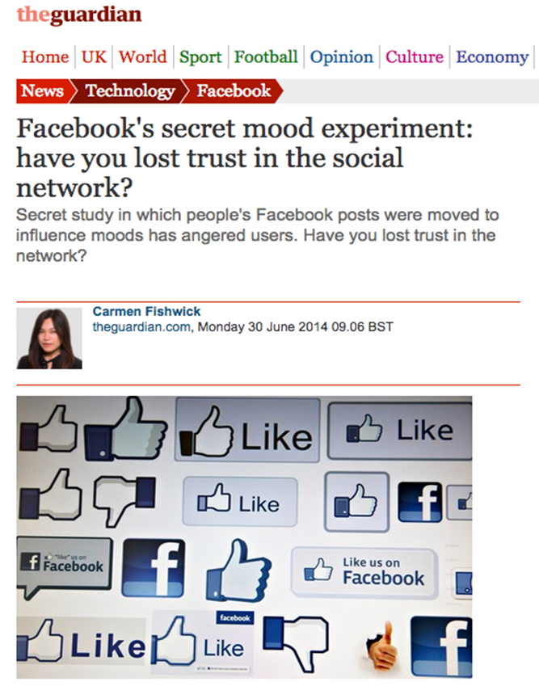
Examples of “no-go zones”?

Slide 53
Eloïse Gratton
National Co-Leader, Privacy & Data Protection Group
514.954.3106 / 416.367.6225
egratton@blg.com
Elisa Henry
Partner, Privacy & Data Protection Group
514.954.3113
ehenry@blg.com

