Slide 1
IP Update for Technology Law Practitioners: Patents
Michael Van Eesbeek
Patent Counsel, TD Bank
Office of Patentable Innovation
October 28, 2019

Slide 2



IP Update for Technology Law Practitioners Patents
Brief update on the new Canadian Patent Rules
Patent eligibility for computer-implemented inventions and the current state of software patent practice at the USPTO and CIPO
Practical patent drafting and prosecution strategy for avoiding and/or responding to statutory subject matter related rejections
Michael Van Eesbeek
Patent Counsel, TD Bank

Slide 3
Amendments to the Patent Act and Repeal and Replacement of Canadian Patent Rules in force October 30, 2019
Highlights:
Two options for amendment after allowance.
Correcting errors in applications now easier.
Simplified change of ownership.
Simplified NON-PCT filing requirements to get a filing date.
File Wrapper Estoppel.
Notes:
Two options for amendment after allowance: 1. Amendment to correct obvious errors or amendment via withdrawal of allowance. 2. Amendment to correct obvious errors (previously clerical errors) in specification or drawings (Rule 100(2)) on or before payment of the final fee – no fee required. Amendments to specification or drawings, requested after Notice of Allowance but prior to the final fee being paid, can be made where: “obvious” that “something other than what appears in the specification and the drawings was intended and that nothing other than” the proposed amendment/correction “could have been intended”. Amendment after allowance via withdrawal of allowance requires a request to withdraw allowance (Rule 86(17)) within 4 months of the Notice of Allowance and before payment of the final fee; a $400 fee applies; application subject to further examination and an amendment can be submitted.
Correcting errors in applications: Several new options, such as priority details, applicant/inventor, obvious errors in specifications or drawings, obvious errors made by the Commissioner, post-grant corrections, etc. Reissue, re-examination, and disclaimer are still available. Priority dates may be corrected prior to the earlier of the time prescribed for requesting priority as determined using the corrected priority date AND the time prescribed for requesting priority using the uncorrected date (Rule 73(4)). It is possible to claim priority to an application filed 14 months prior if submitted with a statement that failure to file the priority request within 12 months was unintentional.
Simplified changed of ownership: Changes of ownership are now called "transfers" rather than "assignments" with a change from "registration of assignment" to "recordal of facts". Evidence no longer needs to be filed if submitted by the Applicant. Assignments don’t have to be witnessed anymore! Evidence is only needed if request to record transfer is made by transferee.
Simplified NON-PCT filing requirements to get a filing date: At the time of filing, no application fee is required, and the description may not be in English or French – these can be tended to later. Filing fee can be paid within 3 months. A translation into English or French can be filed within 2 months. Failure to pay application fee with additional late fee results in the application being withdrawn. Failure to provide translation or documentation results in the application being abandoned.
File Wrapper Estoppel: Written communications between Applicant and CIPO now relevant to claim construction (in force as of December 13, 2018).

Slide 4
Amendments to the Patent Act and Repeal and Replacement of Canadian Patent Rules in force October 30, 2019
Highlights:
PCT filing deadline is now 30 months.
Four years to request examination.
Four month due date for replying to requisitions, office actions, and final actions.
Four months to pay final fee.
Missed maintenance fee now triggers a late fee notice.
Reinstatement now requires due care.
Certified copies of priority documents now required.
Notes:
Extension to 42 months is still possible but requires demonstration that delay is “unintentional”.
4 years to request examination after application filed (no longer 5 years). No extension is available. A notice is sent when fee payment is missed providing two months from the date of notice OR six months from the original fee deadline, whichever is later, to pay the fee with an additional late fee.
4 month due date to respond to requisitions, extendable to 6 months (previously 6 months, not extendable).
4 months to pay final fee in allowed applications (not extendible, previously 6 months).
Missed maintenance fee now triggers a late fee notice and associated due date (+6 months) for paying maintenance fee and late fee. A notice is sent when fee payment is missed providing two months from the date of notice OR six months from the original fee deadline, whichever is later, to pay the fee with an additional late fee.
Reinstatement as of right within 12 months no longer the rule and no longer available in some situations. In many situations, reinstatement requires a showing of "due care" or that missing the due date was unintentional, such as failure to pay maintenance fee by the late fee due date, failure to pay examination fee by the late fee due date.
Certified copies of priority documents now required where priority claims are made.

Slide 5
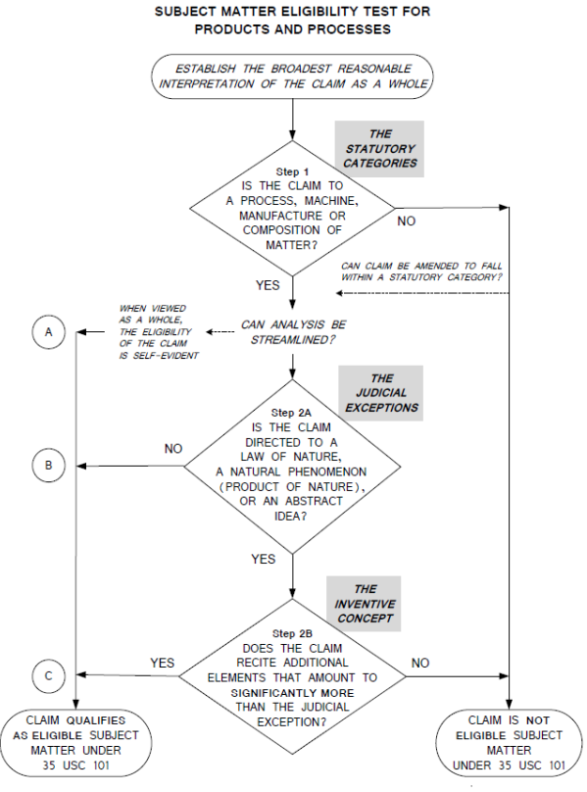
Statutory Subject Matter
In June 2014, the U.S. Supreme Court issued the Alice Corp. v. CLS Bank International decision.
Left TD
99/363
Notes:
From section 2106 of the MPEP:
III. SUMMARY OF ANALYSIS AND FLOWCHART Examiners should determine whether a claim satisfies the criteria for subject matter eligibility by evaluating the claim in accordance with the following flowchart. The flowchart illustrates the steps of the subject matter eligibility analysis for products and processes that are to be used during examination for evaluating whether a claim is drawn to patent-eligible subject matter. It is recognized that under the controlling legal precedent there may be variations in the precise contours of the analysis for subject matter eligibility that will still achieve the same end result. The analysis set forth herein promotes examination efficiency and consistency across all technologies.
As shown in the flowchart, Step 1 relates to the statutory categories and ensures that the first criterion is met by confirming that the claim falls within one of the four statutory categories of invention. See MPEP § 2106.03 for more information on Step 1. Step 2, which is the Supreme Court’s Alice/Mayo test, is a two-part test to identify claims that are directed to a judicial exception (Step 2A) and to then evaluate what more such claims recite to provide an inventive concept (Step 2B) (also called a practical application) to the judicial exception. See MPEP § 2106.04 for more information on Step 2A, and MPEP § 2106.05 for more information on Step 2B.
The flowchart also shows three pathways (A, B, and C) to eligibility:
Pathway A: Claims taken as a whole that fall within a statutory category (Step 1: YES) and, which may or may not recite a judicial exception, but whose eligibility is self-evident can be found eligible at Pathway A using a streamlined analysis. See MPEP § 2106.06 for more information on this pathway and on self-evident eligibility.
Pathway B: Claims taken as a whole that fall within a statutory category (Step 1: YES) and are not directed to a judicial exception (Step 2A: NO) are eligible at Pathway B. These claims do not need to go to Step 2B. See MPEP § 2106.04 for more information about this pathway and Step 2A.
Pathway C: Claims taken as a whole that fall within a statutory category (Step 1: YES), are directed to a judicial exception (Step 2A: YES), and recite additional elements either individually or in an ordered combination that amount to significantly more than the judicial exception (Step 2B: YES) are eligible at Pathway C. See MPEP § 2106.05 for more information about this pathway and Step 2B.
Claims that could have been found eligible at Pathway A (streamlined analysis), but are subjected to further analysis at Steps 2A or Step 2B, will ultimately be found eligible at Pathways B or C. Thus, if the examiner is uncertain about whether a streamlined analysis is appropriate, the examiner is encouraged to conduct a full eligibility analysis. However, if the claim is not found eligible at any of Pathways A, B or C, the claim is patent ineligible and should be rejected under 35 U.S.C. 101.
Regardless of whether a rejection under 35 U.S.C. 101 is made, a complete examination should be made for every claim under each of the other patentability requirements: 35 U.S.C. 102, 103, 112, and 101 (utility, inventorship and double patenting) and non-statutory double patenting. MPEP § 2103.

Slide 6
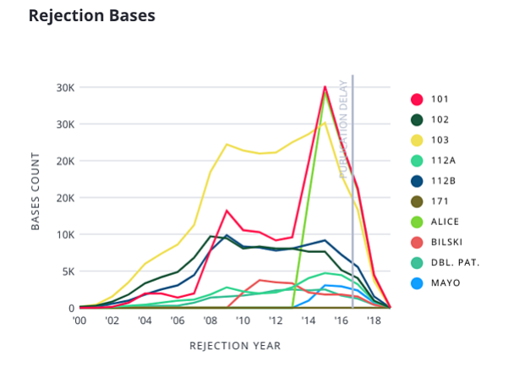
Rejection Bases
Source: https://blog.juristat.com/alice-rejections-class-705
Notes:
The chart shows the incidence of rejection under different statutory sections overs time. Remember that the Alice decision was released in June, 2014.

Slide 7
Practical Approach: Get out of 705!
Banking inventions involve facilitating financial transactions, business processes, or other forms of financial technology.
Class 705 - DATA PROCESSING: FINANCIAL, BUSINESS PRACTICE, MANAGEMENT, OR COST/PRICE DETERMINATION.
Red flag words like:
Transaction
Financial
Payment
After Alice, Examiners automatically called anything in class 705 an "abstract idea", which allegedly did not recite "significantly more", and rejected it.
Notes:
At TD, many of our claimed inventions involve facilitating financial transactions, business processes, or other forms of financial technology.
In 2016, nearly all TD applications were classified in Class 705 - DATA PROCESSING: FINANCIAL, BUSINESS PRACTICE, MANAGEMENT, OR COST/PRICE DETERMINATION.
Red flag words like "transaction", "financial", and "payment" in the title, background, or claims would send an application directly to class 705.
After Alice, Examiners automatically called anything in class 705 an "abstract idea", which allegedly did not recite "significantly more", and rejected it.

Slide 8
Practical approach: Get out of 705! Claim the forest, not the tree!
A payment system is a database system.
A payment is a data transfer in a database.
Counter-Intuitive Approach: BROADEN THE CLAIMS
Claim the broad scope that you are really entitled to!
Notes:
A payment system is really just a database system that has been specifically applied to account for financial transactions.
A payment is really just a data transfer in a database.
Payment in a payment system is really just a particular embodiment or specific example of a data transfer in a database system.
Counter-Intuitive Approach: BROADEN THE CLAIMS
Claim the broad scope that you are really entitled to!

Slide 9

A Real Example
This patent allows merchants who provide credit cards in online wallets to provide an image or colour scheme stored in the online wallet with the credit card product to better brand the credit card.
Summarized claim:
An electronic device stores a data transfer application
displays … a plurality of data transfer methods;
receives … a selection of one of the data transfer methods for use in making a subsequent data transfer;
retrieves a graphical element corresponding to the selected data transfer method;
configures the electronic device for making data transfers using the selected data transfer method; and
presents the graphical element in an interface of the data transfer application and modifies an icon for launching the data transfer application to correspond to the graphical element.
Notes:
Actual claim, as filed:
An electronic device comprising: an input interface module; an output interface module; a processor coupled to the input interface module and the output interface module; a memory coupled to the processor and storing a data transfer application comprising instructions which, when executed by the processor, cause the electronic device to:
display, via the output interface module, indications corresponding to a plurality of data transfer methods;
receive, via the input interface module, a selection of one of the data transfer methods for use in making a subsequent data transfer;
retrieve a graphical element corresponding to the selected data transfer method;
configure the electronic device for making data transfers using the selected data transfer method; and
indicate the electronic device is operable to perform data transfers using the selected data transfer method by at least one of:
presenting the graphical element in an interface of the data transfer application whenever the interface is displayed via the output interface module, and
modifying an icon for launching the data transfer application to correspond to the graphical element.

Slide 10
Result
Classified in class 715 - DATA PROCESSING: PRESENTATION PROCESSING OF DOCUMENT, OPERATOR INTERFACE PROCESSING, AND SCREEN SAVER DISPLAY PROCESSING
A single Office Action presented only an obviousness rejection.
Addition made to claim: presenting the graphical element in the interface of the data transfer application comprises displaying a border based on the graphical element extending along and from one or more edges of the display screen.
Notice of Allowance received within 2 years of the filing date.
Now Granted U.S. Patent No. 10,423,307, issued September 24, 2019.
Continuation application filed directed at the more specific embodiment where:
the data transfer application = a payment application
data transfer = payment
Notes:
Granted claim:
An electronic device comprising: an input interface module; an output interface module including a display screen; a processor coupled to
the input interface module and the output interface module; a memory coupled to the processor and storing a data transfer application
comprising instructions which, when executed by the processor, cause the electronic device to:
display, via the output interface module, indications corresponding to a plurality of data transfer methods;
receive, via the input interface module, a selection of one of the data transfer methods for use in making a subsequent data transfer;
retrieve a graphical element corresponding to the selected data transfer method;
configure the electronic device for making data transfers using the selected data transfer method; and
indicate that the electronic device is operable to perform data transfers using the selected data transfer method by at least one of: presenting the graphical element in an interface of the data transfer application whenever the interface is displayed via the output interface module, and modifying an icon for launching the data transfer application to correspond to the graphical element, wherein presenting the graphical element in the interface of the data transfer application comprises displaying a border based on the graphical element extending along and from one or more edges of the display screen.

Slide 11
The 2019 Revised Patent Subject Matter Eligibility Guidance published in January, 2019
Increase clarity, predictability, and consistency.
Notes:
From 2019 Patent Eligibility Guidance, February 7, 2019:
Revised Step 2A is a two-prong inquiry
•Prong One: Evaluate whether the claim recites a judicial exception (an abstract idea enumerated in the 2019 PEG, a law of nature, or a natural phenomenon).
–If no exception is recited, the claim is eligible. This concludes the eligibility analysis.
–If claim recites an exception, go to Prong Two.
•Prong Two: Evaluate whether the claim recites additional elements that integrate the exception into a practical application of the exception.
–If the recited exception is integrated into a practical application, then the claim is eligible. This concludes the eligibility analysis.
–If the exception is not integrated into a practical application, then the claim is “directed to” the exception. Go to Step 2B for further analysis.

Slide 12

Enumerated Groupings of Abstract Ideas Under The New Guidance
Mathematical concepts, relationships, formulas or equations
Mental processes
Certain methods of organizing human activity
Fundamental economic principles
Commercial or legal interactions
Managing personal behavior or relationships or interactions between people
NOTE: The recitation of generic computer components in a claim does not necessarily preclude that claim from reciting an abstract idea.
Notes:
Mathematical concepts, Mathematical relationships, Mathematical formulas or equations, Mathematical calculations
Mental processes - Concepts performed in the human mind, including an observation, evaluation, judgment, opinion
Certain methods of organizing human activity
Fundamental economic principles or practices (including hedging, insurance, mitigating risk)
Commercial or legal interactions (including agreements in the form of contracts; legal obligations; advertising, marketing or sales activities or behaviors; business relations)
Managing personal behavior or relationships or interactions between people (including social activities, teaching, and following rules or instructions)
NOTE: The recitation of generic computer components in a claim does not necessarily preclude that claim from reciting an abstract idea.

Slide 13
Recipe For a Grant Before The USPTO:
Focus the title, background, and independent claims on technical aspects.
DO NOT characterize your invention as FINANCIAL, BUSINESS PRACTICE, MANAGEMENT, OR COST/PRICE DETERMINATION
Argue rejections under 35 U.S.C. 101 based on the revised guidance.
Argue that the Examiner has not met his burden under the revised guidance:
Examiner has not provided sufficient reasoning
Examiner has made only conclusory statements
Examiner has not analyzed the actual elements of the claims
Examiner has not provided reasoned rejections for every claim
Set up Examiner interviews.
Do not be afraid of appeal, particularly pre-appeal!
We have experienced a high success rate with pre-appeal based on 35 U.S.C. 101 – 75%+ success rate.
Notes:
Consider the technical aspects of your invention and focus the title, the background, and the independent claims on those features.
Leave example applications and embodiments as exactly that, to be given in the detailed description and dependent claims only.
DO NOT characterize your invention as FINANCIAL, BUSINESS PRACTICE, MANAGEMENT, OR COST/PRICE DETERMINATION, if it doesn’t have to be!
Argue rejections under 35 U.S.C. 101 based on the revised guidance - the invention does NOT recite an abstract idea, law of nature, or natural phenomenon, and IF IT DOES, the claims recite additional elements that claim a practical application.
Argue that the Examiner has not met his or her burden under the revised guidance:
Examiner has not provided sufficient reasoning as to why the claims recite an abstract idea
Examiner has made only conclusory statements with insufficient support
Examiner has not analyzed the actual elements of the claims in reaching his or her position
Examiner has not provided reasoned rejections for each and every claim
Set up Examiner interviews after filing the first response. Communicate with the Examiner.
Do not be afraid of appeal, particularly pre-appeal!
We have experienced a high success rate with pre-appeal based on 35 U.S.C. 101 – 75%+ success rate.

Slide 14

What about Canada and the CIPO?
Largely status quo – no strong guidance since Amazon in 2011.
An Examiner’s bulletin (March, 2018), instructs Examiners that the classic “need for speed” argument in rendering a computer an essential element of the claim is not necessarily a successful argument.
CIPO status quo: on issues under section 2 of the Patent Act, the Office continues to operate in a less than transparent manner, sometimes taking positions that appear to have no basis in Canadian law.
CIPO Examiners strongly persuaded by foreign allowances, particularly from the USPTO and the EPO.
BEST PRACTICE: File request for examination with the CIPO after securing a foreign allowance.
Notes:
Largely status quo – no strong guidance since the Amazon decision from the Federal Court of Appeal in 2011.
An Examiner’s bulletin (March, 2018), instructs Examiners that the classic “need for speed” argument in rendering a computer an essential element of the claim, and therefore statutory subject matter, is not necessarily a successful argument.
Bulletin on available through Freedom of Information request.
CIPO status quo: on issues under section 2 of the Patent Act, the Office continues to operate in a less than transparent manner, sometimes taking positions that appear to have no basis in Canadian law.
CIPO Examiner continue to strongly persuaded by allowances from foreign offices, particularly the USPTO and the EPO.
BEST PRACTICE: File your request for examination with the CIPO only after securing an allowance from another patent office.

Slide 15
IP Update for Technology Law Practitioners: Industrial Designs
Michael Van Eesbeek
Patent Counsel, TD Bank
Office of Patentable Innovation
October 28, 2019

Slide 16


IP Update for Technology Law Practitioners Industrial Designs
Implementation of the Hague Treaty
Protection of User Interfaces – When do Industrial Designs Make Sense?
Michael Van Eesbeek
Patent Counsel, TD Bank

Slide 17
Implementing the Hague Treaty:
Canada acceded to the Hague Agreement Concerning the International Registration of Industrial Designs on November 5, 2018.
Industrial Design Act amended in 2014.
New Industrial Design Regulations finalized in 2018.
The Hague System provides a single application filed with WIPO for procuring and maintaining design rights in multiple countries (like a PCT patent application).

Slide 18

Benefits/Changes from the Hague System:
Longer term: maximum term increases, now 15 years from filing date
Error Correction: within 6 months of entry of an “obvious” error
Codification of SCC test for “originality”, now called “novelty”
Applications publicly available at registration or 30 months from priority date, whichever is earlier.
Enhanced e-services: Electronic system open 24/7
Simplified Filing Date Requirements
Simplified Application Requirements
Notes:
Longer term: maximum term increases from 10 years to 15 years from filing date
Error Correction: within 6 months of entry of an “obvious” error (previously limited to clerical errors)
Codification of SCC test for “originality”, now called “novelty”
Applications publicly available at registration or 30 months from priority date, whichever is earlier
Earlier publication may be requested
Enhanced e-services: Electronic system open 24/7 and communications deemed received any time
Simplified Filing Date Requirements:
An indication that registration of a design is sought
A means of identifying the Applicant
Contact information; and
A representation of the design
Simplified Application Requirements:
CIPO Application form no longer required
Optional description – applications deemed to relate to all four of shape, configuration, ornamentation, and pattern, unless specified otherwise
Designs no longer have to be applied to finish article
No longer limited to single environmental view

Slide 19
When do Industrial Designs make sense?
Low cost; Easy prosecution
Industrial Designs operate in a similar manner to copyright protection.
Infringement requires that the infringing item or design “not differ substantially” from your registered industrial design from the perspective of “an informed consumer”.
Features dictated solely by function are not protected.
Covers visual features such as shape, configuration, pattern, or ornament, or any combination.
Consider Industrial Designs when:
Your design is finalized.
Your design does not have new functional aspects that may be subject to a utility patent.
You are concerned about others copying your design.

