Slide 1
Open The Legal Briefs, Hal
How AI will shape the legal landscape in the next 5 years
James Kosa
416-947-5043 jkosa@weirfoulds.com

Slide 2
Overview
Artificial Intelligence – What it is and is not.
Applications for AI in the legal space
Challenges for lawyers in using AI
Benefits for lawyers in using AI
Where I think we will be in 5 years

Slide 3
AI: What do you think it is?

Slide 4


Slide 5


Slide 6


Slide 7
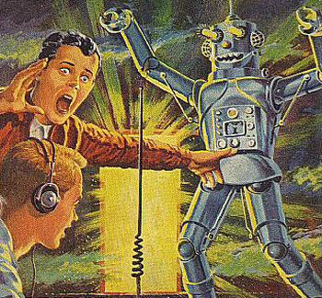

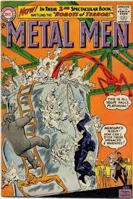

Slide 8

AI: Artificial Intelligence
When asked about the possibility of AI:
Oh, I don't think there's any question of that. I think that the people that say we will never develop computer intelligence — they merely prove that some biological systems don't have much intelligence.
Arthur C. Clarke in "Science Fiction and Prophecy: Talking to Arthur C. Clarke" (1995)

Slide 9
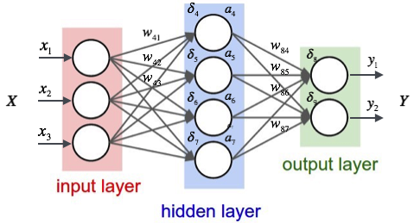
AI: Artificial Intelligence
The next revolution in technology: it has the potential to reshape our society.
First posited in the 1940s
Developed in fits and starts until the computing technology itself was advanced enough to catch up with theory
Early models were based on mimicry of self-learning cells (neurons -> neural networks)
Later models involved complex structures, combinations of techniques to train and refine AI. Different techniques are used depending on data and use case.
Google's Tensorflow User Documentation

Slide 10
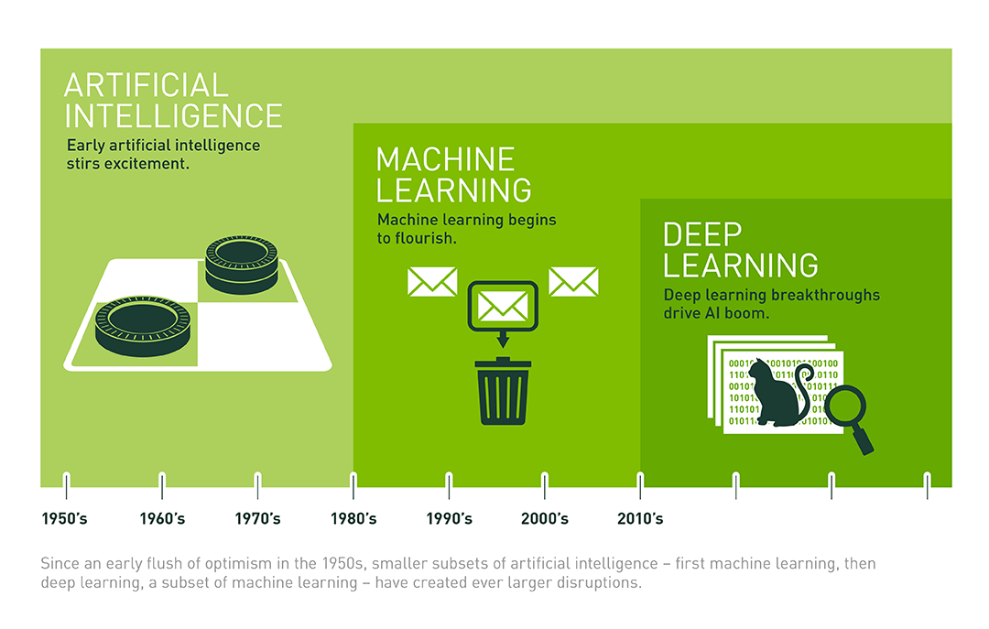
Distinguishing Types of AI
"What's the Difference Between Artificial Intelligence, Machine Learning, and Deep Learning?" – Copeland, M. Nvidia, July 2016 (https://blogs.nvidia.com/blog/2016/07/29/whats-difference-artificial-intelligence-machine-learning-deep-learning-ai/)

Slide 11
Fun and Famous AI Applications
"Forget artificial intelligence - in the brave new world of big data, it's artificial idiocy we should be looking out for."
Tom Chatfield https://www.theguardian.com/commentisfree/2014/jan/06/artificial-intelligence-understanding-big-data
Some recent examples:
IBM's Deep Blue (1997): playing chess using more than brute force of algorithmic depth
IBM's Watson playing Jeopardy (2011): natural language processing, rapid search and retrieval of trivia
Google's AlphaGo (2016), AlphaGo Zero: mastering Go through sheer practice, and teaching itself (https://www.nature.com/articles/nature24270)
Facebook's face recognition: finds every instance of you (whether you want it or not) (https://techcrunch.com/2017/12/19/facebook-facial-recognition-photos/)

Slide 12
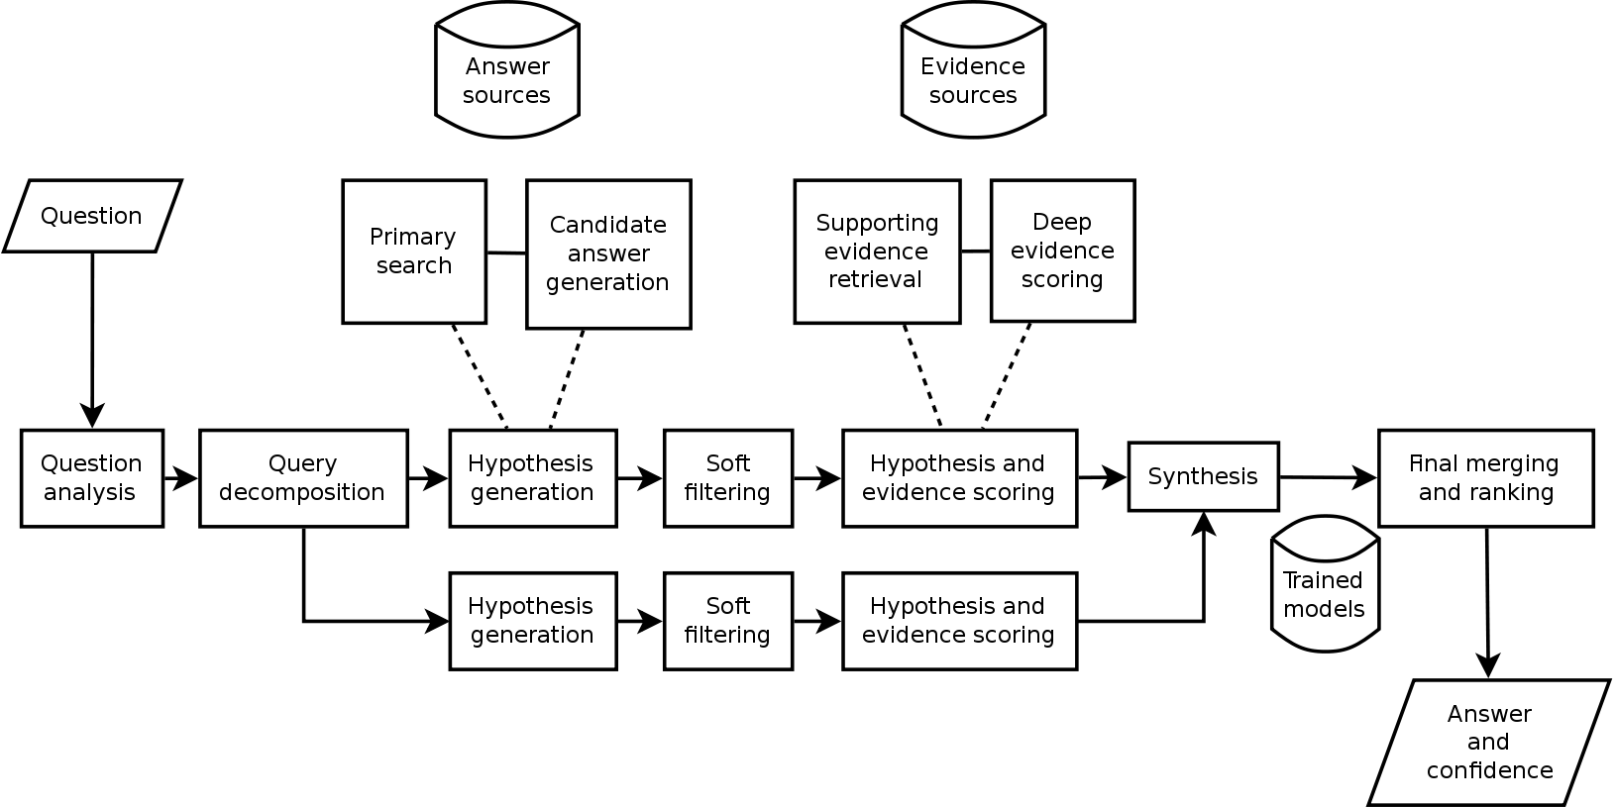
Watson Architecture (Natural Language)
Ferrucci, D.; et al. (2010). "Building Watson: An Overview of the DeepQA Project". AI Magazine. 31 (3).

Slide 13
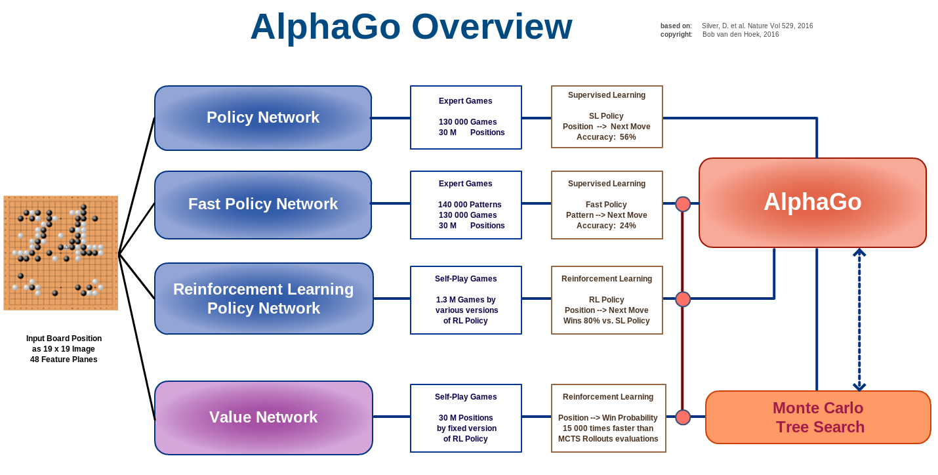
AlphaGo Architecture (Strict Rules)
Bob van den Hoek: http://deeplearningskysthelimit.blogspot.ca/2016/04/part-2-alphago-under-magnifying-glass.html
See also: Shane (Seungwhan) Moon, Carnegie Mellon student: https://www.slideshare.net/ShaneSeungwhanMoon/how-alphago-works

Slide 14

Balancing of Risks: AI in Regulated Fields
"In general, the approach to regulation of AI-enabled products to protect public safety should be informed by assessment of the aspects of risk that the addition of AI may reduce alongside the aspects of risk that it may increase."
"Preparing for the Future of Artificial Intelligence", NSTC of President Obama, 2016
Broad regulation of AI is inadvisable
Augment existing regulation to account for the effects of AI instead
Need to have technical expertise to account for AI-introduced challenges:
GIGO (tay.ai)
Data bias (WEAT)
Uncanniness (http://inspirobot.me/)

Slide 15
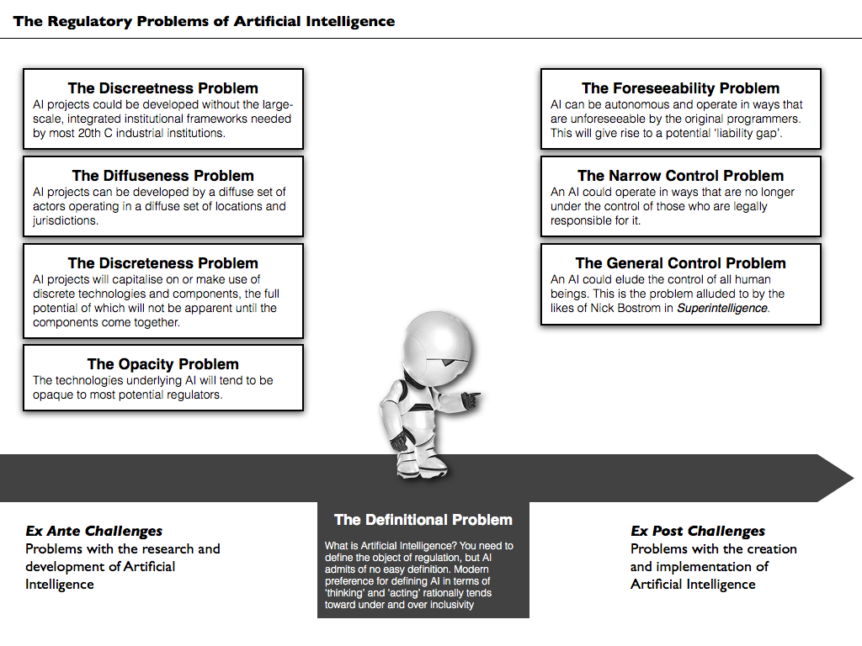
Some Regulatory Challenges
John Danaher - Is effective regulation of AI possible? Eight potential regulatory problems. http://philosophicaldisquisitions.blogspot.ca/2015/07/is-effective-regulation-of-ai-possible.html

Slide 16
How AI affects the Law
Liability
Who is liable if an AI causes damage?
If it is aware, is “it” liable? Spooky.
What about the programmer? Errors in architecture, data bias, training can all arise.
If there is damage caused by an AI, does it arise to negligence? (Google car hits bus.)

Slide 17
How AI affects the Law
Liability
For contracts, expect that AI errors will be disclaimed just like buggy software! A similar regime is being applied.
But is that good enough?

Slide 18
How AI affects the Law
Processing of Information
GDPR imposes restrictions on profiling, automated decision making, data minimization (both collection and use)
But AI ingests lots of data and it can be used for purposes that are not clear
AI training will need to be called out as a data use in privacy policies
GDPR will make its way to Canada eventually

Slide 19
How AI affects the Law
Data Bias
AI considers all provided data
If there is a bias in the training set, there will be a bias in the result (that is expected behaviour of the system)
Filtering problems – what data is not considered by the AI that a human would consider?
Think about hiring!

Slide 20
How AI affects the Law
Data Bias
AI considers all provided data
If there is a bias in the training set, there will be a bias in the result (that is expected behaviour of the system)
Filtering problems – what data is not considered by the AI that a human would consider?
Think about hiring!

Slide 21
Lawyers using AI
AI is good at boring, error-prone, repetitive tasks.
Humans are good at analytical, creative, and intuitive tasks.
Lawyers using AI allows the humans to focus on the interesting stuff, leaving the boring stuff to AI.

Slide 22
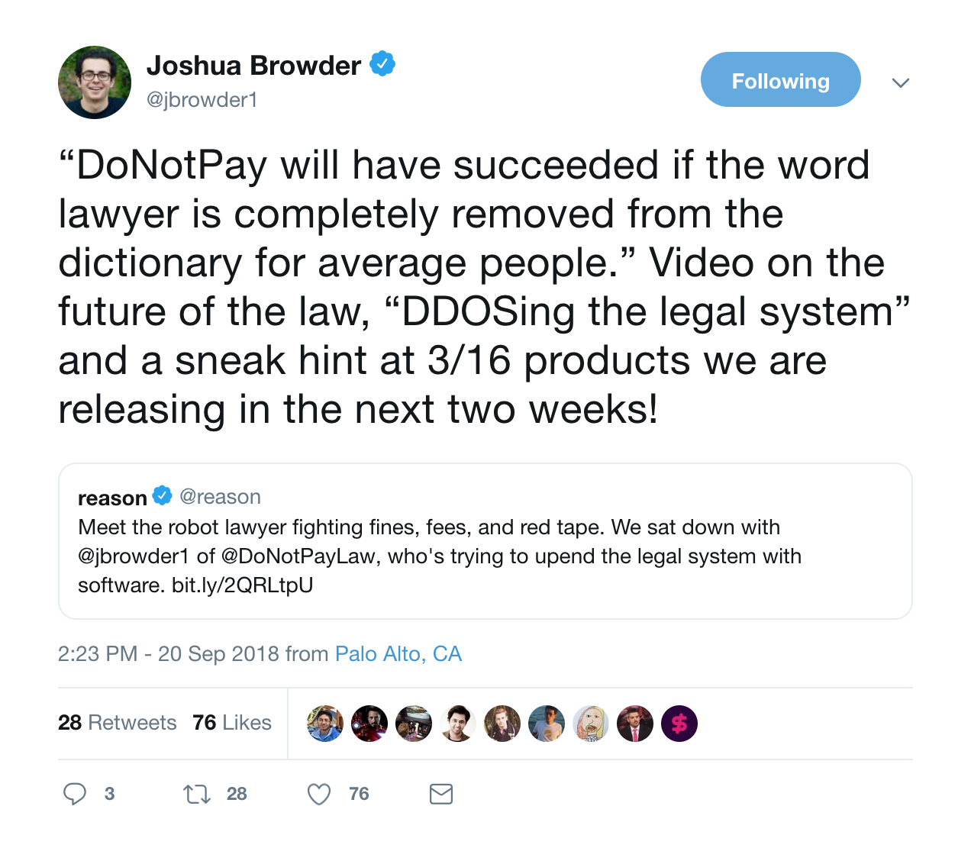
Hacking the legal system

Slide 23
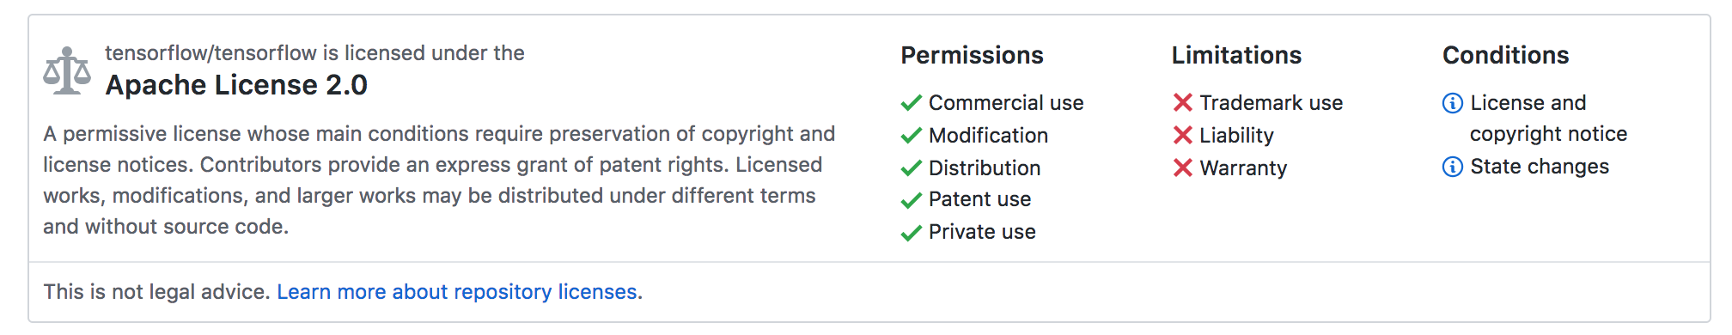
Open Sourcing Legal Advice

Slide 24
Workaround
Corp A: Legal-tech
Corp B:
Host
Open Source
Legal Advice Generator
Liability
Warranty
Compliance
Open Source Legal Advice Generator
Hosting Service

Slide 25
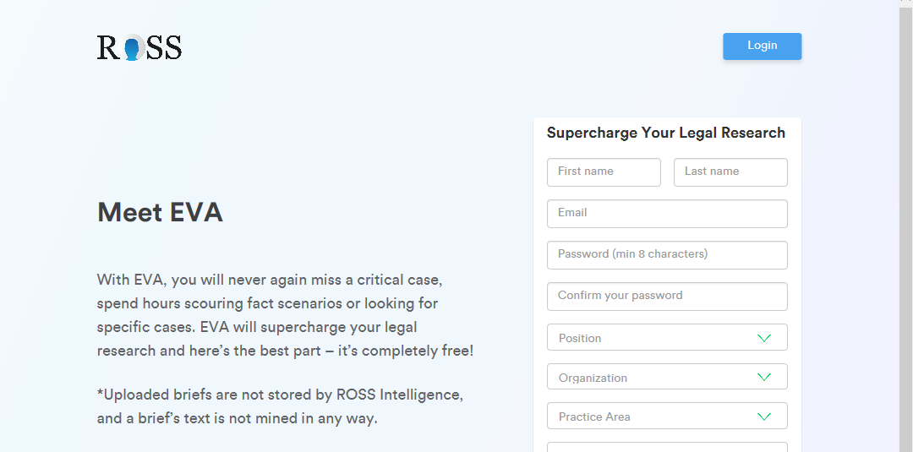
Example Tools:
Ross -

Slide 26
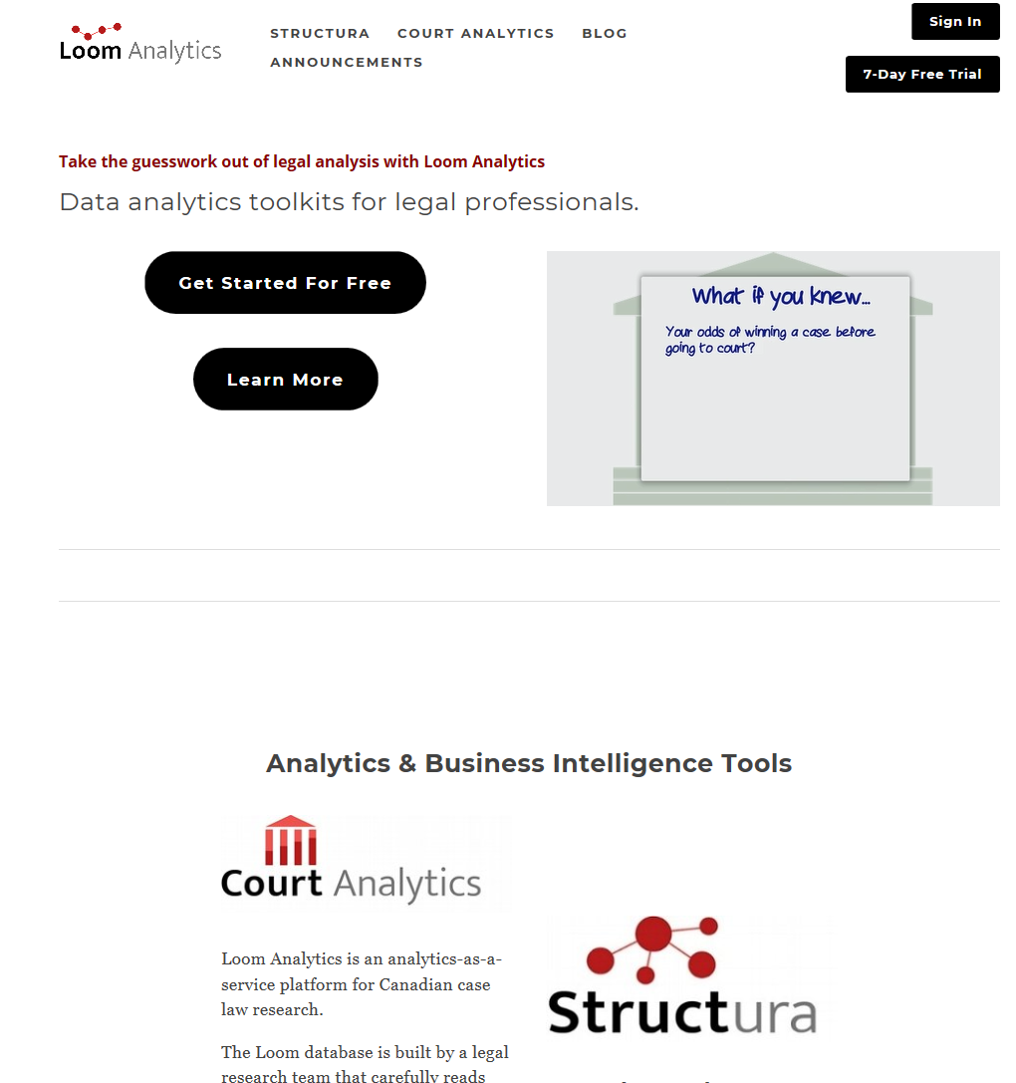
Example Tools:

Slide 27
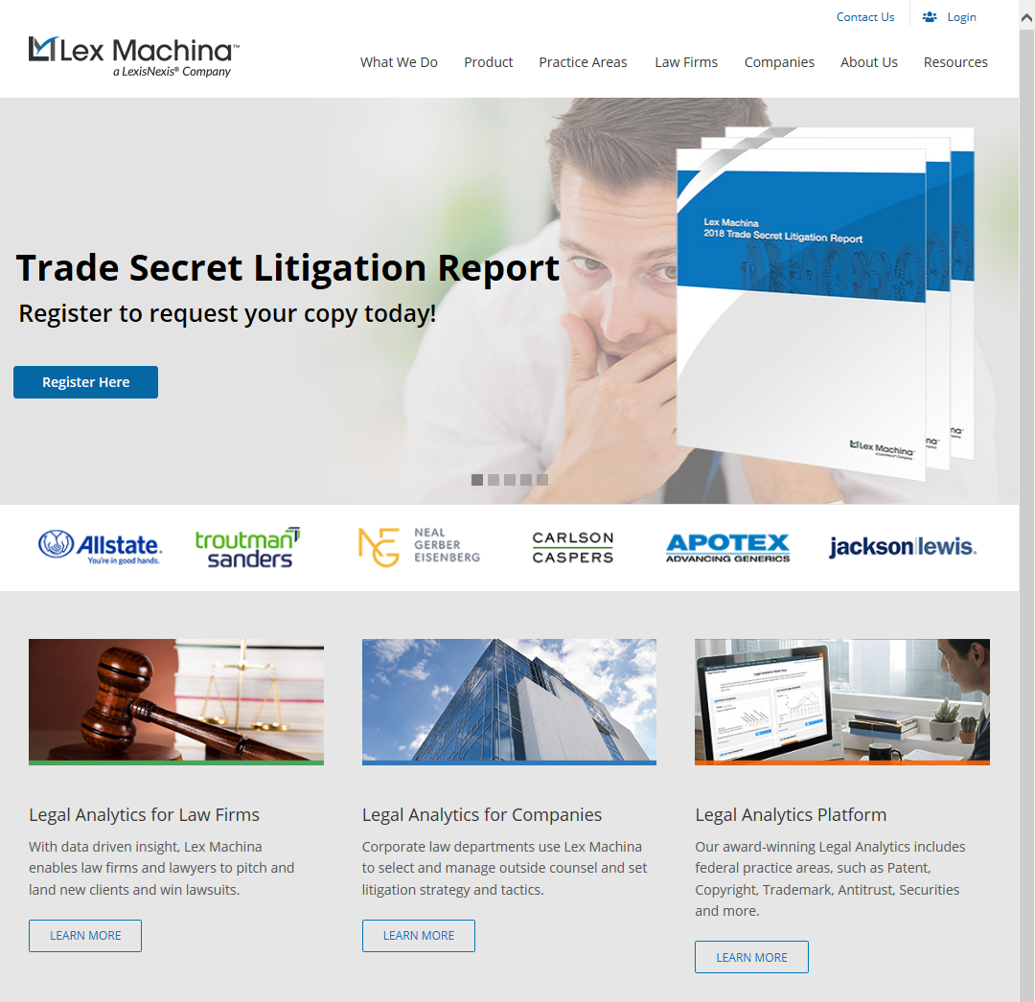
Example Tools:

Slide 28
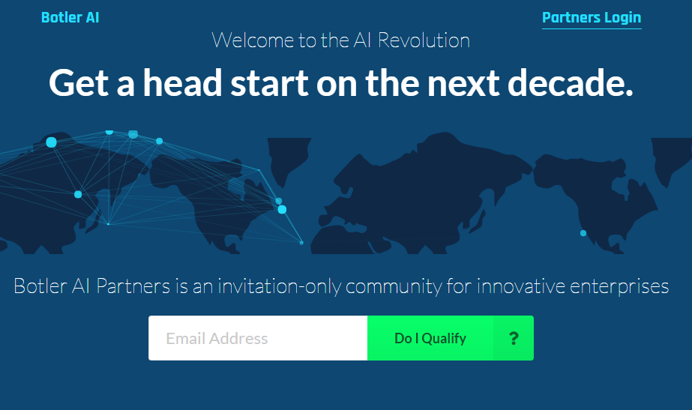
Example Tools:

Slide 29

LSO Rules of Professional Conduct
Using AI bears on competence…
How many of these can be assisted through AI?
Which of these are indirectly helped by AI?
Which involve judgement beyond the capacity of an AI (in the near term, anyway)?
"competent lawyer" means a lawyer who has and applies relevant knowledge, skills and attributes in a manner appropriate to each matter undertaken on behalf of a client including:
(a) knowing general legal principles and procedures and the substantive law and procedure for the areas of law in which the lawyer practises,
(b) investigating facts, identifying issues, ascertaining client objectives, considering possible options, and developing and advising the client on appropriate courses of action,
(c) implementing, as each matter requires, the chosen course of action through the application of appropriate skills, including;
(i) legal research
(ii) analysis,
(iii) application of the law to the relevant facts,
(iv) writing and drafting,
(v) negotiation,
(vi) alternative dispute resolution,
(vii) advocacy, and
(viii) problem-solving,

Slide 30
LSO Rules of Professional Conduct
How many of these can be assisted through AI?
Which of these are indirectly helped by AI?
Which involve judgement beyond the capacity of an AI (in the near term, anyway)?
(d) communicating at all relevant stages of a matter in a timely and effective manner;
(e) performing all functions conscientiously, diligently, and in a timely and cost- effective manner;
(f) applying intellectual capacity, judgment, and deliberation to all functions;
(g) complying in letter and in spirit with all requirements pursuant to the Law Society Act;
(h) recognizing limitations in one's ability to handle a matter or some aspect of it, and taking steps accordingly to ensure the client is appropriately served;
(i) managing one's practice effectively;
(j) pursuing appropriate professional development to maintain and enhance legal knowledge and skills; and
(k) otherwise adapting to changing professional requirements, standards, techniques, and practices.

Slide 31
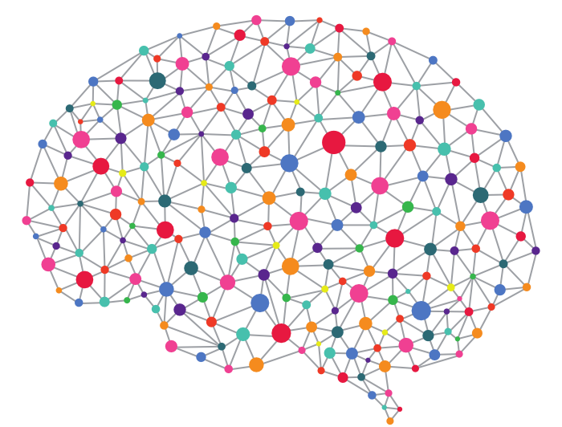
LSO Guidelines on Technology
https://www.lsuc.on.ca/For-Lawyers/Manage-Your-Practice/Technology/Technology-Practice-Management-Guideline/
Lawyer should support client service expectations and practice management
Lawyer must address concerns respecting security, disaster management and technological obsolescence.
The point is made: you are expected to be up to date!
https://www.lsuc.on.ca/For-Lawyers/Manage-Your-Practice/Technology/Technology-Practice-Management-Guideline/

Slide 32
LSO Guidelines on Technology
5.3 Systems to Support Client Service
Lawyers should consider the use of information technologies to enable them to perform all client service functions conscientiously, diligently, and in a timely and cost-effective manner. [Rule 3.1-1(e) and Rule 3.1-2 of the Rules of Professional Conduct]
Lawyers may wish to consider the use of the following information technologies:
5.3.1 Electronic Legal Research Methods
Lawyers should consider whether their legal research skills include and make use of online legal research tools (e.g., CanLII or Quicklaw) [Rule 3.1-1(c)(i) of the Rules of Professional Conduct].
5.3.2 Electronic Document Management Systems or Services
Lawyers should consider the use of electronic document management systems such as
case management or litigation support software for litigation matters
document assembly software to create legal forms and documents.
https://www.lsuc.on.ca/For-Lawyers/Manage-Your-Practice/Technology/Technology-Practice-Management-Guideline/

Slide 33
LSO Guidelines on Technology
5.3.3 Analysis Support Software
Lawyers should consider the use of information technologies that support their analytical skills and functions including spreadsheet software where appropriate. [Rule 3.1-1(c)(ii) of the Rules of Professional Conduct]
5.3.4 Productivity Software
Lawyers should consider the use of electronic productivity software suite or voice recognition software to ensure that writing and drafting is accomplished in a timely and cost-effective manner (eg, Word, Word Perfect, and Google Docs) [Rule 3.1-1(e) and Rule 3.1-2 of the Rules of Professional Conduct].
https://www.lsuc.on.ca/For-Lawyers/Manage-Your-Practice/Technology/Technology-Practice-Management-Guideline/

