Slide 1
2018 CAN-TECH Law Annual Copyright Update
Catherine Lovrics, Bereskin & Parr LLP
October 29, 2018

Slide 2
Online infringement & reverse class actions

Slide 3
Rogers v. Voltage
Voltage initiates what is often referred to as a “reverse” class action
Claimed approx. 55,000 alleged infringers
Launched suit against a Rogers customer as John/Jane Doe defendant
Norwich order granted by Federal Court requiring Rogers to identify
Rogers claimed fees of $100/hour to identify customer from records
Voltage appealed, claimed no fee, points to part of notice and notice regime under the Copyright Act stipulating no fees unless set by regs.
FCA agreed with Voltage
SCC agrees with Rogers (Sept 14 2018, allowed appeal)
ISPs may charge reasonable fee for identifying customers to copyright owners pursuant to a Norwich order
Identification outside scope of statutory obligations of ISPs under ss. 41.25 and 41.26 of Copyright Act (aka notice and notice regime)
What is reasonable costs? TBD by trial judge on evidence from ISPs
Rogers had claimed $100/hour plus HST

Slide 4
The trend …
Numerous claims proceeded prior to SCC decision
Using simplified procedure, claiming against hundreds of defendants at once
Stats:
At least 13 separate court files
1401 defendants
$650 in court fees for plaintiff to file ($50 per)
27 discontinuances, 28 consent judgments, and 50 John/Jane Doe defendants defending
Remaining 1296 claims… ?
All defendants’ identities confidential

Slide 5
Statutory damages for non-commercial infringement
38.1 (1) Subject to this section, a copyright owner may elect, at any time before final judgment is rendered, to recover, instead of damages and profits referred to in subsection 35(1), an award of statutory damages for which any one infringer is liable individually, or for which any two or more infringers are liable jointly and severally,
(b) in a sum of not less than $100 and not more than $5,000 that the court considers just, with respect to all infringements involved in the proceedings for all works or other subject-matter, if the infringements are for non-commercial purposes.

Slide 6
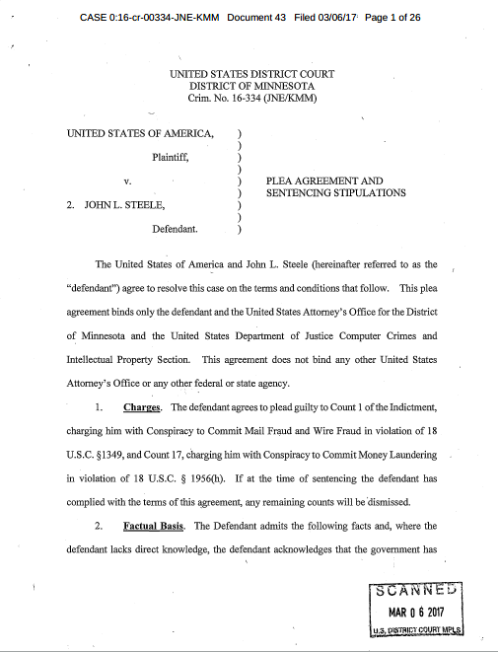
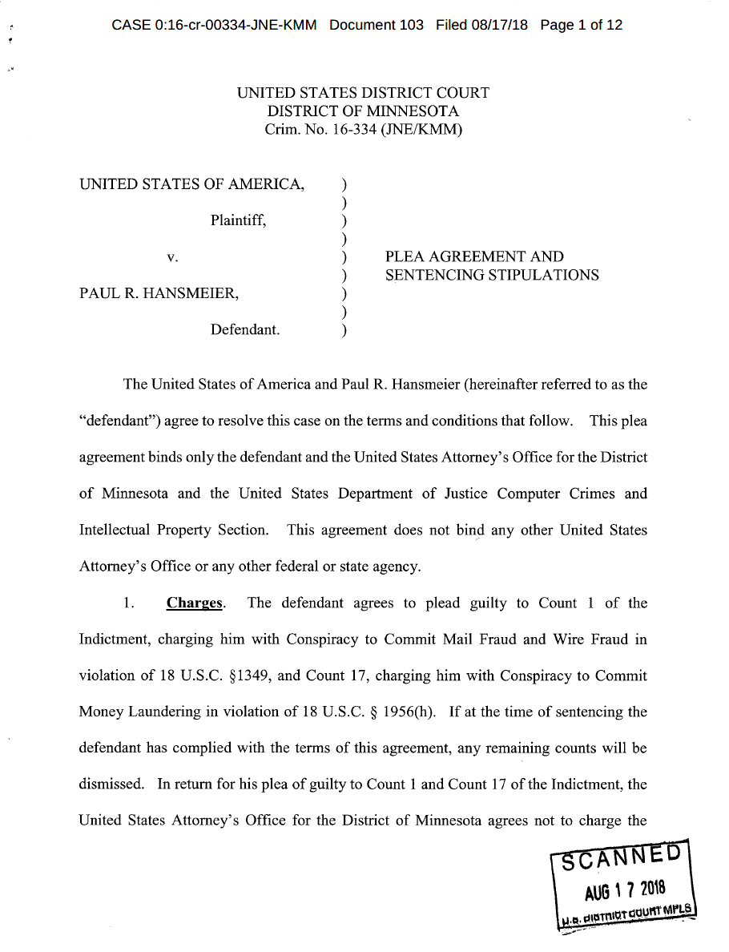

Porn-trolling and Prenda Law
+$3million in fraudulent proceeds
Filmed their own porn and uploaded to file-sharing websites to catch downloaders
Obscured their involvement in the lawsuits and created Prenda Law
Concealed their actions from courts
False hacking allegations by ‘defendants’ to seek discovery of ‘co-conspirators
Money laundering

Slide 7
Strike 3 Holding LLC v. John Doe
… to be clear to the Court, Plaintiff must address the elephant in the room, and that elephant’s name is Prenda. That was a big, dumb, malicious animal from years ago that unfortunately now poses the risk of trampling the rights of all the legitimate content creators, such as Plaintiff, who have been forced to seek court intervention to address the tidal wave of internet infringement that puts content creators at risk of drowning in a sea of theft.
The Court should rest assured: Plaintiff and its counsel are the anti-Prenda. Plaintiff is a legitimate producer, creator and owner of its own content – it does not acquire old films for the purpose of seeding the internet to entice infringement and then sue people. Plaintiff does not have a litigation business model, its main source of income is the sale/licensing of its content. Plaintiff does not ever make any contact with Doe Defendants (unless initiated by them or their counsel – and, under this Court’s Order, Plaintiff does not communicate with Does at all in these matters). Plaintiff does not threaten to “out” defendants for their content choices and always will agree to protective orders maintaining anonymity if requested. Plaintiff is represented by anational law firm with an expertise in intellectual property. Plaintiff carefully, ethically and at great expense and effort does one thing: it brings actions against people who appear clearly to be rampantly stealing Plaintiff’s content. Under appropriate circumstances and based on extensive investigation, Plaintiff will dismiss, settle or litigate, based on the facts of each case. That is precisely what it has done in all the Seattle Strike 3 Cases and Plaintiff has acted whollyproper in that pursuit.

Slide 8
Defence strategies
attack title
attack IP address not amounting to proof the named defendant downloaded
No source IP address validation by P2P platform?
Evidence of platform injecting random IP addresses in swarm lists?
Routers left unsecured?
Passwords shared with family members, housemates, guests, neighbours?
Passwords cracked or compromised?
Backdoors and malware?
don’t wipe hard drives!
attack the file-sharing evidence – e.g. no evidence of substantial taking
admit infringement, but attack the statutory damage claim as disproportionate to the infringement

Slide 9


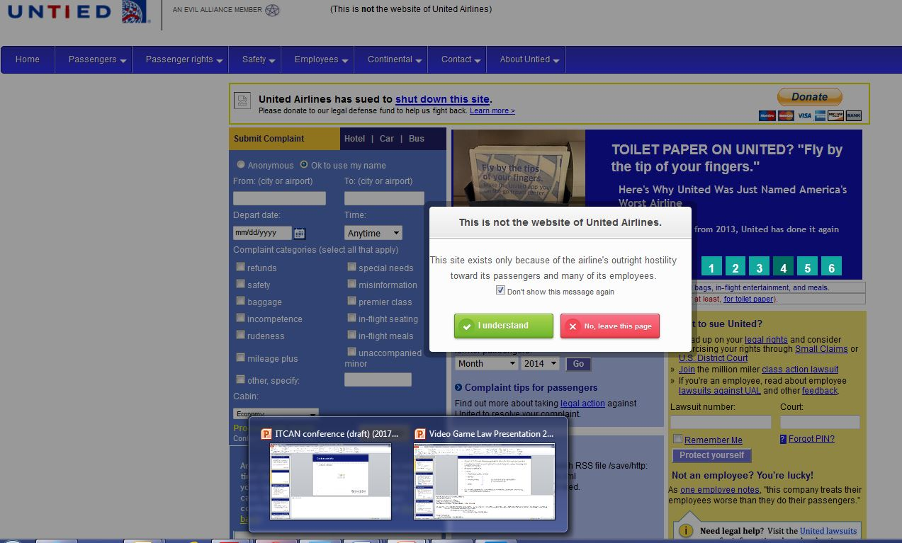
Use of © protected logos by consumer criticism & review sites

Slide 10


United Airlines, Inc. v. Jeremy Cooperstock, 2017 FC 616
gripe site at untied.com about United Airlines
similar ‘look and feel’ to United’s website
United’s globe logo with “IT” inversed and a frown-face
disclaimer (but some technical issues)

Slide 11
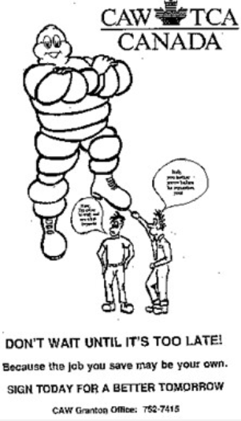
Not ‘fair dealing’ with copyright in logo and website
“[P]arody must include some element of humour or mockery – if extended too far, what may be designed in jest as parody may simply become defamatory.”
United, para 124
“Parody” may be unfair if purpose is to disparage, embarrass or punish
step 1: purpose of dealing for parody
the evocation of an existing work while exhibiting notable differences
the expression of mockery or humour
step 2: fair in all the circumstances
if too biting/effective, might not be fair

Slide 12





Heightened risk of IP infringement based on current law?
Use of (altered) logos
Similar look and feel of websites
Use of domain names/meta tags that contain marks and don’t differentiate
No, inconspicuous, or inconsistent disclaimer

Slide 13
Confusing
I would note that it is questionable whether the parody exception may successfully be invoked when there is confusion. Parody depends on the recipient or viewer recognizing that the work in question is a spoof – therefore, it will be difficult to establish that the true purpose of a given work is parody when it is confusingly similar to the original work.
Defendant: “you’d have to be somebody who is, you know, cognitively challenged… to believe that they’re actually complaining to the airline” through UNTIED.com.
Court: “[T]his was clearly not the case: the evidence of Ms. Proietti and of the complaints submitted to UNTIED.com showed that visitors to UNTIED.com were or were likely to be confused as to the source of the website that they were visiting and the services offered through that website. Further, the pop-up dialogue box disclaimer was flawed in that it could be disabled and it was not always functional – Ms. Proietti indicated that she did not see a pop-up dialogue box when she visited the website. If the “Do not show this message again” box is selected then subsequent visitors to UNTIED.com from the same computer will not see the pop-up dialogue, and this box has been pre-selected at certain points in time.”

Slide 14




Not confusing (pre-1999)
Not confusing (1999 to 2007)

Slide 15
Consistent, conspicuous disclaimer now required?
A disclaimer does not automatically nullify a misleading impression created by an ad. Its effect will depend on several factors, including the degree to which a representation misleads the public without the disclaimer, the prominence which it is given in the context of the entire advertisement, the degree of sophistication that the public to whom the advertisement is directed exhibits, and the likelihood that the audience would recognize the disclaimer. It is a question of fact whether, in the circumstances, a disclaimer is sufficient to ensure that the representation is not otherwise misleading.
Purolator v. United Parcel
[When a] disclaimer “makes it clear that the website has nothing to do with the plaintiff or any of its affiliated entities so the prospect of the plaintiff successfully establishing that there is a passing off here appears remote.
Bell v. Tedmonds

Slide 16
Consumer criticism & review
Consumers may express their frustration or disappointment with a product or service. Their freedom of expression in this respect is not limited to private communications intended solely for the vendor or supplier of the service. Consumers may share their concerns, worries or even anger with other consumers and try to warn them against the practices of a business. Given the tremendous importance of economic activity in our society, a consumer’s “counter-advertising” assists in circulating information and protecting the interests of society just as much as does advertising or certain forms of political expression. This type of communication may be of considerable social importance, even beyond the merely commercial sphere.
R. v. Guignard, para 23 (SCC)

Slide 17
Consumer expression using IP (private property)
The Charter does not confer the right to use private property – the Plaintiff’s copyright – in the service of freedom of expression.
I hold that a person using the private property of another like a copyright, must demonstrate that his or her use of the property is compatible with the function of the property before the Court can deem the use a protected form of expression under the Charter.
In the present case, subjecting the Plaintiff's "Bibendum" to ridicule as the object of parody is not compatible with the function of the copyright. A "Bibendum" about to stomp hapless workers into submission does not present the original author's intent of a favourable corporate image or provide an incentive for compensating artists for the integrity of their vision.
In the balance of interests and rights, if the Defendants have no right to use the Plaintiff's "Bibendum", they have a multitude of other means for expressing their views. However, if the Plaintiff loses its right to control the use of its copyright, there is little left to the Plaintiff's right of private property. The Defendants seek to extend the scope of their right of free expression to include the use of another's property.
Michelin (FCTD)

Slide 18
The limited nature of IP rights
The proper balance among these and other public policy objectives lies not only in recognizing the creator’s rights but in giving due weight to their limited nature.
Theberge, para 31 (SCC)
The Copyright Act strikes a careful balance between promoting the public interest in the encouragement and dissemination of creative works and obtaining a just reward for creators. To tilt the balance too far towards protection of creators’ rights would undermine the right of users to access and work with creative materials. To tilt it too far towards access, on the other hand, would fail to provide a just reward to creators, leading authors and their supporters to under-invest in producing and distributing their works. At both ends of the spectrum, the public loses some of the benefit of creative works.
SODRAC, para 145 (SCC)

Slide 19
Crown copyright

Slide 20
Crown copyright - Keatley v. Teranet
Without prejudice to any rights or privileges of the Crown, where any work is, or has been, prepared or published by or under the direction or control of Her Majesty or any government department, the copyright in the work shall, subject to any agreement with the author, belong to Her Majesty and in that case shall continue for the remainder of the calendar year of the first publication of the work and for a period of fifty years following the end of that calendar year.

Slide 21
Published under gov’t direction and control
[O]ne must consider the nature of the “rights” in the property held by the Crown when the Crown publishes the property (when the Crown makes copies available). In my view, the more extensive those rights, and the more rights associated with copyright are in the Crown’s hands, the stronger the inference that the publishing occurs under the “direction or control” of the Crown. (at para 33)
Statutory provisions giving the Crown exclusive custody and control over the registered or deposited plan
Strict requirements & control re: form and content & broad authority to audit and require changes for compliance
Exclusive power to alter the document & without the knowledge/approval of surveyor
Exclusive authority to reproduce registered/deposited plans

Slide 22
Data & database protection

Slide 23
Databases - originality
The Tribunal considered a number of criteria relevant to the determination of originality. Those included the process of data entry and its “almost instantaneous” appearance in the database. It found that "“TREB’s specific compilation of data from real estate listings amounts to a mechanical exercise”. We find, on these facts, that the originality threshold was not met.
In addition, we do not find persuasive the evidence that TREB has put forward relating to the use of the database. How a “work” is used casts little light on the question of originality. In addition, we agree with the Tribunal’s finding that while "“TREB’s contracts with third parties refer to its copyright, […] that does not amount to proving the degree of skill, judgment or labour needed to show originality and to satisfy the copyright requirements”“
TREB v. Commissioner of Competition, 2017 FCA 236
SCC denied leave

Slide 24
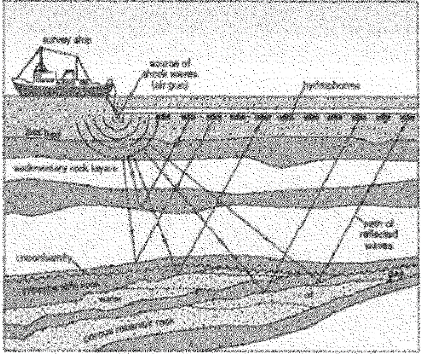
Data – originality and idea vs. expression
The [contributions] appear to fall into the category of ideas, methods, procedures, algorithms or other categories of contributions which, while perhaps valuable, fall outside the type of intellectual effort protected by copyright law …
Andrews v. McHale 2016 FC 624 at para 88
Raw & processed data found to result from skill & judgment and be protected by ©
The raw data is not simply pumped into a computer and a useful product comes out.
Geophysical Service Inc. v. Encana 2016 ABQB 230 at para 83

Slide 25
Data – originality and idea vs. expression
[C]opyright extends to the expression of an idea, i.e. the work, not the idea or facts contained therein. I differ from them in finding that the seismic data is an expression of GSI’s views of what the image of the subsurface of the surveyed areas represents. The creation is obtained by a series of sounds emanating from the subsurface that have been collected, selected and arranged in a very particular fashion and stored on various media. The facts themselves, the rocks, are still at the bottom of the sea available for anyone else to survey.
Alternatively, if one says that an individual ping of sound is a “fact” then these too can be obtained by someone else who wants to go to the same location and bounce sound waves off the bottom of the sea (although it is unlikely that the new person would get exactly the same sound for the reasons discussed above). The tapes of the collections of sounds are no different from a negative of a photograph or the tape recording of a symphony. It is the compilation that makes them a protected work. The Copyright Act does not require a “preconceived” idea to protect its expression.
Geophysical Service Inc. v. Encana 2016 ABQB 230 at para 87-88

Slide 26
Databases, algorithms – originality and idea vs. expression
Andrews v. McHale, citing Cyprotex Discovery Limited v the University of Sheffield [2003] EWHC 760 (TCC), aff’d [2004] EWCA Civ 380 [Cyprotex], a decision of the Court of Justice, Queen’s Bench Division, Technology and Construction Court. Commenting on the particular type of skill and labour protected by copyright law, the Court stated as follows at paragraph 78:
78. … What is protected is the skill and labour involved in the artistic or technical endeavour involved in creating that work. Thus, copyright protection is concerned with the process of the creation of a work and not with the ideas going into it nor with the functionality or end-product that results. In computer programming, therefore, what is capable of protection are the codes that are written by the programmer including the design and structure of the program.
In that case, the defendant contended that the computer program that was the subject of the dispute was the product of joint authorship by it and the plaintiff, in that a member of the defendant’s team had made contributions including devising algorithms and data bases that were provided to the plaintiff and providing detailed consideration as to what the program should contain and what its parameters should be. Following Fylde, the Court held at paragraph 84 that these contributions were not the work of an author.

Slide 27
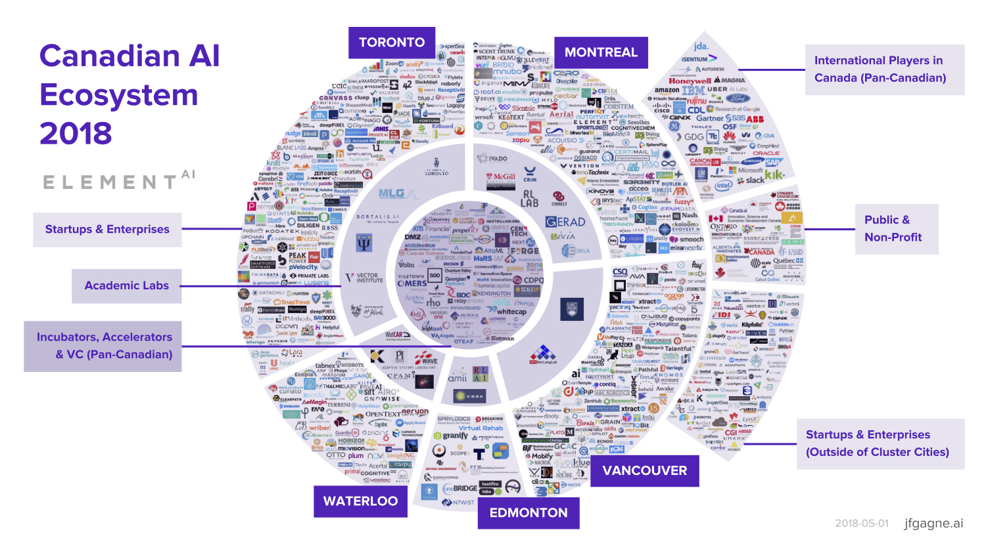
A(I) Million Monkeys Challenging ©?
Infographic courtesy of Element AI (JF Gagné)

Slide 28
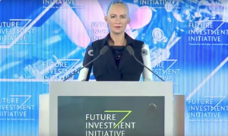


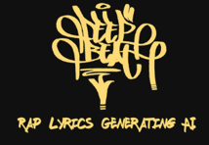


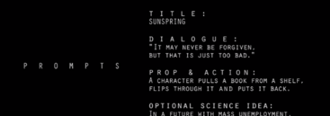

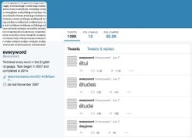
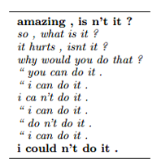

Death of the author and rise of the machines?
1. Copyright in code, data & databases
2. Clearance issues re: data, text & other AI inputs
3. Copyright in AI outputs (i.e. works created using AI

Slide 29
More questions than answers … for now:
Clear inputs … and outputs
Consider protecting as confidential information or trade secret
Use TPMs and terms of use to control access and copying
Keep AI infusion to creation of works limited
Aim for an element of human authorship before publication/dissemination of the work
When using AI applications in creation, monitoring and enforcement
Review terms of use – e.g. risk allocation and liability, as well as IP ownership
Importance of human review, clearance and moderation

Slide 30

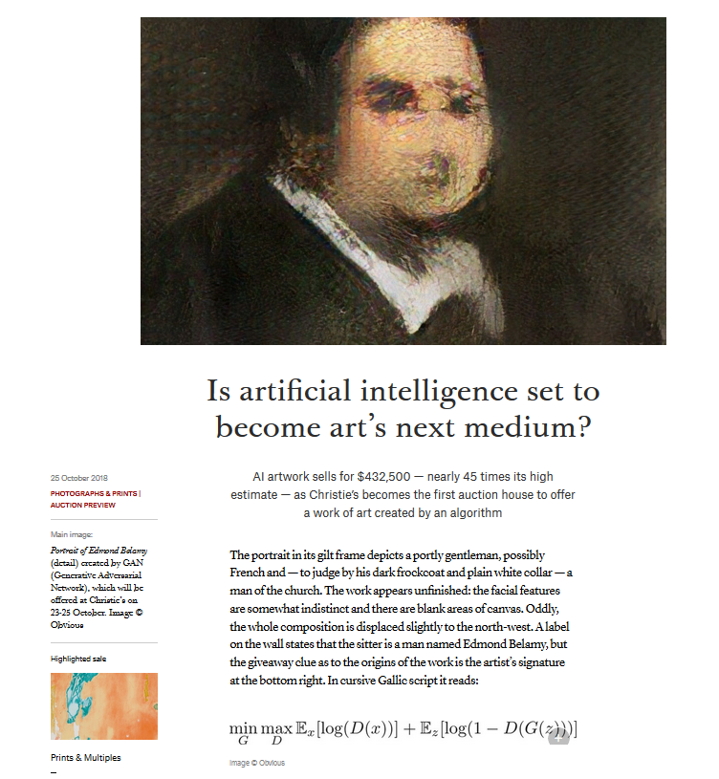
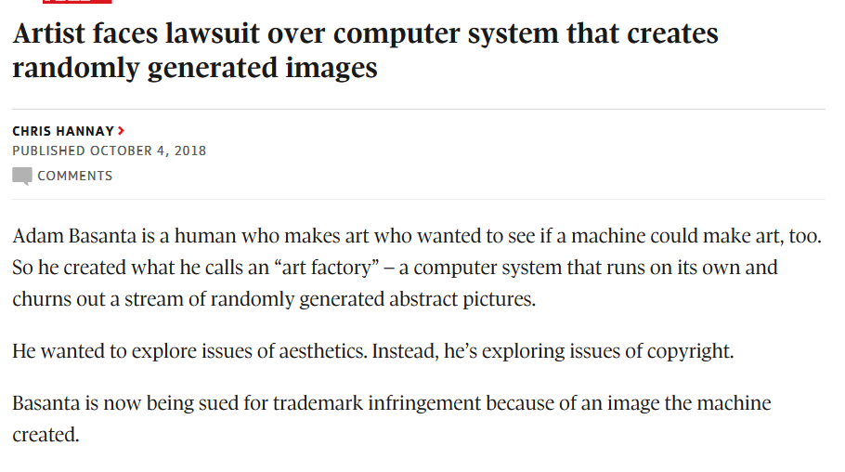

Slide 31
Blockchain & ©

Slide 32







Blockchain applications in the © world

Slide 33
Legislative changes?
Copyright Act Review & USMCA

Slide 34
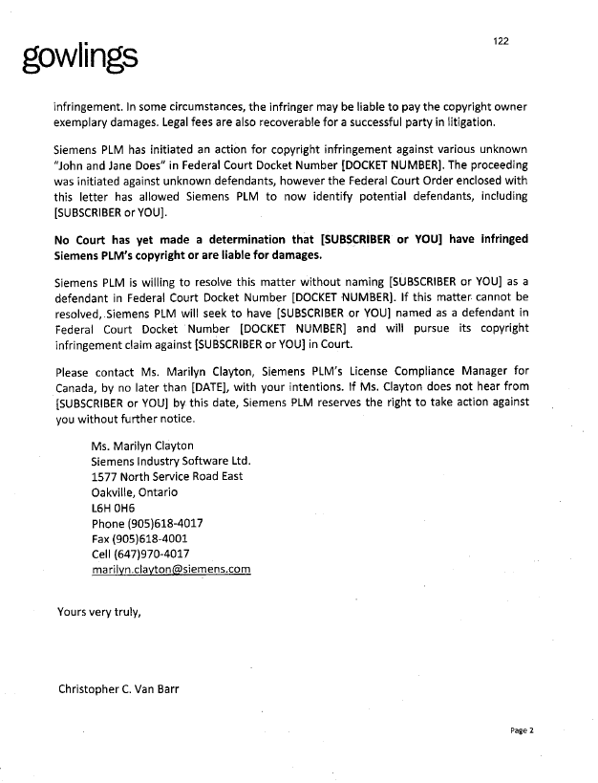
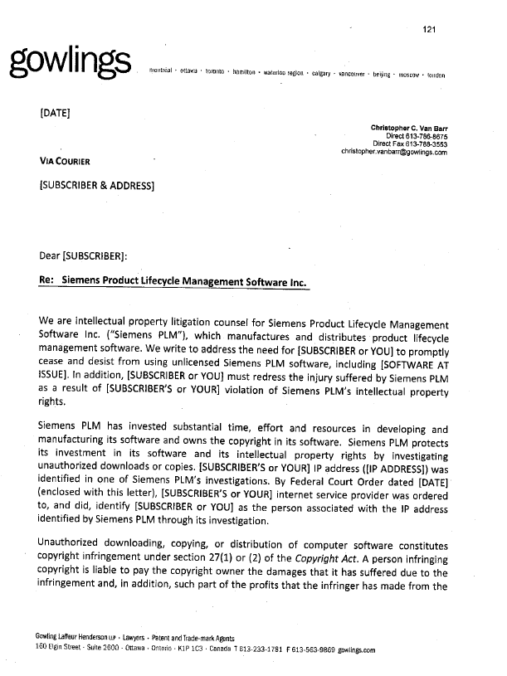
© Act Review – witnesses before INDU
Several submissions to push for regulation re: form and content of notices to prevent improper information and demands in notice
E.g. ISPs recommended the government prescribe content of notices so only prescribed information can be contained
→ minimally no settlement demands

Slide 35
© term extension to life + 70
Article 20.H.7: Term of Protection for Copyright and Related Rights
Each Party shall provide that in cases in which the term of protection of a work, performance or phonogram is to be calculated:
(a) on the basis of the life of a natural person, the term shall be not less than the life of the author and 70 years after the author’s death; and
(b) on a basis other than the life of a natural person, the term shall be:
(i) not less than 75 years from the end of the calendar year of the first authorized publication of the work, performance or phonogram; or
(ii) failing such authorized publication within 25 years from the creation of the work, performance or phonogram, not less than 70 years from the end of the calendar year of the creation of the work, performance or phonogram.

Slide 36
Platform liability (cont’d)
information content provider means any person or entity that creates or develops, in whole or in part, information provided through the Internet or any other interactive computer service
interactive computer service means any system or service that provides or enables electronic access by multiple users to a computer server

Slide 37
Change to platform liability (non-IP)
Article 19.17: Interactive Computer Services
[N]o Party shall adopt or maintain measures that treat a supplier or user of an interactive computer service as an information content provider in determining liability for harms related to information stored, processed, transmitted, distributed, or made available by the service, except to the extent the supplier or user has, in whole or in part, created, or developed the information
No liability for restricting access to or availability of material considered harmful/objectionable
Doesn’t apply to IP measures (including re: liability for IP infringement)
Doesn’t enlarge or diminish ability to protect/enforce an IP right

Slide 38
US Communications Decency Act, s. 230
No provider or user of an interactive computer service shall be treated as the publisher or speaker of any information provided by another information content provider.

Slide 39
Catherine Lovrics, Partner, Bereskin & Parr LLP
October 29, 2018

