Slide 1
Challenges in Implementing IT Solutions for Health Care
October 20, 2016
Confidential

Slide 2
Role of IT Solutions in Health Care
Current Context
Disconnected
Costly
Main Health Care Issues
Role of IT Solutions
The example of ePrescribing
How it helps
Challenges
Information for Life

Slide 3








Disconnected
Physicians
Nurses
Allied care providers
Pharmacists
Insurers
Hospitals
Home care organizations
Patients and Consumers
Connections are in silos and are manual

Slide 4
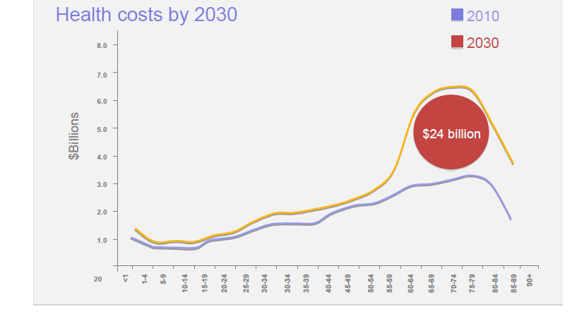
Costly

Slide 5
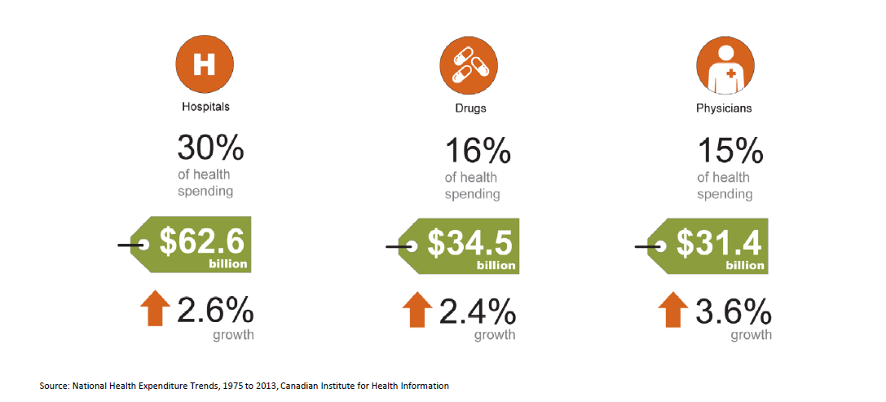
Costly

Slide 6
Costly
“Gentlemen, we have run out of money. It's time to start thinking.”
― Ernest Rutherford, 1871-1937
(As quoted by Ontario Health Minister Deb Matthews in January 2014)

Slide 7
Main Health Care Issues
5 key issues where health IT can contribute
Chronic Disease Management increasing prevalence
(Telehealth)
Medication errors and compliance
(EMRs and ePrescribing, PHRs, eRenewals)
Need for improvement in performance to address cost challenge
(Data Analytics, EHRs)
Long wait times, poor access to care and lack of continuity of care
(Telehealth, PHRs, Patient Portals, EHR)
Lack of focus on prevention and patient self-management
(Wellness
PHRs)

Slide 8
Role of IT Solutions
Physicians
Allied care providers
Nurses
Hospitals
Patients and Consumers
Pharmacists
Home care organizations
Connections

Slide 9
The value of ePrescribing is clear but Canada has been slow to adopt
2007: “Health Canada has decided that legislative and regulatory amendments are not necessary… A major impediment to e-prescribing has been removed”
Federal law no longer a roadblock to e-prescribing. Canadian Pharmacists Journal. July/August 2007.
2009: ePrescribing is expected to “improve patient safety and quality of care by reducing prescription errors”
eHealth Ontario Press Release: Canada’s First ePrescribing Program Launches in Ontario. May 12, 2009.
2011: “Efforts to ensure doctors can transfer prescriptions to pharmacists electronically are long overdue”
Value of e-prescribing questioned. Canadian Medical Association Journal October 4, 2011
2012: “The CMA and the CPHA have identified e-prescribing as a key tool to deliver better value to patients… By 2015, e-prescribing will be the means by which prescriptions are generated for Canadians”
Canadian Medical Association and Canada Pharmacists Association: e-Prescribing Joint Statement December 2012.

Slide 10
What is ePrescribing?
Full electronic prescribing (ePrescribing) is defined as the electronic generation, authorization and transmission of dispensing directions for a drug or mixture of drugs from a prescriber to a pharmacy.
ePrescribing does not include prescriptions that are digitally generated, but then printed by physicians to be manually delivered to pharmacists by patients.
eRx Exchange
Prescriber
Pharmacists

Slide 11



ePrescribing offers significant clinical, productivity and cost savings benefits
Patient | Prescriber | Pharmacist
Improve medication adherence (eRx was shown to decrease non-adherence from 30% to 20% in the US*) Reduce wait times at the pharmacy Eliminate unnecessary back and forth with the physician if the prescription is misplaced | Improve quality of care by eliminating medication errors caused by illegible, hand-written prescriptions Reduce follow up visits by patients who lose their prescription Reduce resource-intensive phone / fax communication to the pharmacy | Increase first-fill thereby improving customer experience Smooth workload by enabling prescriptions to be filled before the patient arrives Reduce time spent keypunching prescriptions Reduce resource- intensive phone / fax communication to the physician
*evidence from Surescripts

Slide 12
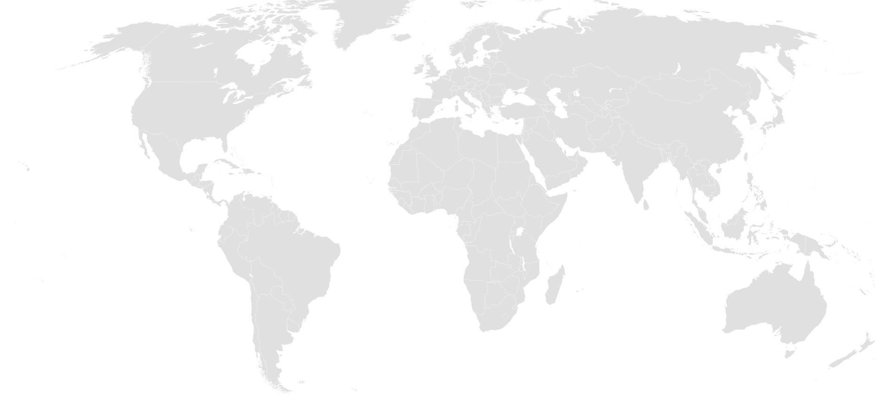



ePrescribing has been implemented in many countries around the world, using different transmission models
United States
United Kingdom
Australia
ePrescribing workflow
Push model
MD sends eRx from EHR to patient’s preferred pharmacy where pharmacy receives eRx in PMS
Other ePrescribing related services available
Electronic renewals
Cancel requests
Fill status notifications
Drug formulary/benefits check
Medication history
Electronic prior authorizations
ePrescribing workflow
Push/Pull model
Patient informs MD of preferred pharmacy. MD adds nomination and sends eRx to National Health Service
Pharmacy pulls eRx down (at pre-determined intervals throughout the day) and prepares rx for patient
Other ePrescribing related services available
Fill status notifications
Cancel requests
ePrescribing workflow
Pull model
MD sees patient and prints a paper rx with barcode and sends eRx to secure exchange
Patient takes paper rx to the pharmacy. Pharmacy scans barcode and “pulls” the eRx down from secure exchange to prepare for patient
Other ePrescribing related services available
Fill status notifications

Slide 13
Why Not Canada?
Failed Attempts
Canada’s approach to automated medication management activities has focused on the development and implementation of provincial drug information systems (DIS)
Several provinces have tried to implement ePrescribing in the DIS using a ‘pull’ model where pharmacists pull prescription information from the DIS when the patient presents in the pharmacy with a paper-based prescription
EMRs upload prescription information to the DIS repository
Adoption of ePrescribing using a pull model has been very limited due to workflow inefficiencies for both prescribers and pharmacists
Regulatory Challenges
Need to obtain support from multiple stakeholders: Ministries of Health, Colleges of Pharmacists and Physicians and Surgeons, Medical and Pharmaceutical Associations
Regulatory approval process varies from province to province

Slide 14
Current provincial regulations differ on their permissions and requirements for electronic prescribing
Prov. | Requirements
BC | Pharmaceutical Services Act - Section 27 (6) - “A practitioner may issue electronically a prescription for a drug, device, substance or related service, but only through prescribed information management technology.” The only prescribed interface is PharmaNet.
AB | Alberta College of Pharmacists state that “… until requirements for securing patient confidentiality, verifying authenticity, and preventing diversion are defined, e-prescribing is not acceptable.”
ON | College of Physicians and Surgeons of Ontario Policy on Prescribing Drugs states that “a prescriber can authorize a prescription verbally, with a signature, or electronically.” Furthermore, digital signatures are deemed acceptable by the Ontario College of Pharmacists (OCP)
SK | SK College of Pharmacists Bylaws and standards governing pharmacy practice, state the electronic transmission of a prescription for any drug is equivalent to the written format and is acceptable
MB | Electronic prescriptions must contain an electronic image of prescriber’s signature and all electronic prescriptions must be entered into Drug Programs Information Network (DPIN)
NS | Electronic prescriptions allowed only when the prescription is transmitted through the Nova Scotia Drug Information System (DIS), however until Stream 2 of the DIS is implemented all e-prescriptions are “non-authoritative” and require a paper copy
NL | The NL Pharmacy Board states that electronic signatures on prescriptions are not currently acceptable because “requirements for securing patient confidentiality, verifying authenticity, and preventing diversion have not been defined.”
PEI | PEI Pharmacy Act does not specify electronic transfer as a valid means of transmitting a prescription and there is a requirement to initial a prescription upon receipt at the pharmacy
NB | Electronic transmission of prescriptions permitted by the Regulations of the New Brunswick College of Pharmacists

