Slide 1
The Innovation Supercluster Initiative
$1B federal government funding over 5 years
5 collaborative and industry-led superclusters
Based on technology leadership, new approach to collaboration
Aimed at developing ecosystem and drive economic output
~60 applications received, final selection of the 5 in Feb. 2018
Supercluster | Key sectors
Digital Technology Supercluster | Telecom, ICT
Protein Innovations | Agri-food
Next Generation Manufacturing | Manufacturing
SCALE AI AI-powered Supply Chains Supercluster | Retail, Manufacturing, Transport, AI
Ocean Supercluster | Fisheries, Oil & Gas, Energy
1
2
3
1
2
4
5
4
3
5

Slide 2
SCALE AI's strategy and what success will look like
Bring our successes in AI from the lab to the field
Adoption enablement
Commercialization enhancement
Empower Canada as a global hub for intelligent supply chains
Business solutions
Technology landscape
Establish a new way to collaborate on leading-edge tech
Build the next-generation supply chain
Deliver competitive advantage across industrial sectors
Grow the world’s best applied AI services providers
Boost the talent pool of today and tomorrow

Slide 3








































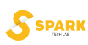






































































118 members to date incl. 80 industrial partners
Verticals in focus
Consumer goods & retail
Industrial goods & manufacturing
Infrastructure & construction
Hospital logistics
Transport, logistics and SC specialists
Horizontals
Digital
and AI
Incubators
Funds
Professional associations
Public
authorities
Federal org.
Global partners
Banks
Consultants
Academia
Enablers

Slide 4
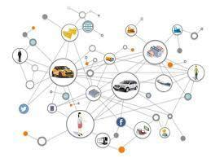
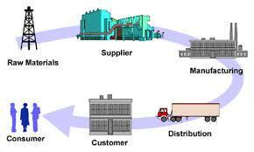
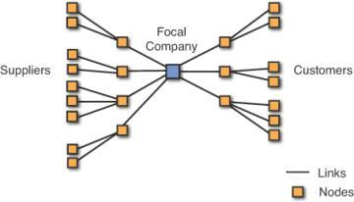
AI-enabled SC transformation based on collaboration… several steps
Enhance internally
Integrate
with partners
Enable interoperability
Connectivity
Predictive maintenance
Inventory optimization
Advanced command and control
Risk management
Secure data exchange
“X” As-a-Service
Capacity market
Open standards
Example
use cases

Slide 5
SCALE AI's scope of work
Activities
The SCALE AI way
Industrial projects
Adoption
Commercialization
Training
Industry workforce
Academia
Scale-up support
Incubation
Growth
Ecosystem development
Frameworks
Engagement
Visibility / Influence
Relationship building
Project methods
Technology ecosystem
Data
IP
Funding
Governance

