Slide 1
Real-Time Rail Overview
October, 2018
Confidential

Slide 2
Canadian Payments Today
Canadian Payments Market in 2016:
$21.3 B
$9.2 T
Consumer and Business Transactions
Total Payments Market Value
Evolution of Payments
1960s
1970s
1980s to 1990s
2000s – 2020s
Paper Payments
Consumers pay for goods with available funds using cash or cheque
Credit Cards
Credit cards provides consumers with easy access to credit and expands their availability of short term funds
Available & Secure Payments
Debit / credit cards gain traction and are accepted at POS and online. Security increases due to fraud
Digital & Mobile Payments
Consumer demand for choice, convenience, and speed drives innovation in payments

Slide 3





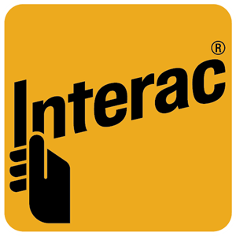


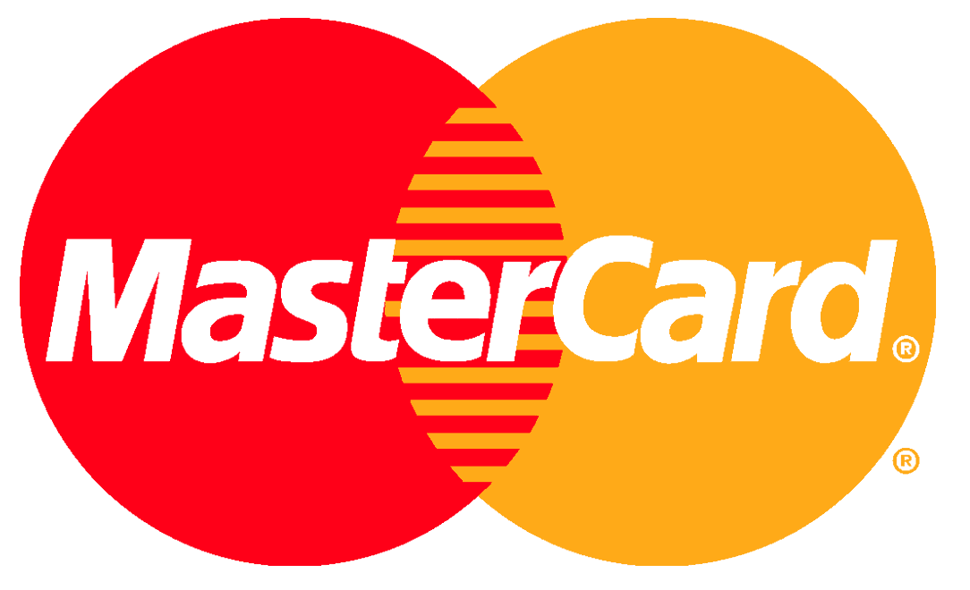
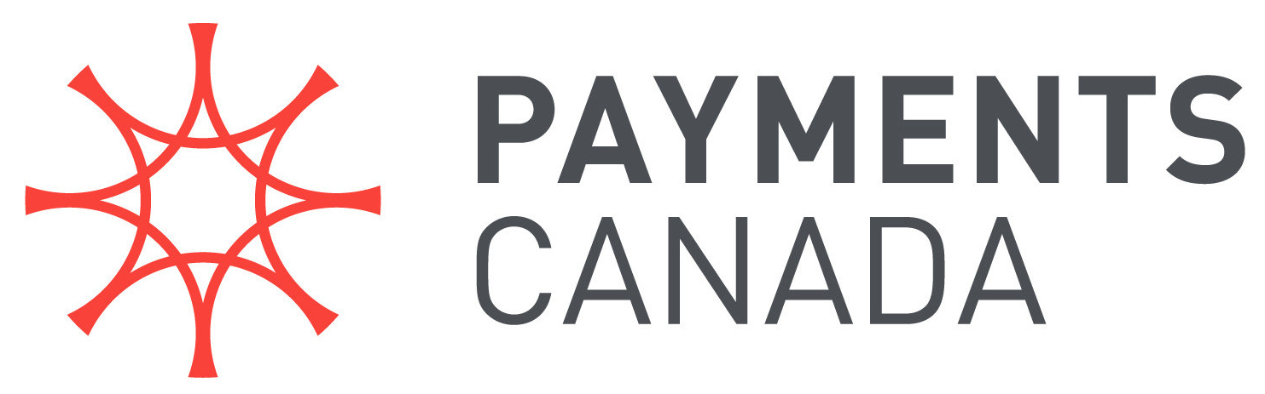




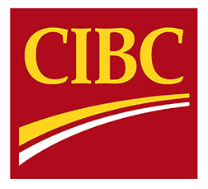
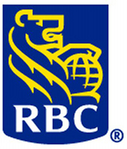
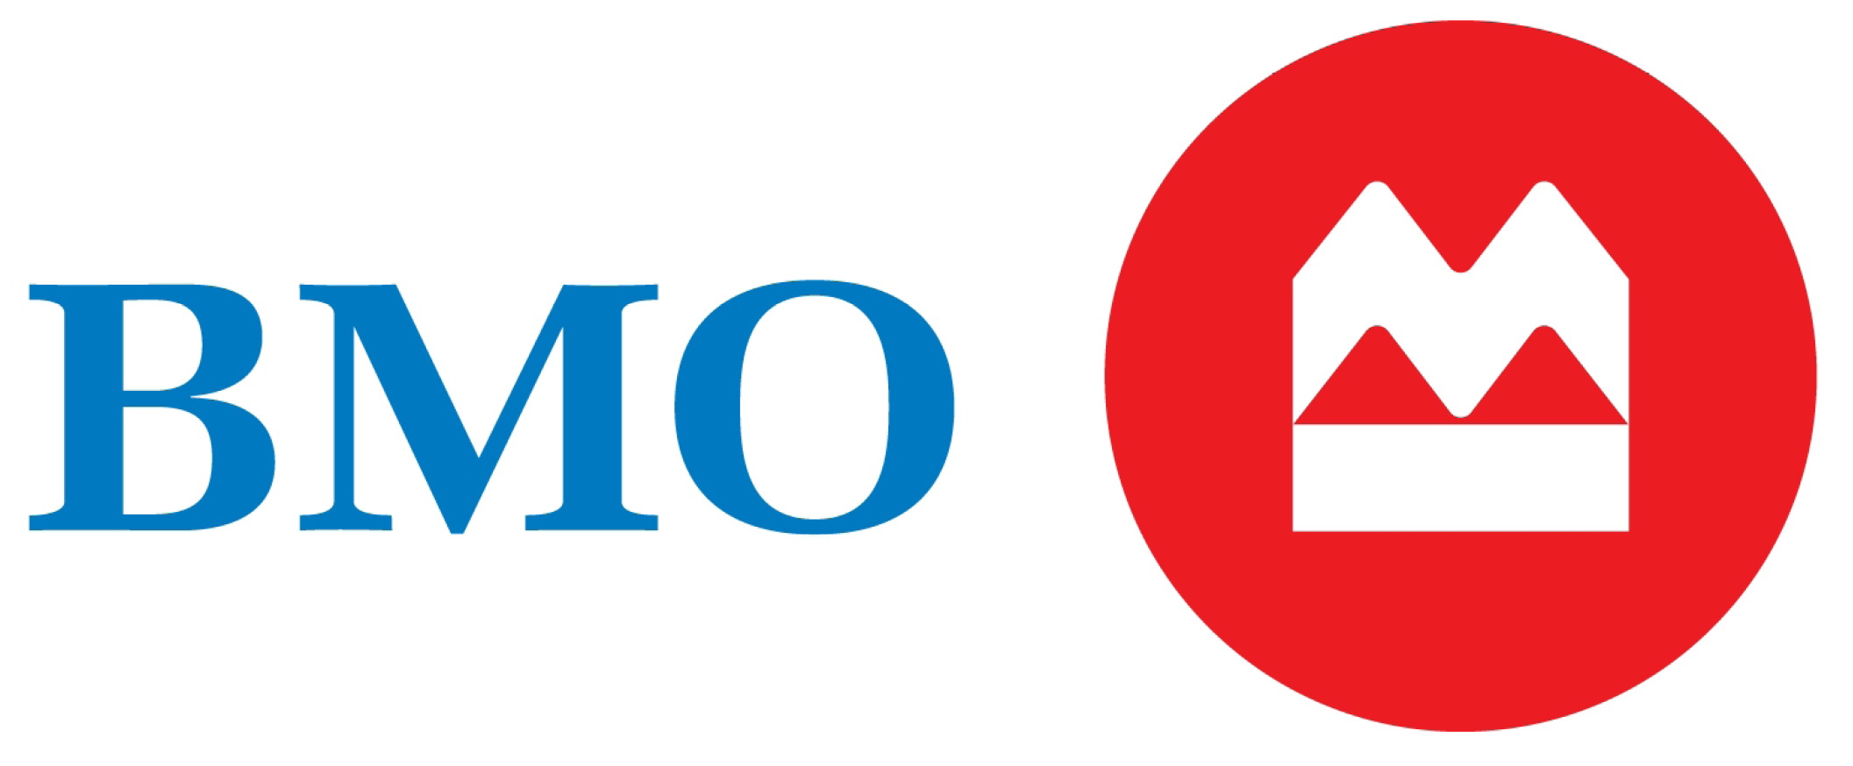




Canadian Payments Ecosystem
Canadian Payments Statistics
Consumers
Payment Service Providers (PSPs)
$50.8 Trillion payments clears and settled (2016)
People
SMB
Corporate
Government
7.4 Billion transactions executed (2016)
$201 Billion average payments per business day
Scheme Operators
Payments Operators / Regulators
Payments Volume Shift Between 2011 - 2016
Electronic Payments (Credit & Debit)
35%
Direct Clearers
Indirect Clearers
Online Transfers (e-Wallet & P2P)
517%
Paper (Cheque & Cash)
-23%
Sources: 1. Payments Canada

Slide 4















Regulatory Landscape
The payments industry operates under a complex regulatory regime, with a goal of promoting systemic efficiency, safety, soundness, and consumer protection
Payment Oversight and Standards
Prudential Oversight
Bank of Canada: Oversee systemically-important and prominent payment systems
Department of Finance: Main regulator (rule oversight and non-disapproval)
Sample Legislation: Bank of Canada Act, Canadian Payments Act
Monitor the actions of financial market participants (at Federal and Provincial levels) to ensure the soundness and stability of the system
Sample Legislation: Bank Act, Provincial financial institutions acts
Canadian Payments Regulators
OSFI
Safety and Security
Consumer Protection
Investigate and enforce protection against issues such as fraud, anti-terrorism and anti-money laundering
Sample Legislation: Money Laundering and Terrorist Financing Act, Criminal Code of Canada
Enforce controls that ensure consumer rights and financial privacy are respected by market participants
Sample Legislation: PIPEDA, Competition Act
Payment Rules & Standards
Develop rules and standards for payment networks and systems
Sample Legislation: Canadian Payments Act, Payment Card Networks Act

Slide 5
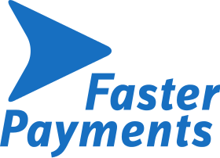








Customer and Regulatory Trends
Customer Expectations
Payments Modernization and
Regulatory Pressures
Business Payments Innovation
New entrants are redefining customer experiences and changing customer expectations around payments
Businesses will experience payments innovations that consumers have been living for the past two decades
Payment profit pools will shift away from traditional payment methods, due to payments modernization and regulatory pressures
74% increase in Canadian Fintech Startup investments in 2016 resulted in an increase of C$264.8 M
10% YOY drop of Canadian business cheque volumes in 2016
UK’s Faster Payments, launched in 2008, enables multi-device payments, 24/7 payments
SEPA is payment initiative of the EU, enabling customers to make cashless euro payments to anyone in the eurozone
Apps such as WeChat, Uber, and Airbnb, are making “invisible” payments ubiquitous, making it a part of contextual commerce
16% of small to medium sized businesses used online transfers to make payments as compared to 5% the previous year
Transition from paper-based to electronic invoicing / payments
Google, Amazon, and Facebook have introduced offerings such as mobile wallets, and P2P money transfer services, disrupting traditional networks
Interchange fees are shrinking, with the European Commission limiting fees to 0.3% for credit cards and 0.2% for debit cards⁵ Similarly, Australia has limited fees in 2017
Integrate ordering, billing, settlement between buyers / sellers
Banks are pursuing strategic partnerships with technology companies and FinTechs to meet evolving customer expectations
Banks are re-evaluating existing product offerings and business models to create a sustainable competitive position post modernization
Business payments are in the spotlight – banks and the FinTech sector are investing significantly to provide new and integrated payment experiences

Slide 6

















Canadian Payment System Clearing and Settlement
.
Payment Type
Clearing
Settlement
Retail Payments¹
ACSS
Direct ACSS Banks
LVTS
Bank of Canada
Volume: 6.99B
Value: $6.47T
Simplified flow
Interac e-Transfer
Direct e-transfer participants
Volume: 8.09M
Wholesale payments²
LVTS
Value: $43.03T
Securities
CDSX
CDSX
LVTS Direct Participants
Notes:
As a part of the Modernization vision, Payments Canada is looking to deliver a real time payments capability for a faster, more efficient, data-rich payments platform, offering 24/7/365 availability for immediate, irrevocable payments, ubiquity, and platform security

Slide 7
Debit Pull vs Credit Push
The Debit Pull Model
Sender gives the account number to the recipient/recipient processor
Recipient pulls funds from the consumer's account
Recipient waits for funds availability via batch process
For security purposes, Sender has to rely on the recipient's systems to protect their information
The Credit Push Model
Recipient gives their account number to the Sender (no Sender card/account information sent to Recipient)
Sender pushes funds to the Recipient's account
Funds are available near real-time to Recipient
For security purposes, the Sender does not need to disclose any account information to Recipient
Cheques and paper items (e.g., paper remittances)
ACH Debits (e.g., Pre-Authorized Debits)
Credit Card
Debit Card¹
Cash
P2P Transfers (e.g., EMT, PayPal)
ACH Credits (e.g., Direct Deposits)
EFTs / Electronic Remittances / Bill Payment
Pre-Paid Card Disbursements
Wire Transfers
Processor
Sender's Bank
Processor
Sender's Bank
Batch
Real-time
Recipient
Sender
Recipient
Sender
When a Recipient is collecting money from a Sender, it is a Pull payment
When a Sender is sending money to a Recipient, it is a Push payment

Slide 8
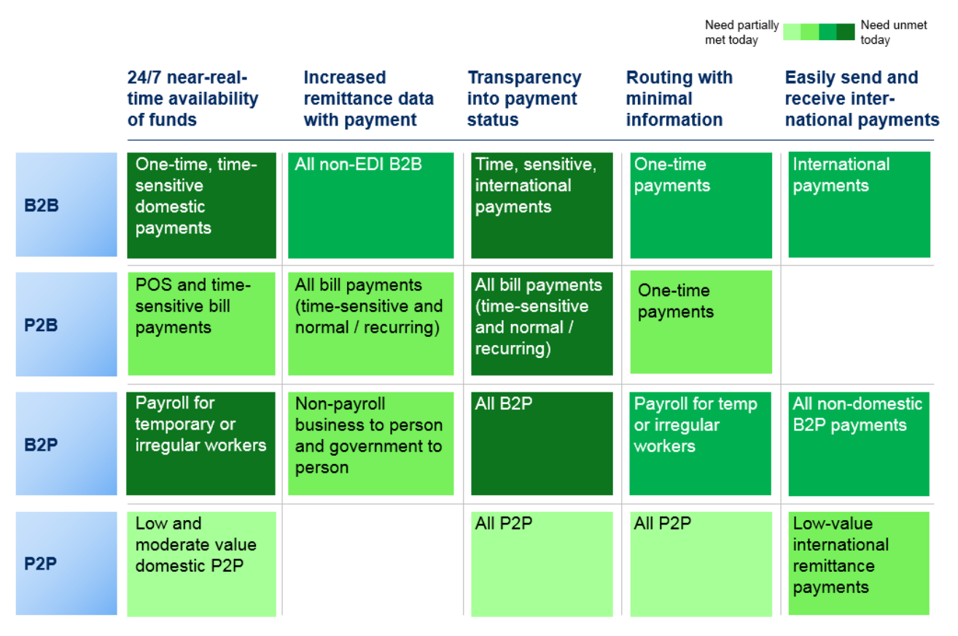
“A modern payment system is fast, flexible and secure, promotes innovation and strengthens Canada’s competitive position”
.
Why?
Canada’s core payment systems are largely outdated and were note designed to support emerging needs for faster, data-rich payments and regulatory changes
End-user expectations are evolving
More options to make funds available in near real-time
Expanded and standardized information
Easier ways to send and receive payments
Transparency into transaction status
More convenient cross border payments
Organization agnostic oversight rules applied consistently
Open and risk based access
Modernization of core payment systems is occurring around the globe
Systems that are flexible and reduce processing costs
Notes:
As a part of the Modernization vision, Payments Canada is looking to deliver a real time payments capability for a faster, more efficient, data-rich payments platform, offering 24/7/365 availability for immediate, irrevocable payments, ubiquity, and platform security

Slide 9








Faster Payments Across the Globe
Sweden
U.K
Payments in Real-time (PRT)
Launch: 2012
Standard: ISO 20022
Finland
Faster Payment Systems
Launch : 2008
Payments Architecture (NPA) in 2021+
Standard: ISO 20022
Siirto
Launch: March 2017
Standard: ISO 20022
India
Unified Payment Interface (UPI)
Launch: 2010
Standard: XML Based APIs
U.S.A
Real-Time Payments
Launch: Expected 2018
Standard: ISO 20022
Netherlands
Instant Payments
Launch: Expected 2019
Standard: ISO 20022
Denmark
Australia
NETS (Express Transfers)
Launch: November 2014
Standard: ISO 20022
New Payments Platform
Launch: February 2018
Standard: ISO 20022
Legend:
RTP Live
RTP in Planning
Overall RTP Maturity
Notes:
Faster and near real-time payments are already emerging across the globe, with technology, high speed data networks and consumer behavior among some of the factors fueling the demand for simpler payment and transfer experiences, regardless of consumer location.

Slide 10




Payments Canada’s Payments Modernization Program
Faster Payment Options
Data-rich Payments
Transaction Transparency
Easier Payments
A Platform for Innovation
Open & Risk- Based Access
Activity-Based Oversight
Cross-Border Convenience
1
2
3
4
5
6
7
8
Payments Modernization Overview
Lynx
Real-Time Rail (RTR)
Automated Funds
Transfer (AFT)
Settlement Optimization Engine (SOE)
Rules Framework
Replace LVTS with a new core clearing and settlement system including risk model changes
Enable a faster payment capability with a real-time ISO 20022 payment rail
Enhance the batch AFT with ISO 20022, additional exchange windows and faster funds availability
Replace ACSS and USBE with SOE, and implement the Interim Credit Risk Model
Develop a modern rule set for high value and retail payments
Notes:
Payments Canada’s Payments Modernization is a major transformation initiative impacting several key players within the ecosystem, requiring significant changes in the way payments are initiated, exchanged, and processed today.

Slide 11






Real-Time Rail Overview
.
Payments Canada’s vision for the new Real-Time Rail (RTR) includes the following six key characteristics:
24/7/365: The RTR will operate on a 24/7/365 model, which would enable customers to send and receive payments at any time
Immediate Funds Availability: Recipients will receive the funds in real-time (seconds) of the payment being initiated by the sender, except in cases where risk management or, legal compliance make it necessary to hold funds
Ubiquity: The Canadian RTR platform should be able to reach & service the vast majority of Canadian retail and business consumers, with accounts at any Canadian financial institution
Irrevocability of Payments: Payments on the RTR once authorized and initiated within the RTR platform cannot be recalled or, revoked; however, there will be processes between financial institutions around return of funds sent in error
Data-rich Payments (leveraging global ISO standard): RTR payments will include expanded and standardized information with each payment (following ISO 20022) to enable straight-through processing capability and inter-operability with other global jurisdictions, while maintaining security of the data
Safe & Secure: The RTR platform will embed the highest standards of security and customer data protection, including encryption, tokenization and other advanced risk management capabilities to protect the integrity of the system
Notes:
As a part of the Modernization vision, Payments Canada is looking to deliver a real time payments capability for a faster, more efficient, data-rich payments platform, offering 24/7/365 availability for immediate, irrevocable payments, ubiquity, and platform security

Slide 12
Implications
Faster Data-Rich Payments
Automation & Straight-Through Processing
Open Access
Potential Pathway to Open Banking
Faster funds availability (including same-day settlement) and contextual rich data with payments
Standardization of ISO 20022 message schema across payment rails resulting in better interoperability
Broadening of access to the payment rails for new participants leading to greater competition and innovation
A framework that enables consumers with the ability to share their own banking information with other financial service providers
Definition
Evolution of faster payments creates new customer expectations, and implications to fraud and AML capabilities
Improvements for corporates and government in operational efficiency through digitization of legacy paper based processes
Incumbent players will need to explore new business models (e.g., sponsorship, platform based) to drive revenue opportunities
Banks’ vertically integrated value chain will be unbundled and re-bundled as access to proprietary data becomes democratized
Implication

Slide 13
Use-Cases Enabled by Faster Payments
P2P Person to Person
A mother is able to send emergency funds to her son for college dues, meeting the deadline and avoiding fees and other inconveniences
C2B
Consumer to Business
A self-employed mechanic is able to send a request-to-pay to his customer, providing greater customer service
B2C
Business toConsumer
Insurance company reviewing a auto-claim and providing immediate access to funds for the policy holder to complete repairs
B2B
Business to Business
A business initiates a real-time payment to their supplier upon successful delivery and inspection of fragile or perishable goods
G2C
Gov. to Consumer
A government agency or NGO can instantly distribute funds to victims of natural disasters, offering immediate support in distress situations
C2G
Consumer to Gov.
A tax payer is able to make a payment to CRA which reconciles in real-time with her tax file based on the message sent with the payment

Slide 14
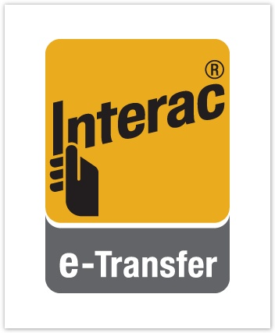
Interac e-Transfer at a glance…
Interac e-Transfer is a convenient way to send, request and receive money directly from one bank account to another.
All one needs is access to online or mobile banking through a participating FI, and they can send or request money to anyone with an email address or mobile phone number and a bank account in Canada — without sharing any personal financial information.
The Enhanced User Features (EUF) Request Money (recipient initiated) and Autodeposit (direct deposit) solve key market use cases that are required to make Interac e-Transfer the de facto faster payment solution in Canada
282 FIs | 56% YoY Growth | 375MM annual volume | $135B annually | 16MM users
2002
2005
2009
2010
2014
2016
2017
2018
Launch of a P2P desktop product
Variable Fraud Delay
SMS notification enablement
Mobile Banking App deployment
Facebook notifications
Instant Transfer critical mass
Alias payments
Request to Pay
Recurring Transfers

Slide 15
...Interac e-Transfer at a glance
Interac e-Transfer is the Canadian standard for electronic payments and transfers
World Class
Ubiquitous | Available to >99% of the Canadian online/mobile banking population
Fast | >72% of transfers are instant¹
Safe | Industry leading ~4bps of fraud
Transparent | Real-time notifications
Convenient | 76% of Interac e-Transfers are received on mobile
Growing | Value growing >56% / year
Value | ~$135B
Volume | ~375M
Users | 16.7M
Adoption | 74%

