Slide 1
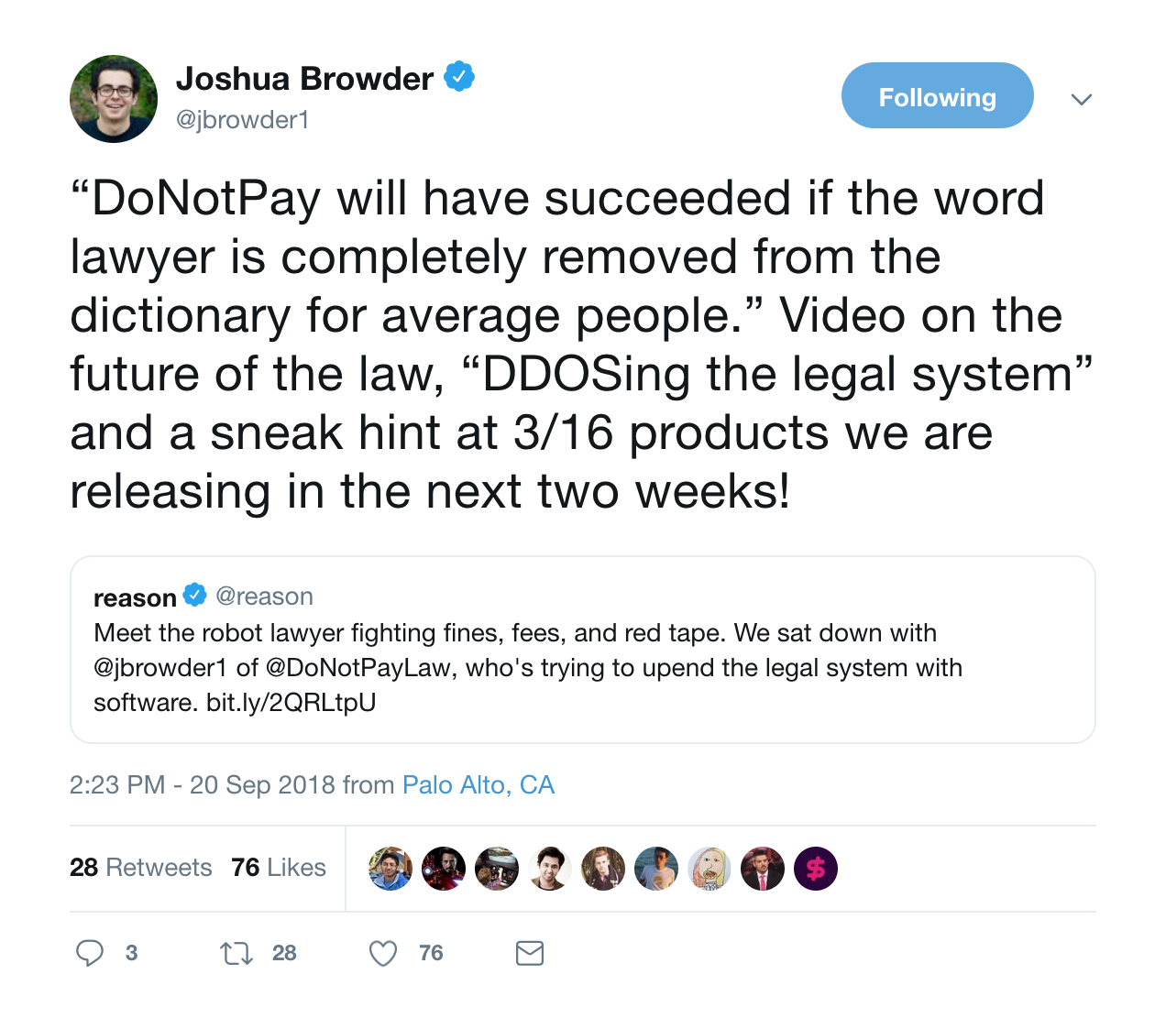
Hacking the legal system

Slide 2
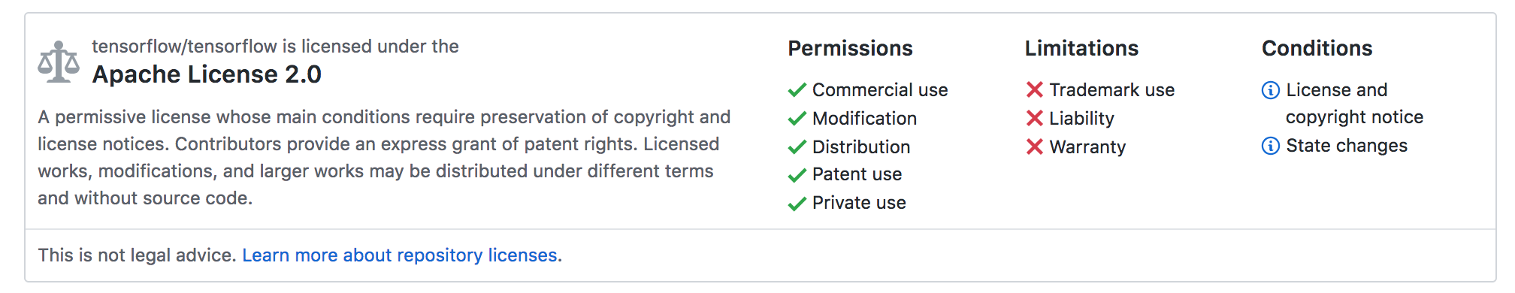
Open Sourcing Legal Advice

Slide 3
Workaround
Corp A: Legal-tech
Corp B:
Host
Open Source
Legal Advice Generator
Liability
Warranty
Compliance
Open Source Legal Advice Generator
Hosting Service

