Slide 1
Agile Software Development: Setting the Scene
Robert Percival
Partner & Head Technology & Innovation – Canada
IT.CAN 20th Annual Conference – Montreal – 25 October 2016

Slide 2
Outline of this part of the discussion
1. | Overview of Agile
2. | Agile project considerations
3. | Contracting for Agile projects
4. | When to use Agile

Slide 3
Overview of Agile

Slide 4
What is software development?
A set of steps of phases that a computer program goes through while it is being created
Not just about the code itself
Rather, a structured and planned process from conception to design to creation to deployment
Software development principles have origins in long standing principles utilized in the construction and manufacturing industries
Long standing most well-known and utilized is the “waterfall software development” process

Slide 5
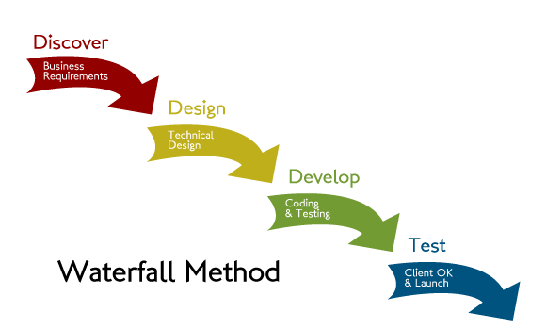
“Traditional” / waterfall development model

Slide 6
Main benefits of waterfall development model
Provides a clear and structured way to approach software development projects
Lends itself to identifying clear milestones to track project progress
If the requirements and design are correct at the start of the development project, time and effort and money may be saved

Slide 7
Issues with waterfall development model
In practice it is difficult to define requirements in clear and unambiguous way at the outset
WDM is not very adaptable to change–assumes requirements can be “frozen” at conclusion of planning phase before moving to design/build stages
This is often not a likely valid assumption – especially where requirements are not well understood at the project outset
Required changes not may present themselves until deployment stage where problems / shortcomings in the software can be observed
Changes “up the waterfall” during development often occur – requirements may change during development – due to business changes, changes in law etc. – sends development back to design, re-development etc.
Sequential nature means much up front requirements scoping and design before any development started – much time and money is spent before any tangible deliverables

Slide 8
Issues with waterfall leads to Agile
S/W dev success statistics are not great*: ~16% success / ~53% completed over budget, over time, or delivered less functionality / ~31% projects cancelled < * See Standish Group’s “Chaos Reports” >
WDM issues lead to development of other methodologies in the 1990’s
Focus was on “iterative” software development
“Agile” is a general term for a several different iterative software development methodologies which all have a core common element:
the rapid development of software on an iterative basis with working software delivered at the end of each iterative cycle
In 2001 a group of software developers produced the “Manifesto for Agile Software Development” – purpose was to define the values of the so-called Agile movement

Slide 9
Agile development – the Agile manifesto
We are uncovering better ways of developing software by doing it and helping others do it. Through this work we have come to value:
Individuals and interactions over processes and tools Working software over comprehensive documentation Customer collaboration over contract negotiation Responding to change over following a plan
That is, while there is value in the items on the right, we value the items on the left more.
© 2001, this declaration may be freely copied in any form, but only in its entirety through this notice

Slide 10
The 12 principles of the Agile manifesto*
Manifesto supplemented by 12 principles
Resulting focus of ASD has the following primary characteristics:
Iterative development: Bursts of design / build / test / deploy
Functional software: Working software is primary measurement of success
Enabling change: Changing requirements need to be accommodated – even late in the development process
Customer involvement: Developers and business teams (including customer, if external) need close interaction and work together
*See all 12 principles at:
www.agilealliance.org/the-alliance/the-agile-alliance-maifesto/the-twelve -principles-of-agile-software/

Slide 11
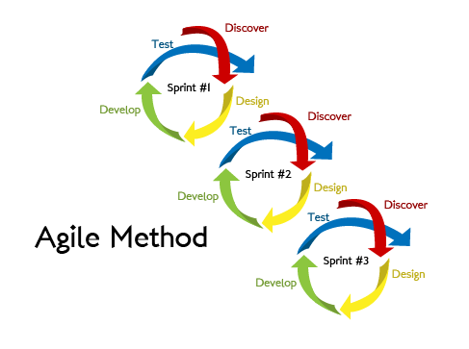
Agile development
Concept
Close

Slide 12

One common Agile type: Scrum methodology
Product Vision
Product Owner
Daily Sprint Meeting
1-4 week Sprint
Product Backlog
Sprint Planning Meeting
Sprint Backlog
Sprint Review Meeting
Finished Product
User Story
Legend:
Scrum Master Product Owner Development Team
12

Slide 13
Waterfall vs. Agile
Waterfall
Strong dependency between phases. Changing requirements are difficult to address
Progress is measured in deliverable artifacts (e.g. requirement specifications, design documents, test plans)
Critical design flaws may be discovered too late during development
Value is delivered at the end of the project and may not meet expectations
Longer project timeframes
Agile
Change inherent to the process. Frequent insight on measurable progress aiming at continuous improvement
Progress is demonstrated through tangible results – working software
Risks can be identified and remediated early on
Customers are involved throughout the product development lifecycle
Requirements are prioritized based on value
Breaks a complex problem in manageable units of work

Slide 14
Agile project considerations

Slide 15
Agile project considerations
Range of Agile projects
Purely internal vs. external / outsourced Agile project
Contracting models for external / outsourced Agile project
A range of possible models
Service provider resource location
Co-located vs. onshore / offshore mix

Slide 16
Contracting for Agile projects

Slide 17
Why “traditional” contracts do not work for Agile (and raise issues for lawyers drafting them)
“Traditional” / waterfall contracts are “flawed” when applied to Agile projects because:
The requirements are fixed at project start
They mandate sequential development
Scope, resources and schedule are fixed at the start of the project
Testing is used as a contractual tool
While the lawyers remain concerned about:
Defining the “what” i.e. the work product, specs
How much it will cost
How long it will take and when will be delivered
X

Slide 18
Contracting issues for Agile (Scrum, fully outsourced)
Project/product vision
Focuses attention on the desired outcome, and acts as a reference point
Product Backlog
Evolving statement of the customer’s requirements based on the product vision
Key roles and personnel issues
Product Owner, Development Team, Scrum Master
The Sprint process
Duration, Sprint planning meeting, daily meetings, Sprint review meetings, starting the next Sprint
Deliverables and acceptance
“Definition of Done”
Project completion
Velocity
Ensuring the Product Backlog is being cleared as the project progresses
Tracking progress against projected timeframes

Slide 19
Contracting issues for Agile (Scrum, fully outsourced)
Pricing
Range of pricing models – T&M, fixed price project, price per Sprint completed, incentives
Warranties and indemnities
Liability
Termination
Termination for convenience
IP rights
IP ownership can be problematic if customer personnel are part of the development team
Dispute resolution
Possible use of expert determination for technical issues

Slide 20
When to use Agile

Slide 21
Requirements for Agile success
Customer engagement, commitment and knowledge of Agile
Executive level buy-in and organisational acceptance
Challenges in overcoming waterfall / “traditional” concepts in Agile
Clarity around priorities and time to market to capture market opportunities
Service Provider experience
Strong project management
Empowerment of team members for rapid decision making
Trust
Recognition of different contracting framework and risk allocations
Early and collaborative engagement with legal counsel who have familiarity with Agile contracting

Slide 22
When to use Waterfall vs. Agile
Waterfall
Works well in an environment with:
Fixed scope
Defined set of requirements
Defined set of technology
Agile
Works well in an environment with:
Uncertain level of requirements
An aligned goal
High level of agreed user involvement
Customer targets time-to-market and an ability to react quickly to market changes
Customer needs to see how development progresses before fully committing

Slide 23
Wrapping up
Agile development methodologies are a substantial departure from the more traditional waterfall model
Agile projects have the potential to deliver faster and more flexible projects, with potentially shippable software iterations or features
In the same way that Agile methodologies challenge the more traditional concepts of waterfall model software developments, contracting for Agile projects require new ways of thinking and different approaches to common contractual issues

Slide 24
Contacts
Robert Percival
Partner
Head of Technology & Innovation – Canada
Norton Rose Fulbright
Direct: 416 216 4075
Email: robert.percival@nortonrosefulbright.com

Slide 25
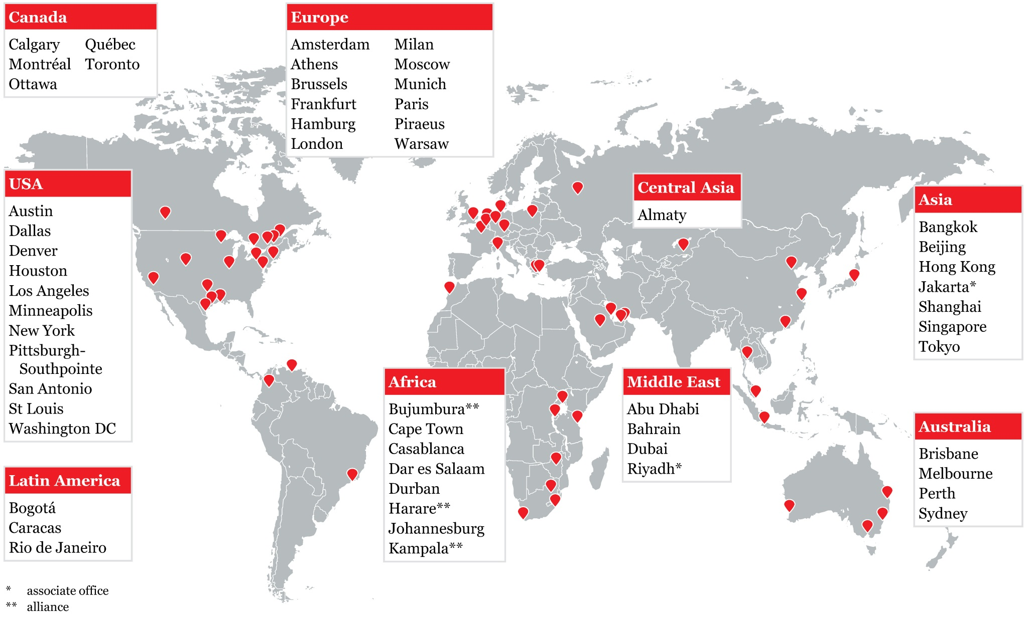

Slide 27
Disclaimer
Norton Rose Fulbright US LLP, Norton Rose Fulbright LLP, Norton Rose Fulbright Australia, Norton Rose Fulbright Canada LLP and Norton Rose Fulbright South Africa Inc are separate legal entities and all of them are members of Norton Rose Fulbright Verein, a Swiss verein. Norton Rose Fulbright Verein helps coordinate the activities of the members but does not itself provide legal services to clients.
References to ‘Norton Rose Fulbright’, ‘the law firm’ and ‘legal practice’ are to one or more of the Norton Rose Fulbright members or to one of their respective affiliates (together ‘Norton Rose Fulbright entity/entities’). No individual who is a member, partner, shareholder, director, employee or consultant of, in or to any Norton Rose Fulbright entity (whether or not such individual is described as a ‘partner’) accepts or assumes responsibility, or has any liability, to any person in respect of this communication. Any reference to a partner or director is to a member, employee or consultant with equivalent standing and qualifications of the relevant Norton Rose Fulbright entity.
The purpose of this communication is to provide general information of a legal nature. It does not contain a full analysis of the law nor does it constitute an opinion of any Norton Rose Fulbright entity on the points of law discussed. You must take specific legal advice on any particular matter which concerns you. If you require any advice or further information, please speak to your usual contact at Norton Rose Fulbright.

