Slide 1
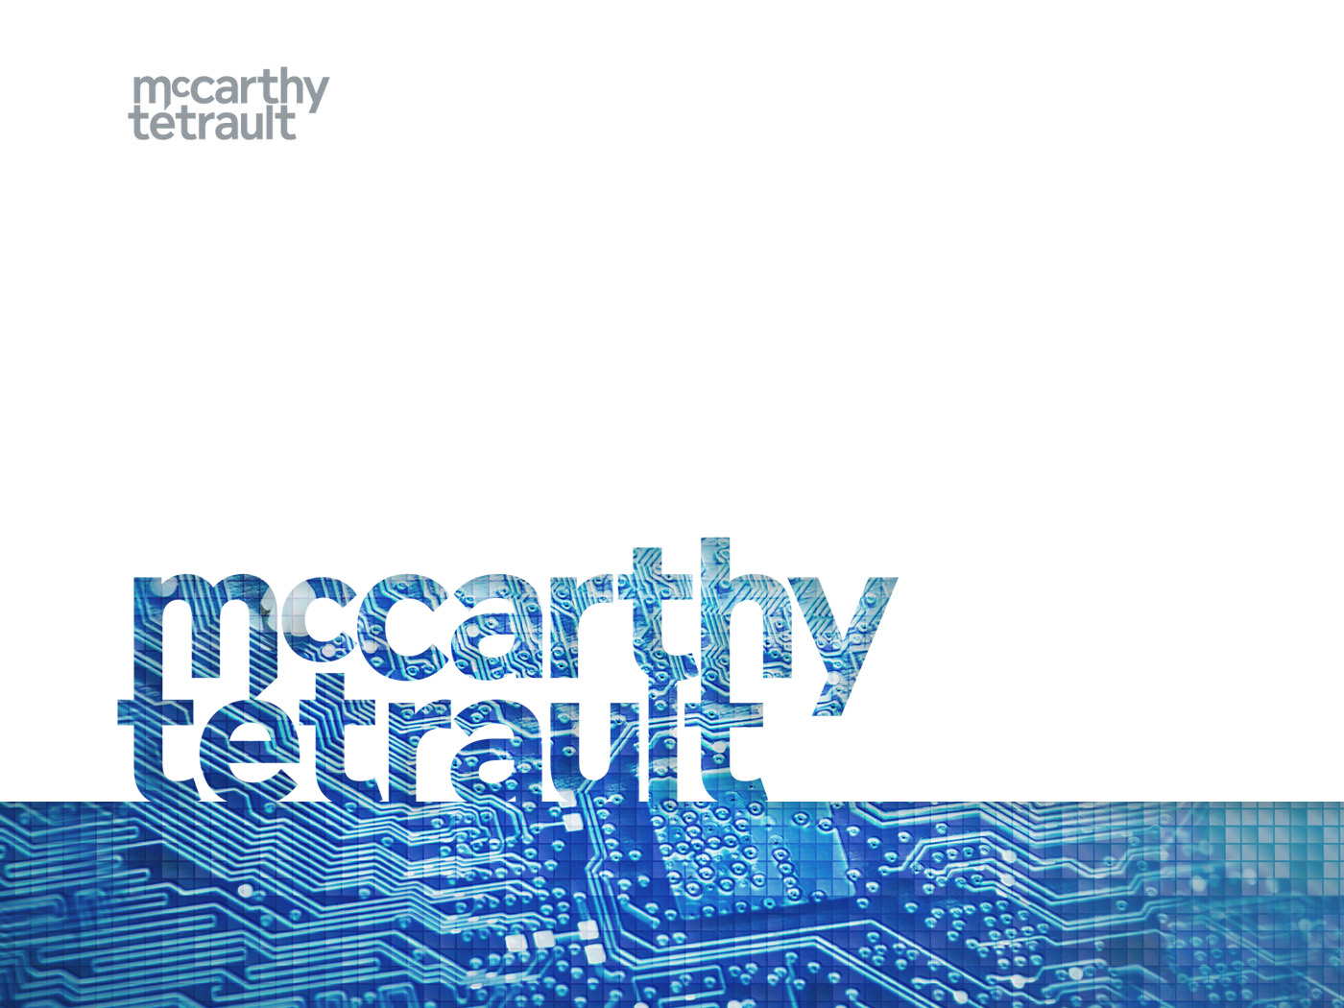
A Legal Perspective on AI
Carole Piovesan
Co-Lead, National Cybersecurity, Privacy and Data Management group
@cjpiovesan
Notes:
We are in a data optimization era barreling towards and AI-first world.
AI is fueled by data and data is increasingly in abundance.
90% of the world’s data was created in the past 5 years.
By 2020, it is predicted that there will be 40 zettabytes of data in the digital universe. This is the equivalent of 5,200 GB of data per person.
By 2025, there will be 80B connected devices.
Many companies today are sitting on mounds of data as though it were money under a mattress. It’s not being invested in a way that can fuel growth in the future.
But this is rapidly changing with advances with artificial intelligence .
AI, as we’ll explore in a moment, can analyze massive datasets and generate valuable predictions and actions. AI makes predictions cheaper. Predictions help individuals and organizations arguably make more informed decisions. It can detect cancer, predict market trends, efficiently redistribute humanitarian aid.
Given this ability to more quickly, cheaply and accurately analyze data, AI is broadly applicable across any sector and industry.
As a result of its depth of information and scope of applicability, AI has a virtually unfettered ability to persuade. Therein lies the opportunities and real risks with this rapidly advancing technology.
Artificial intelligence, as we will explore together over the next hour or so, is a remarkable tool that will augment human experience but one that requires thoughtful and inclusive discussion about its current and future use and potential impact on human society.

Slide 2
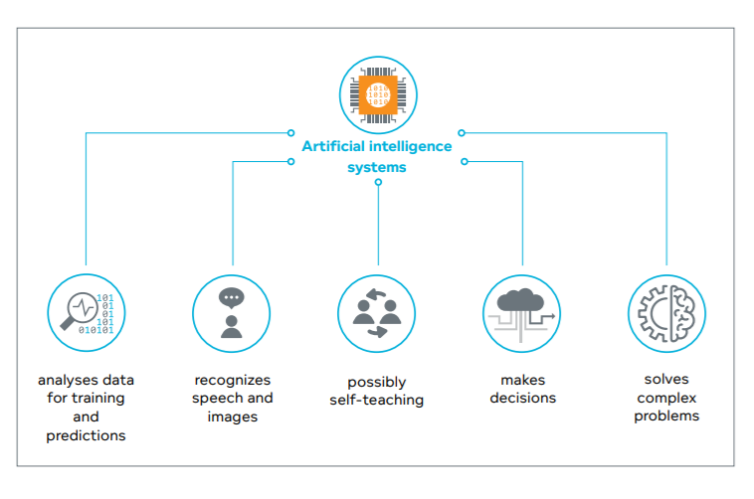
Concept of AI
Understanding AI
Notes:
Start high-level and then become more granular.
For those who have seen the Imitation Game or who closely follow computer science history, will know of Alan Turing, who, in addition to being an instrumental agent in ending the second World War also authored a paper in which he stipulated a seemingly simple question “Can machines think?”
Artificial intelligence is not a precisely defined term. In part this is because some of the main concepts implicit in artificial intelligence are difficult to define on their own. Like, what is intelligence generally? Is something intelligent simply by knowing how to survive? Or does intelligence require something more profound like the ability to retain and process information? AI is a legacy term from the 1950s when it was first used.
An entry point for me to understand AI is to understand what it can do. AI can analyze data, make predictions, recognize speech and images, make decisions, act on those decisions, it is self-teaching and solves complex problems that would be highly inefficient for a human to solve. These are all inter-dependent functions that highlight the various roles and applications of AI at a high-level.
Specifically:
Object recognition and labelling or characterization
Language processing to converse with human, summarize human communication in an accurate and meaningful way
Autonomous cars
Surgical robots that can operate in context (not simply a tool)
These functions are highly complex. For instance, understanding the nuance and context of language is far more challenging than first impression. Words need to be read in context of other words to make meaning. More traditional computer systems follows rules that are binary not contextual. The breakthrough of AI will be as it begins to accurately and reliably decipher context. The computer can label with a high degree of certainty that a picture of a dog as “a dog”.

Slide 3
The Race to Innovation
$950,000 in Supercluster Investment
Global GDP will be 14% higher in 2030 as a result of AI - the equivalent of $15.7 trillion (PwC).
In a simulation, companies that use a full suite of AI technologies in the next five years doubled their normal profits by 2030, bringing in an additional 4% of gross profit growth annually at the expense of their competitors (MIT Sloan Management Review).
Notes:
But let’s step out of the legal and philosophical domain for a moment to look at the broader commercial context. Because of the various functions of AI, its potential to reduce costs and boost efficiencies, it is sparking an intense race to innovation around the world with China, the US and little countries like Estonia as leaders.
The rewards for investment in AI technology is predicted to be quite massive with notable increases to company profits, and significant increase to global GDP. AI = money and money = power, AI is a tremendously valuable asset.

Slide 4
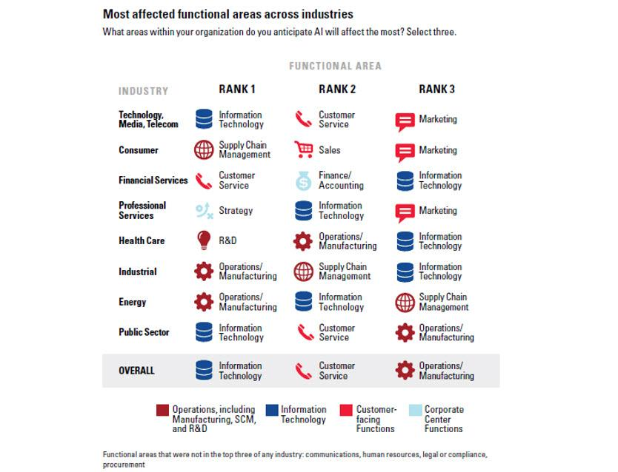

Slide 5
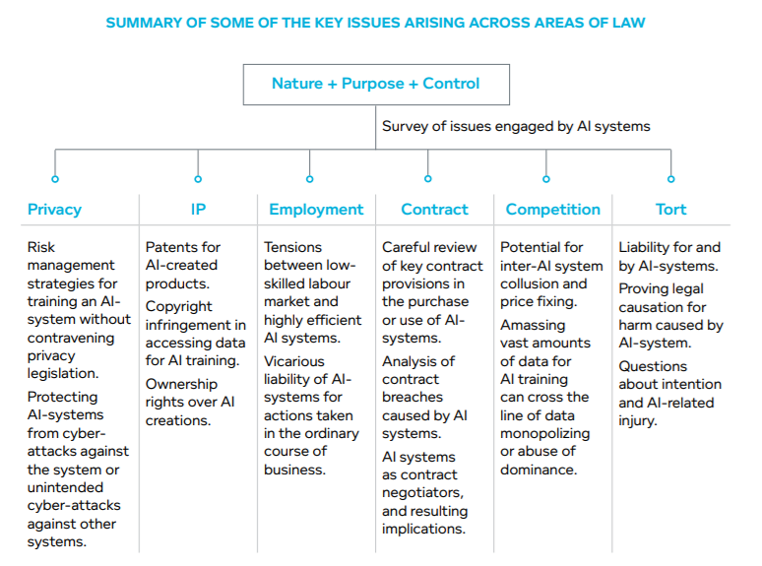
AI & Law
Notes:
I want to accomplish two things in this section. First, I want to talk practically about a legal approach to AI integration while raising questions lawyers should be thinking about as this technology is introduced into their client’s businesses. Next, I’ll pull back to talk about to talk about how AI is starting to stretch some of our foundational principles in the areas of privacy, IP and competition.
I want to propose three questions for thinking through the legal categorization of AI systems:
What is the nature of the AI system? Is the system best characterized as a product, a service or something else?
What is the purpose of the AI system? Is the AI system intended to act as an instrument or a tool (a truck to a truck driver), an agent (akin to an employee) or a fully autonomous “person”?
Who has control over the AI system: the creator/programmer? The user? The system is autonomous?
Identifying relevant legal standards will not always be straightforward. For example, it’s not clear if a wearable is a product under product liability law. Thinking about the nature, purpose and control of the system will help to parse out where there may be legal uncertainty in the way in which the system will be treated in a dispute and who could be held liable for any harm caused.
Going back to first principles, law governs human behaviour to create predictability and certainty among human relations. The more that the human is remote to the behaviour, the more our laws are challenged. In addition, AI doesn’t fit neatly into many legal doctrines because of the elements of self-teaching and self-actioning. In so doing, I support Mr. Smith’s assertion that AI will require new law based on modern thinking about issues of agency, liability, property.
We have thought through some key questions relevant to various areas of law. While we’ll talk in a little more depth about privacy, IP and competition law, you can see that AI is raising important questions across various areas of law. And this is just a snapshot, it’s not exhaustive.
[Employment, Contract and Tort]
We’re now going to turn to Privacy, IP and Competition to explore ways in which AI is challenging some fundamental principles of law and policy.

Slide 6
Notes:
Since we’re barreling towards an AI-first world, we need to do so with our eyes wide open, respectful of our values, thoguhtful of our systems and principles, and mindful of our increasingly dependent relationship with technology.

