Slide 1


Avoiding Cross–Border Tax Pitfalls
For Technology Companies
Katy Pitch (Wildeboer)
Paul Casuccio (Fasken)
October 30, 2018

Slide 2



Slide 3

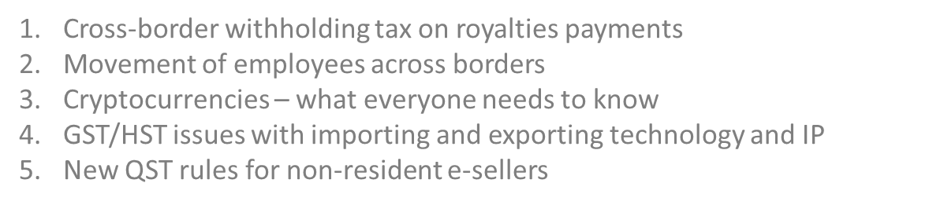

Slide 4

Royalty payments
License agreements and rents, royalties or similar payments
What are these?
What happens if a Canadian company makes these payments?
Withholding tax
Treaty help
Are there any exceptions?
Cloud computing – withholding tax should be avoided where payments made for the cloud-based services are not dependent on the use made of the particular information or services.
If payments are so dependent, withholding tax may apply

Slide 5

Employees in Canada – income tax
Employees coming up to Canada from another country
Employee issues
Company issues
Does the company have to pay income tax in Canada?
What about independent contractors?

Slide 6

Employees
Employees in Canada – GST/HST Issues
What are the implications of having an employee in Canada?

Slide 7

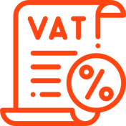
Employees
Non-resident Deeming Rules
In general, under the GST/HST legislative scheme, a non-resident corporation does not have an obligation to:
Register for GST/HST purposes
Collect GST/HST on supplies

Slide 8
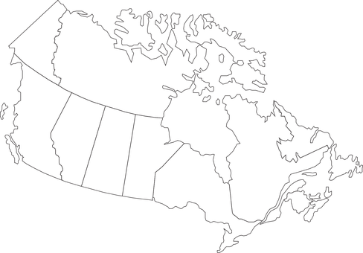

Employees
Carrying on a Business in Canada
However, if a non-resident corporation has an employee(s) situated in Canada, the corporation will likely be “carrying on a business in Canada”

Slide 9
Employees
Implications of Carrying on a Business in Canada
As a result, assuming the a non-resident corporation is considered to be carrying on a business in Canada, it will have an obligation to:
Register for GST/HST purposes
Collect GST/HST on supplies

Slide 10

Cryptocurrencies – what everyone needs to know

Slide 11

What are they?
CRA has said that cryptocurrencies are not “money” or a “currency”, but a commodity (like gold or oil)
Significance
not a “qualified investment” for registered plans
falls under barter transaction rules

Slide 12
Can I pay with them?
CRA has said paying in cryptocurrencies fits under its policy for Barter transactions
where “two persons agree to a reciprocal exchange of goods or services and carry out that exchange usually without using money”
value of cryptocurrencies received in exchange for goods or services to be included in income
values must be stated in Canadian dollars (but how do you value?)
Later sale (or exchange) of cryptocurrency received

Slide 13
What if I trade in them?
Buying/selling cryptocurrencies like a commodity (speculating on the volatility of cryptocurrencies), results in either a capital gain or (or loss) or income (or business loss)
Analysis of whether income or capital is long legislated tax issue
capital appreciation vs. running a business
Look at variety of factors:
frequency of transactions
period of ownership
knowledge of matters
relationship to taxpayer’s business
time spent
financing
advertising

Slide 14
What if I mine them?
“Mining” of cryptocurrencies is either a business or a personal hobby (not taxable)
Differences between business and personal activities
Consequences of running a business
income from business included in income at end of the year
inventory
theft/losses deductible if inherent risk to carrying on the business

Slide 15
Cross-border issues
International response
Holding cryptocurrencies directly offshore
Holding securities of offshore entities that deal in cryptocurrencies
offshore investment fund property rules
possible transfer pricing rules
specified foreign reporting rules (T1135)

Slide 16

Cryptocurrencies
Cryptocurrencies – GST/HST Issues
How does the GST/HST currently apply to cryptocurrencies?

Slide 17

Cryptocurrencies
Intangible Personal Property or Money
In order to determine, the application of GST/HST to transfers of cryptocurrency, one must first determine whether a cryptocurrency is:
or
NO SUPPLY
Intangible personal property
Currency and/or money

Slide 18
Cryptocurrencies
Place of Supply for Cryptocurrencies
In general, a supply of an IPP is deemed to have been made in Canada if it can be used in whole or in part in Canada

Slide 19

Cryptocurrencies
Other Cryptocurrency Issues
The classification of a cryptocurrency as IPP, as opposed to money, raises a number of other issues with respect to:
Exports of cryptocurrencies
Imports of cryptocurrencies

Slide 20

Exports/Imports
Exporting/Importing Introduction
What issues should I consider when exporting and/or importing IPP/services?

Slide 21



Exports/Imports
Exporting/Importing Overview
Types of exports/imports
Exporting/Importing implications
QC’s new tax proposals

Slide 22

Exports/Imports
Types of Exports/Imports
Subject to certain exceptions, technology companies primarily export/import two different types of supplies:
Intangible Personal Property (incl. IP)
Services

Slide 23
Exports/Imports
Exporting Implications
A supply of IPP/IP made to an unregistered, non-resident person is generally zero-rated and, therefore, not subject to GST/HST
Supply of IPP/IP
Tax
A
B
B = non-resident person
Canada
United States

Slide 24
Exports/Imports
Exporting Implications
Certain supplies of services made to an unregistered, non-resident person may also be zero-rated for GST/HST purposes
Supply of Service
Tax
A
B
B = non-resident person
Canada
United States

Slide 25
Exports/Imports
Importing Implications
If a resident person is a recipient of a supply of IPP/IP made outside Canada, that person must self-assess and remit GST/HST
Supply of IPP/IP
A
B
A = resident person
CRA
B = non-resident person
Tax
Canada
United States

Slide 26



Exports/Imports
Importing Implications
However, a person does not have to self-assess and remit GST/HST with respect to the supply of IPP/IP made outside Canada, if the IPP/IP
is acquired for commercial activities
may not be used in Canada
relates to property situated outside Canada

Slide 27
Exports/Imports
Importing Implications
If a resident person is a recipient of a taxable supply of a service made outside Canada, that person must also self-assess and remit GST/HST
Supply of a Service
A
B
A = resident person
CRA
B = non-resident person
Tax
Canada
United States

Slide 28

Exports/Imports
Importing Implications
However, a person does not have to self-assess and remit GST/HST with respect to a service made outside Canada, if the service is
acquired for commercial activities
in respect of real property outside Canada
in respect of TPP situated outside Canada

Slide 29
Exports/Imports
Importing Implications
If a resident person imports a good (i.e. tangible personal property) as an importer of record, that person may also need to pay and remit GST/HST
Import of a Good
A
B
A = Importer of Record
CRA
Tax
Canada
United States

Slide 30
Exports/Imports
Quebec’s New Tax Proposals
In 2018, QC released proposed rules that, if imposed, would affect persons not resident in QC selling IPP/services over digital platforms
US

Slide 31


Exports/Imports
Quebec’s New Tax Proposals
If the QC government decides to impose these new rules, such rules will primarily affect online sellers that are:
selling IPP and services to QC residents
not resident in Quebec
entering B2C transactions

Slide 32

Exports/Imports
Quebec’s New Tax Proposals
If applicable to a person not resident in Quebec, the new rules will require such a person to:
Register for the QST
Collect QST on sales of IPP/Services

Slide 33

Exports/Imports
Quebec’s New Tax Proposals
These new rules may also impose collection and remittance obligations on digital intermediaries (e.g. facilitating transaction)
$
$
A
B
Third party facilitator

Slide 34





Summary
How to contact me
Katy Pitch
+1 416 361 4787
kpitch@wildlaw.ca

