Slide 1
Artificial Intelligence and How it Will Impact You
Richard Austin
Douglas Deeth
October 28, 2019

Slide 2
I. Introduction – Setting the AI Table
Company spending on AI expected to grow 600% from $8 billion in 2016 to $47 billion in 2020
Sterling Miller, Part I: Artificial Intelligence & Its Impact on Legal Technology: To Boldly Go Where No Legal Department Has Gone Before, Thomson Reuters, 2019
According to UK LexisNexis 2018 report, 53% of in-house counsel say too much time is spent on repetitive tasks and 34% say too much time is spent reviewing documents
23% of the work lawyers do could be automated with available technology
Steve Lohr, AI Is Doing Legal Work. But it Won’t Replace Lawyers, Yet, New York Times, March 19, 2017 quoting McKinsey Global Institute Study
AI tools offer the potential to save time and money, increase quality, enhance creativity and reduce risk, improve client relations and develop better precedents

Slide 3
Artificial Intelligence
vision
speech
language
knowledge
problem solving
etc.
A set of technologies that enable machine intelligence to simulate or augment elements of human thinking
deep learning
machine learning
neural networks
search
probabilistic reasoning
etc.

Slide 4
Where’s the Status of AI Today?
It’s important to understand that for all of these AI systems we see today — the fact is, none of them is real AI,” he said. “None of them can match the ability of biological systems. We are very far from making machines intelligent.”
“While AI systems aren’t as smart as cats or infants, and there are many obstacles still to surmount, the future of AI is wide open.”
Yann LeCun, director of AI research at Facebook, in a speech on March 6, 2018 at NYU

Slide 5
Human Brain vs. Neural Networks
The artificial neuron fires totally different than the brain.
A human brain has 100 billion neurons and 100 trillion connections (synapses) and operates on 20 watts.
Cf. the biggest neural network have 10 million neurons and 1 billion connections on 16,000 CPUs (about 3 million watts)
The brain is limited to 5 types of input data from the 5 senses.
Children do not learn what a cow is by reviewing 100,000 pictures labelled “cow” and “not cow”, but this is how machine learning works.
Probably we don't learn by calculating the partial derivative of each neuron related to our initial concept. (By the way we don't know how we learn)

Slide 6
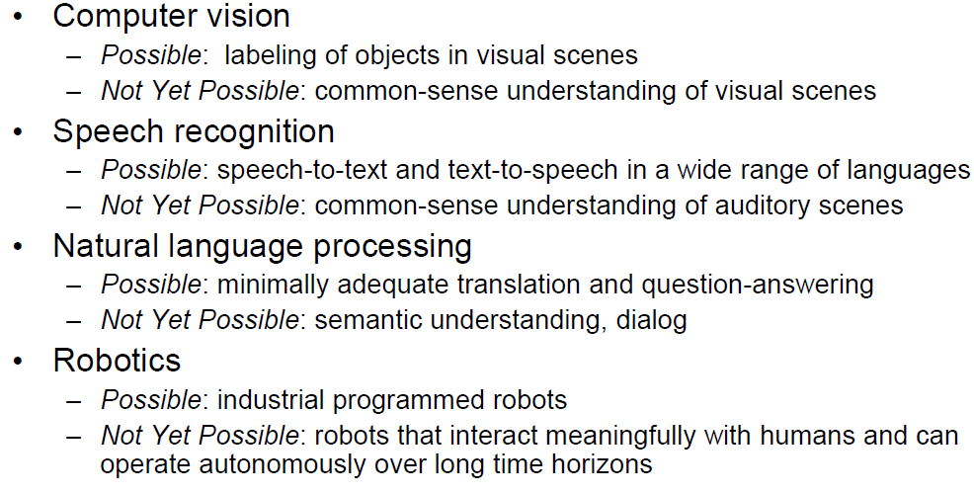
Human-Imitative AI: Where Are We?

Slide 7
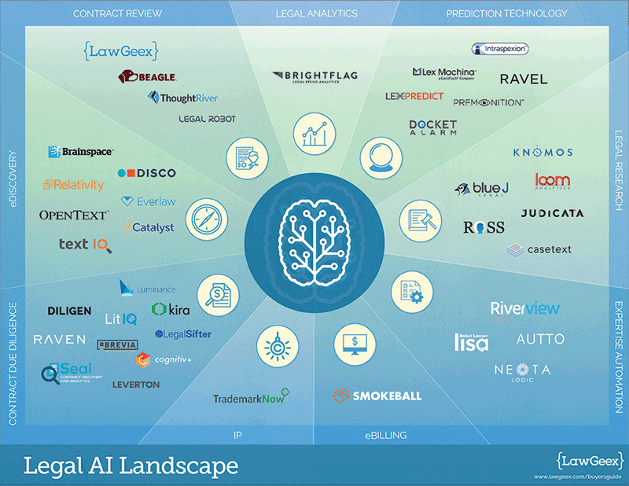
Legal AI Products and Services
Table from Jonathan Marciano, Automating the Law, A Landscape of Legal AI Solutions, TOPBOTS, June 2017, reproduced in Sandra McCandless and Stephen Klein, Ethical Issues Posed by Artificial Intelligence, June 15,2018

Slide 8
How Legal AI Products and Services are being applied
Technology-Assisted Review | Legal Analytics (Big data, algorithms and AI) | Practice Management Assistants | Making Legal Decisions | Legal Bots
E-discovery M & A due diligence Record keeping investigations | Predictions on trends and outcomes in IP and other litigation Recommendations on staffing, billing and timelines Predictions on judges’ decisions, recommendations on precedents and language | Transactional due diligence Bankruptcy Litigation research and preparation Real Estate Legal research and analysis UTBMS / LEDES coding Automated time recording | Algorithms for criminal sentencing decisions Online dispute resolution tools Online portals providing legal advice | Assisting clients in dealing with specific legal issues Providing pro bono legal advice

Slide 9

Implementation challenges exist:
AI-based system used for setting bail conditions and sentencing alleged to discriminate based on race
Facial recognition systems used to establish sexual orientation
Accuracy of facial recognition systems identifying individuals in arrest databases questioned
Hiring system to identify top technical talent withdrawn from use for not rating candidates in a gender neutral way
Chatbox trained on conversations with Internet users
removed from service after 24 hours for being sexually
focused, Nazi sympathizing

Slide 10

Issues involved in Using AI Products and Services
How do lawyers determine if they have an obligation to use, or to not use, AI products or services?
What due diligence do lawyers need to do before using AI products and services?
How can lawyers assume responsibility for self-learning AI systems that make decisions or recommendations? How do the lawyers ensure the systems are fair, accurate and provide proper legal advice? How can lawyers “square the circle”?
How can lawyers disclose the information that self-learning systems need to be trained without breaking client confidentiality?
Will AI systems replace lawyers and paralegals? Can companies obtain legal services directly from vendors of legal AI products and services?
How will billing be impacted, when AI systems can do in seconds what previously required [hours]/[days]/[weeks] of effort?

Slide 11
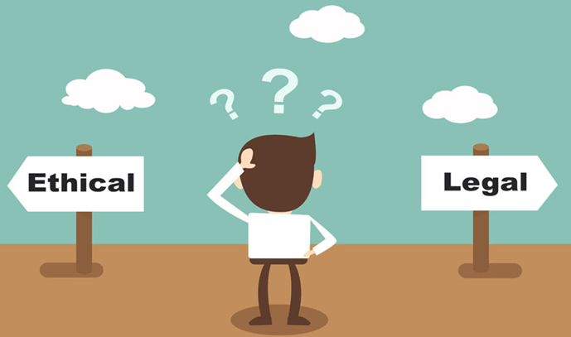
Issues continued
Are there obligations to explain that an AI system is being used, how it is being used and any inherent or other limitations to: (i) clients?; (ii) opposing counsel?; or (iii) the courts?
What happens when the expert systems conflict? Whose software rules?
Can an expert system be deposed? Will those using AI Systems need to be able to explain the algorithms underlying the system?
Will technology-assisted review systems used for e-discovery accurately recognize when legal advice is being given (in order to assert privilege over relevant legal documents)?
What happens to CPD obligations when AI tools will (hopefully) always track changes in the law?
How do we ensure the focus remains on the law and not on the legal profession?
How will young lawyers be trained?

Slide 12

II. Professionalism in the Digital Age
Lawyers’ professional obligations include obligations to:
A. Assess the Use of AI Tools
B. Exercise Independent Judgment
C. Supervise
D. Other Professional Obligations

Slide 13
A. Obligation to Assess the Use of AI Tools
Section 3.1 Competence
3.1-2 A lawyer shall perform any legal services undertaken on a client's behalf to the standard of a competent lawyer.
3.1-1 "competent lawyer" means a lawyer who has and applies relevant knowledge, skills and attributes in a manner appropriate to each matter undertaken on behalf of a client including …
(c) implementing, as each matter requires, the chosen course of action through the application of appropriate skills …
(d) communicating at all relevant stages of a matter in a timely and effective manner;
(e) performing all functions conscientiously, diligently, and in a timely and cost-effective manner;
(f) applying intellectual capacity, judgment, and deliberation to all functions; …
(i) managing one’s practice effectively;
(j) pursuing appropriate professional development to maintain and enhance legal knowledge and skills; and
(k) otherwise adapting to changing professional requirements, standards, techniques, and practices. (emphasis added)

Slide 14
Rule 3.1-2 Competence
Commentary to Rule 3.1-2:
Refers in paragraph [15.1] to Law Society Act provision re standards of professional competence; and
does not otherwise deal with administrative aspects including use of technology.
Skill
Knowledge
COMPETENCE
Preparation
Thoroughness

Slide 15
Competence – cont’d
Federation of Law Societies of Canada, Model Rules of Professional Conduct:
Includes, as part of Quality of Service obligation, Rule 3.2-1[5](j) requiring lawyers to maintain “office staff, facilities and equipment adequate to the lawyer’s practice”.
Proposes in its January 31, 2017 Consultation Report to amend Rule 3.1-2 (Competence) of Model Rules of Professional Conduct to add paragraph 5a:
[5A] To maintain the required level of competence, a lawyer should develop and maintain a facility with technology relevant to the nature and area of the lawyer’s practice and responsibilities. A lawyer should understand the benefits and risks associated with relevant technology, recognizing the lawyer’s duty to protect confidential information set out in section 3.3.

Slide 16
American Bar Association (ABA) Model Rules of Professional Conduct
Rule 1.1 Competence :
A lawyer shall provide competent representation to a client. Competent representation requires the legal knowledge, skill, thoroughness and preparation reasonably necessary for the representation.
Comment
Maintaining Competence
[8] To maintain the requisite knowledge and skill, a lawyer should keep abreast of changes in the law and its practice, including the benefits and risks associated with relevant technology, engage in continuing study and education and comply with all continuing legal education requirements to which the lawyer is subject. (emphasis added)

Slide 17
What is “Competence”?
“… legal prowess and good intent do not create a sufficient level of competence to effectively evaluate, operate or measure the efficacy of algorithmic tools.”
Jason Tashea and Nicolas Economou, Be competent in AI before adopting, integrating it into your practice, ABA Journal, April 23, 2019
Competence will require sufficient knowledge and skill to provide advice and supervision regarding:
what the AI does
its effective operation
whether the desired objectives are met
Lawyers do not need to be AI specialists but should recognize that being competent requires:
understanding the limits of their own knowledge
knowing when to enlist skilled assistance, and doing so

Slide 18
Technology Practice Management Guideline
5.2 Mandatory Use of Technology | 5.3 Systems to Support Client Service | 5.4 Systems to Support Practice Management | 5.6 Delivery of Legal Services Through the Internet
Electronic registration of real property Mandatory electronic filing requirements of Courts or other tribunals LSO electronic filings | Electronic Legal Research Methods Electronic Document Management Systems or Services Analysis Support Software Productivity Software Communications Technologies | Database Management Systems Calendaring and Scheduling Systems Legal Accounting and Time Billing Systems | Uphold Law of Other Jurisdiction Conflicts of Interest Capacity in Which Lawyer is Acting
5.5 Competent Use of Information Technology
5.7 Confidentiality
5.8 Marketing and Making Legal Services Available
5.9 Preventing Software Piracy
5.10 Security Measures
5.11 Back-up and Disaster Management
5.12 Obsolescence

Slide 19
Cass v. 1410088 Ontario Inc., 2018 ONSC 6959
Plaintiff responsible for defendant’s costs objected to as excessive and unnecessary including $900 fee for case precedents
The court stated in relation to both the excessive amount of time counsel had spent on legal research, as well as the fee that,
“[i]f artificial intelligence sources were employed, no doubt counsel’s preparation time would have been significantly reduced.”
The defendant’s claims for disbursements was ultimately reduced from $24,300.67 to $11,404.08.
Drummond v. The Cadillac Fairview Corp. Ltd., 2018 ONSC 5350
Defendant’s objection to $1,323 claimed for legal research costs incurred using WestLaw unsuccessful.
In allowing the disbursement for legal research, the court commented that:
“computer-assisted legal research is a necessity for the contemporary practice of law and computer assisted legal research is here to stay with further advances in artificial intelligence to be anticipated and to be encouraged.”

Slide 20
II.B Obligation to Exercise Independent Judgment
Section 3.2 Quality of Service
3.2-1 A lawyer has a duty to provide courteous, thorough and prompt service to clients. The quality of service required of a lawyer is service that is competent, timely, conscientious, diligent, efficient and civil.
3.2.2 When advising clients, a lawyer shall be honest and candid.
Commentary to Rule 3.2-2:
[2] The lawyer’s duty to the client who seeks legal advice is to give the client a competent opinion based on a sufficient knowledge of the relevant facts, an adequate consideration of the applicable law, and the lawyer’s own experience and expertise. The advice must be open and undisguised and must clearly disclose what the lawyer honestly thinks about the merits and probable results.

Slide 21

Rule 3.2 Quality of Service cont’d
AI Systems are not the lawyer. Regardless of the technology, lawyers are required to provide a competent opinion based on a sufficient knowledge of the relevant facts, an adequate consideration of the applicable law, and the lawyer’s own experience and expertise
Consideration of moral, economic, social and political factors is the domain of the lawyer, not the AI System

Slide 22
II.C Obligation to Supervise
Section 6.1 Supervision
6.1-1 A lawyer shall in accordance with the by-laws
(b) …directly supervise non-lawyers to whom particular tasks and functions are assigned.
Commentary
[1] By-Law 7.1 governs the circumstances in which a lawyer may assign certain tasks and functions to a non-lawyer within a law practice. Where a non-lawyer is competent to do work under the supervision of a lawyer, a lawyer may assign work to the non-lawyer. The non-lawyer must be directly supervised by the lawyer. A lawyer is required to review the non-lawyer’s work at frequent intervals to ensure its proper and timely completion.
[1.1] A lawyer may permit a non-lawyer to perform tasks assigned and supervised by the lawyer as long as the lawyer maintains a direct relationship with the client …
Notes:
.

Slide 23
American Bar Association (ABA) Model Rules of Professional Conduct
Rule 5.3 Responsibilities Regarding Nonlawyer Assistance
With respect to a nonlawyer employed or retained by or associated with a lawyer:
(b) a lawyer having direct supervisory authority over the nonlawyer shall make reasonable efforts to ensure that the person’s conduct is compatible with the professional obligations of the lawyer …
Comment
Nonlawyers outside the Firm
[3] … A lawyer may use nonlawyers outside the firm to assist the lawyer in rendering legal services to the client. Examples include the retention of an investigative or paraprofessional service, hiring a document management company to create and maintain a database for complex litigation, sending client documents to a third party for printing or scanning, and using an Internet-based service to store client information. When using such services outside the firm, a lawyer must make reasonable efforts to ensure that the services are provided in a manner that is compatible with the lawyer’s professional obligations.

Slide 24

II.D Other Professional Obligations
Although codes of professional conduct in Canada do not explicitly require the use of technology like their American counterpart, a number of ethical obligations under the codes – for example, to adapt “to changing professional requirements, standards, techniques and practices” and to maintain “office staff, facilities and equipment adequate to the lawyer’s practice” – suggest that the appropriate use of technology in the circumstances must be considered. If you decide the use of technology is appropriate to provide a legal service or to manage your practice, other rules of professional conduct, such as those governing client confidentiality and marketing by lawyers, will guide your conduct in the use of that technology.” (Footnotes omitted, emphasis added)
Canadian Bar Association, Ethics and Professional Responsibility Committee, Legal Ethics in a Digital World, 2014-2015 at 1.
AI Tools
SaaS
Blackboxes
Cloud
Algorithms
Apps

Slide 25
Other Professional Obligations
Section 3.2 (Confidentiality | Duty to hold in strict confidence all information concerning the business and affairs of the client acquired in the course of the professional relationship
Section 3.5 (Preservation of Client Property) | Duty to care for client’s property as a careful and prudent owner and to observe all relevant rules and law about the preservation of client property entrusted to a lawyer.
Section 3.6 (Fees and Disbursements) | A lawyer shall not charge or accept any amount for a fee or disbursement unless it is fair and reasonable and has been disclosed in a timely fashion. Must be full disclosure in all financial dealings and the lawyer is prohibited from accepting any hidden fees.
Section 5.1 (The Lawyer as Advocate) | A lawyer shall represent the client resolutely and honestly within the limits of the law while treating the tribunal with candour, fairness, courtesy and respect
Section 6.3.1 (Discrimination) | Lawyer has a special responsibility to respect the requirements of human rights laws in force in Ontario and, specifically to honour the obligation not to discriminate on grounds of race, ancestry, place of origin, colour, ethnic origin, citizenship, creed, sex, sexual orientation, gender identity, gender expression, age, …
Rule 7.3.1 (Duty to Report Misconduct) | Duty to report any situation where clients are likely to be severely prejudiced

Slide 26

III. AI ETHICAL ISSUES
“ … the surrender of human decision-making to machines
entails the dystopian risk of a dehumanized legal system,
which mindlessly perpetuates biases, sacrifices the spirit
of the law in pursuit of efficiencies, undermines legal
institutions, destabilizes jurisprudence and corrodes
public trust.
We can reap the benefits of artificial intelligence in the law while mitigating its risks, but only if we develop a normative answer to the central question facing us: “What it comes to the legal system, to what extent should society entrust to artificial intelligence decisions that affect people?”
Eileen M. Lach and Nicolas Economou, INSIGHT: Four Principles for the Trustworthy Adoption of AI in Legal Systems, Bloomberg Law, March 29, 2019

Slide 27
The Rationale for Ethical AI Legal Systems
To realize the benefits of AI systems, we must trust they are safe and effective
Especially the case for AI in our legal systems:
Black box systems and lack of trust in AI will undermine the use of Legal AI Systems
If AI is to be accepted and improve the functioning of our legal systems, we require principles, policies and practices that encourage AI to be adopted on the basis of informed trust

Slide 28
Ethics Frameworks
European Commission, Ethics Guidelines for Trustworthy AI, 2019
IEEE Global Initiative on Ethics of Autonomous and Intelligent Systems, Ethically Aligned Design: A Vision for Prioritizing Human Well-being with Autonomous and Intelligent Systems, 2019, pp. 211 – 281
ITechLaw, Responsible AI: A Global Policy Framework, 2019
Singapore Personal Data Protection Commission, A Proposed Model Artificial Intelligence Governance Framework, 2019
Treasury Board of Canada, Directive on Automated Decision-Making, 2019

Slide 29
ITechLaw, Responsible AI Policy Framework
Responsible AI Policy Framework
Organizations that develop, deploy or use AI systems and any national laws that regulate such use
Principle 1 (Ethical Purpose and Societal Benefit) | Should require the purposes of such implementation to be identified and ensure that such purposes are consistent with the overall ethical principles …
Principle 2 (Accountability) | Shall respect and adopt the eight principles of this Policy Framework for Responsible AI (or other analogous accountability principles). In all instances, humans should remain accountable for the acts and omissions of AI systems.
Principle 3 (Transparency and Explainability) | Shall ensure that, to the extent reasonable and given the circumstances and state of the art of the technology, such use is transparent and that the decision outcomes of the AI system are explainable.
Principle 4 (Fairness and Non-Discrimination) | Shall ensure the non-discrimination of AI outcomes, and shall promote appropriate and effective measures to safeguard fairness in AI use.
Principle 7 (Privacy) | Shall endeavour to ensure that AI systems are compliant with privacy norms and regulations, taking into account the unique characteristics of AI systems, and the evolution of standards of privacy.

Slide 30
IEEE, Ethically Aligned Design
Effectiveness: Adoption of A/IS in a legal system should be based on sound empirical evidence that they are fit for their intended purpose. | Competence: A/IS should be adopted in a legal system only if their creators specify the skills and knowledge required for their effective operation and if their operators adhere to those competency requirements.
Accountability: A/IS should be adopted in a legal system only if all those engaged in their design, development, procurement, deployment, operation, and validation of effectiveness maintain clear and transparent lines of responsibility for their outcomes and are open to inquiries as may be appropriate. | Transparency: A/IS should be adopted in a legal system only if the stakeholders in the results of A/IS have access to pertinent and appropriate information about their design, development, procurement, deployment, operation, and validation of effectiveness.

Slide 31
Treasury Board, Directive on Automated Decision-Making
Compliance required by April 1, 2020
Applies to any system, tool or statistical model used in production to recommend or make an administrative decision about a client
Requires:
Algorithmic Impact Assessments
Transparency
Quality Assurance Requirements
Software:
Copies of all proprietary software must be delivered to the Government
Government has right to access and test the Automated Decision System including to retain third party auditors

Slide 32
IV. Concluding Thoughts - AI in the Practice of Law
Remain Competent
Keep up-to-date on developments in AI and how it is being and can be used
Understand the Role of AI in your practice
Pay attention to the benefits, limitations and liabilities of using AI
Understand how AI is being used in your practice
Seek appropriate advice from outside experts
Require standards and accreditations
Interpret the lawyer’s professional obligations broadly
Duty of confidentiality
Duty to supervise
Obligations to communicate

Slide 33
“We always overestimate the change that will occur in the next two years and underestimate the change that will occur in the next ten. Don't let yourself be lulled into inaction.”
Bill Gates

Slide 34
List of References
Law Firms in Transition, Altman Weil, 2017 available at http://www.altmanweil.com/dir_docs/resource/90D6291D-AB28-4DFD-AC15-DBDEA6C31BE9_document.pdf
Legal Technology: Looking Past the Hype, Thomson Reuters, 2018 at https://www.legalfutures.co.uk/associate-news/in-house-lawyers-are-looking-past-the-hype
Eileen M. Lach and Nicolas Economou, INSIGHT: Four Principles for the Trustworthy Adoption of AI in Legal Systems, Bloomberg Law, March 29, 2019 at https://biglawbusiness.com/insight-four-principles-for-the-trustworthy-adoption-of-ai-in-legal-systems
European Commission, Ethics Guidelines for Trustworthy AI, 2019, available at https://ec.europa.eu/digital-single-market/en/news/ethics-guidelines-trustworthy-ai
IEEE Global Initiative on Ethics of Autonomous and Intelligent Systems, Ethically Aligned Design: A Vision for Prioritizing Human Well-being with Autonomous and Intelligent Systems, First Edition. Pp. 211 – 281, available at https://standards.ieee.org/content/dam/ieee-standards/standards/web/documents/other/ead1e_law.pdf
Steve Lohr, AI Is Doing Legal Work. But it Won’t Replace Lawyers, Yet, New York times, March 19, 2017 quoting McKinsey Global Institute Study available at https://www.nytimes.com/2017/03/19/technology/lawyers-artificial-intelligence.html

Slide 35
List of References cont’d
Jonathan Marciano, Automating the Law, A Landscape of Legal AI Solutions, TOPBOTS, June 2017, https://www.topbots.com/automating-the-law-a-landscape-of-legal-a-i-solutions/ reproduced in Sandra McCandless and Stephen Klein, Ethical Issues Posed by Artificial Intelligence, June 15,2018
Katherine Medianik, Artificially Intelligent Lawyers: Updating The Model Rules of Professional Conduct in Accordance with the New Technological Era, 39 Cardozo Law Review 1497 at 1513-1514
Sterling Miller, Part I: Artificial Intelligence & Its Impact on Legal Technology: To Boldly Go Where No Legal Department Has Gone Before, Thomson Reuters, 2019 https://static.legalsolutions.thomsonreuters.com/static/pdf/S045388_1_Final.Pdf
Singapore Personal Data Protection Commission, A Proposed Model Artificial Intelligence Governance Framework, 2019 available at https://www.pdpc.gov.sg/-/media/Files/PDPC/PDF-Files/Resource-for-Organisation/AI/A-Proposed-Model-AI-Governance-Framework-January-2019.pdf
Jason Tashea and Nicolas Economou, Be competent in AI before adopting, integrating it into your practice, ABA Journal, April 23, 2019 available at http://www.abajournal.com/lawscribbler/article/before-lawyers-can-ethically-adopt-and-integrate-ai-into-their-practices-they-must-first-be-competent
Treasury Board of Canada, Directive on Automated Decision-Making, 2019 available at https://www.tbs-sct.gc.ca/pol/doc-eng.aspx?id=32592

