Slide 1
Trends in US Antitrust Law
Amy W. Ray
Antitrust Partner at Orrick, Herrington & Sutcliffe, LLP
Orrick | CAN-TECH October 30, 2018
Notes:
Introduce yourself, the firm, and your US Antitrust Practice.

Slide 2
Disclaimer
The views and opinions expressed in this presentation are entirely those of the speaker and do not necessarily reflect the views of Orrick or of any current or former clients.

Slide 3

Agenda
Glossary & Animating US Statutes
Antitrust Populism
Tech Leaders & “Techlash”
Rhetoric vs. Enforcement
US Merger Trends & Court Decisions
FTC 21st Century Hearings
Post-Midterm Predictions for Privacy, etc.

Slide 4

Glossary & Animating US Statutes
US Antitrust Enforcement Agencies
Department of Justice Antitrust Division (DOJ)
Federal Trade Commission (FTC)
Sherman Act (1890)
§ 1 unlawful agreement
§ 2 monopolization
Clayton Act (1914): § 7 merger review (DOJ & FTC)
FTC Act (1914): § 5 enforcement re “unfair methods of competition”

Slide 5

Antitrust Populism: Rise of Technology in the US
Technology & data industry leaders
FAANG: Facebook, Apple, Amazon, Netflix & Google
Largest US Companies (& Market Caps):
8/2/2018: Apple $1T
Amazon neared $1T in Sept. 2018

Slide 6
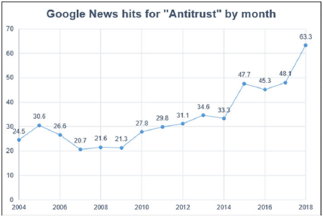
Antitrust Populism: The Amazon Antitrust Paradox, Lina Kahn, Yale Law Review (2017)
“With a single scholarly article, Lina Khan, 29, has reframed decades of monopoly law.”
– NYTimes (9/7/2018)
Kahn critiques the current focus of US antitrust law on economic evidence adhering to the “consumer welfare standard” (i.e., price and output)

Slide 7

Antitrust Populism: Support from Politicians, etc.
“The extensive concentration of power in the hands of a few corporations hurts wages, undermines job growth, and threatens to squeeze out small businesses, suppliers, and new, innovative competitors.”
“As an example of the power structure I'm fighting, AT&T is buying Time Warner and thus CNN, a deal we will not approve in my admin-istration because it's too much concentration of power in the hands of too few.“
– Senate Democrats, A Better Deal: Cracking Down on Corporate Monopolies (2017)
See also: Open Markets Institute
– Then-Presidential Candidate Donald Trump (10/22/2016)

Slide 8

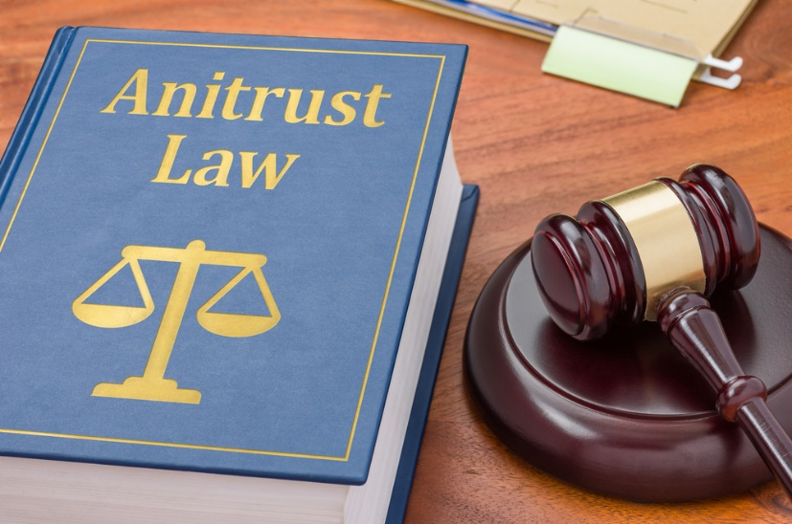

Antitrust Populism vs. Antitrust Trends
Antitrust Populism
Antitrust law as an approach to regulating “Big Data” companies and addressing social issues
Trends in US Enforcement & Courts
Few merger challenges
Pro-business court decisions & regulations
New conduct investigations?
vs.
8

Slide 9

US Merger Trends: Big Mergers Advance in 2018
DOJ sued to block AT&T/Time Warner deal ($85.4B)
District Court Judge Leon allowed merger to proceed
Closed but on appeal (D.C. Circuit)
DOJ approved CVS/Aetna ($68B)
Required to divest Aetna’s Medicare Individual Part D prescription drug plan business (10/10/2018)
DOJ cleared CIGNA/Express Scripts ($54B) (9/17/18)
FTC approved Linde/Praxair ($80B)
Divestitures in 9 markets (10/22/2018) with dissent regarding PE asset buyer

Slide 10

US Court Decision: Ohio v. American Express Co.
US Supreme Court held Amex’s anti-steering provisions (vertical restraints on merchants) do not violate antitrust law
“Two-sided” market definition and competitive effects analysis finding no output effect
To which multi-sided markets does Amex apply?

Slide 11

FTC Hearings on Competition & Consumer Protection in the 21st Century: Big Data Session
Developments involving data – including data resources, analytic tools, technology, and business models
Importance of data – or large, complex data sets comprising personal or commercial information – and how the FTC should analyze mergers or firm conduct
Does data differ in importance from other assets in assessing firm or industry conduct?
Are there policy recommendations that would facilitate competition in markets involving data or personal or commercial information that the FTC should consider?
Does the presence of personal information or privacy concerns inform or change competition analysis?
Hearing #6 “will examine the role that data plays in competition and innovation, and also will consider the antitrust analysis of mergers and firm conduct where data is a key asset or product.” – FTC (Nov. 6-8, 2018)

Slide 12


Conclusions: Post-Midterm Predictions
Privacy legislation
Conduct investigations
Data breach & consent decree enforcement
Biz documents leading to new investigations

