Slide 1
GDPR – the First Six Months
Dr Mark Watts
Partner
Notes:
MW

Slide 2
ETAO
Notes:
CM

Slide 3
GDPR
Notes:
CM

Slide 4
General Themes Post 25th May 2018 (I)
Consent is difficult to use!
Increase in IIRs
Subject access requests
Erasure requests
Data Protection Officers
Compliance Programs
Late to the party…
Assurance projects
Upgrades to BCRs
Notes:
CM

Slide 5
General Themes Post 25th May 2018 (II)
Breach notification
UK ~ 500 a week
Bristows contacted ~ 1 or 2 a day!
Data Protection Impact Assessments
22 country lists
Impact on new technology
Big data/machine learning/AI – Article 22
Biometric data
Legal representatives – status?
Notes:
CM

Slide 6
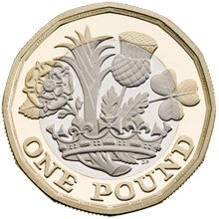
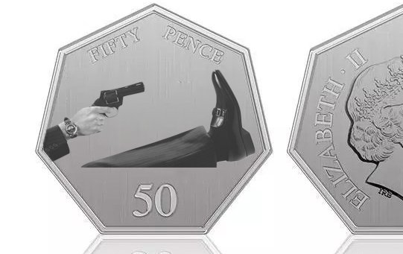
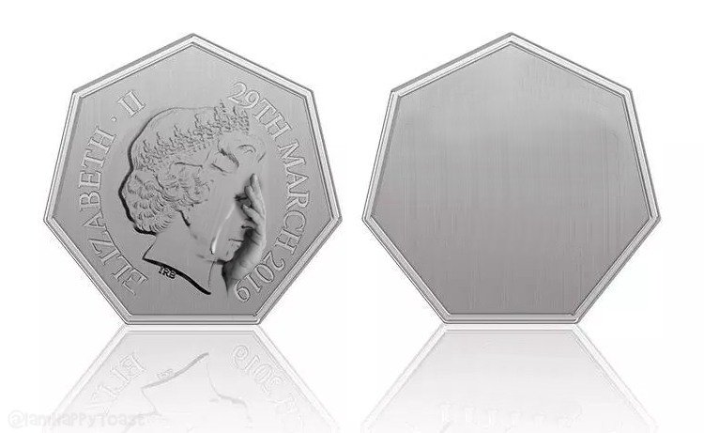
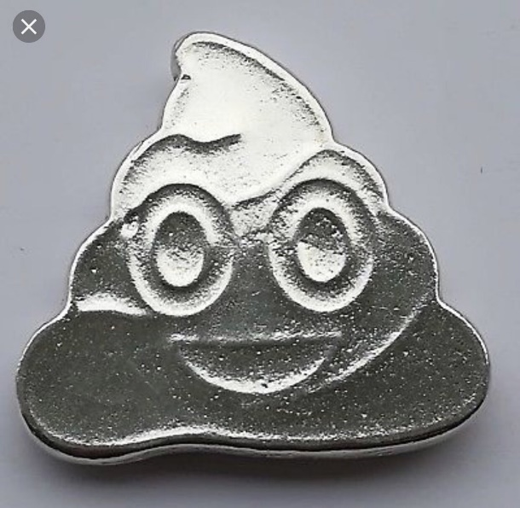
Brexit
Notes:
CM

Slide 7
Brexit
Adequacy or Adequacy +?
‘Adequacy +’ means data transfers from EU to UK OK
PLUS
Participation in European Data Protection Board
One-stop Shop Mechanism
Entry-point for BCRs
Adequacy + rejected by the EU so far
Adequacy likely but delay possible too
Clients preparing EU Model Clauses for transfers to UK!
Notes:
CM

Slide 8
Enforcement
General toughening around the EU
Four complaints filed by NYOB on 25th May 2018 (Google, Facebook, WhatsApp & Instagram)
Complaints filed by Quatrature du Net 28th May 2018 (Google, Apple, Amazon, Facebook & LinkedIn)
All about ‘legal basis’ & consent
Local decisions in German courts
UK Enforcement Notice against AggregateIQ (Canadian company)
Notes:
CM

Slide 9
Thank you
Bristows LLP
100 Victoria Embankment
London EC4Y 0DH
T +44(0)20 7400 8000
This document is for information purposes only and any statements or comments it contains relating to matters of law are not intended to be acted on, or relied upon, without specific legal advice on the matters concerned. To the fullest extent permitted by law, we disclaim all liability and responsibility for any reliance on the statements or comments contained in this document.
Bristows LLP is a limited liability partnership registered in England under registration number OC358808 and is authorised and regulated by the Solicitors Regulation Authority (SRA Number 44205).
Notes:
MW

