Slide 1
Superclusters: catalyst for collaboration
Anthony de Fazekas, Norton Rose Fulbright
Tristan Mallet, SCALE
Carole Piovesan, McCarthy Tetrault

Slide 2
The Innovation Supercluster Initiative
$1B federal government funding over 5 years
5 collaborative and industry-led superclusters
Based on technology leadership, new approach to collaboration
Aimed at developing ecosystem and drive economic output
~60 applications received, final selection of the 5 in Feb. 2018
Supercluster | Key sectors
Digital Technology Supercluster | Telecom, ICT
Protein Innovations | Agri-food
Next Generation Manufacturing | Manufacturing
SCALE AI AI-powered Supply Chains Supercluster | Retail, Manufacturing, Transport, AI
Ocean Supercluster | Fisheries, Oil & Gas, Energy
1
2
3
1
2
4
5
4
3
5

Slide 3
SCALE AI's strategy and what success will look like
Bring our successes in AI
from the lab to the field
  Adoption enablement
  Commercialization enhancement
Empower Canada as a global hub for intelligent supply chains
  Business solutions
  Technology landscape
  Establish a new way to collaborate on leading-edge tech
  Build the next-generation supply chain
  Deliver competitive advantage across industrial sectors
  Grow the world’s best applied AI services providers
  Boost the talent pool of today and tomorrow

Slide 4















































































































118 members to date incl. 80 industrial partners
Verticals in focus
Consumer goods & retail
Industrial goods & manufacturing
Infrastructure & construction
Hospital logistics
Transport,
logistics and
SC specialists
Horizontals
Digital
and AI
Incubators
Funds
Professional associations
Public
authorities
Federal org.
Global partners
Banks
Consultants
Academia
Enablers

Slide 5
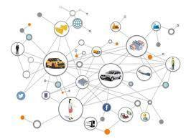
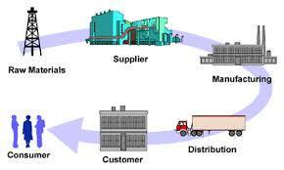
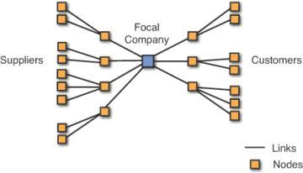
AI-enabled SC transformation based on collaboration… several steps
Enhance
internally
Integrate
with partners
Enable
interoperability
Connectivity
  Predictive maintenance
  Inventory optimization
  Advanced command and control
  Risk management
  Secure data exchange
  “X” As-a-Service
  Capacity market
  Open standards
Example
use cases

Slide 6
SCALE AI's scope of work
Activities
The SCALE AI way
  Industrial projects
  Adoption
  Commercialization
  Training
  Industry workforce
  Academia
  Scale-up support
  Incubation
  Growth
  Ecosystem development
  Frameworks
  Engagement
Visibility / Influence
Relationship building
Project methods
Technology ecosystem
Data
IP
Funding
Governance

Slide 7
What is a supercluster anyways?
industrial cluster
A geographic concentration of interconnected companies and institutions in a particular field that drive productivity, innovation and the creation of new businesses
Professor Michael Porter
Competitive Advantage of Nations

Slide 8
Collaboration system
Discovering partners
Discussing potential projects
Collaborative Development
Joint marketing
IP and data generation and sharing

Slide 9
Policy context of Superclusters

Slide 10
Templates
Streamlining collaborations
Default positions based on proven practices
Sharing mechanisms
Use cases, best practices, standards, policies, clear explanation of rules of engagement
IP and data sharing that ensure that stakeholders can leverage the value created
Education and mentorship
Technology layer for making collaboration more efficient
One to many, peer to peer, clinics
Actionable approaches, data governance, corporate innovation toolkits

Slide 11
Superclusters: systemization of corporate innovation and collaborative development
Preparing membrs for “open innovation” within supercluster framework
Best practices for collaborative development
IP excellence
Protecting innovation, including data, AI, software
Navigating IP in open innovation projects
Legal process systemization
Marrying enterprises and start-ups / scale-ups
Contract agility
Rolling out innovation infrastructure (legal, IP, regulatory)
Agile approaches to building valuable IP, and protecting IP
Template agreements and clauses
Opportunity for smart contract innovation of collaborative development agreements
IP sharing and pooling
Developing practical approach for IP and data sharing

Slide 12

Forms of IP, and their interconnected nature
Foreground IP
Background IP
Can Background IP be derived from Foreground IP?
Latent IP
Arising IP
IP often created for specific purpose. Opportunities to leverage IP into different applications
Shared IP
Marketplace for IP
Joint IP, IP pools
Unpredictable IP “arises”

Slide 13
Resolving ownership/rights to use results of collaboration (data)
Company A’s Data, Derivative Data
Company B’s Data, Derivative Data
Third party data sources, third party enhancing data
Intermingling of data, enriched data
AI system or infrastructure
Data provenance/governance
Who owns or has rights to use “fusion data”?
Should some data be “jointly owned”

Slide 14
“Frictionless IP”
Development of Foreground IP through ambitious collaborative projects
Framework for negotiating access to Foreground IP
Increased sharing of IP
Members in Projects benefit from clear guidelines for accessing Background IP and Foreground IP
Visibility into Foreground IP created across projects, with limitations

Slide 15
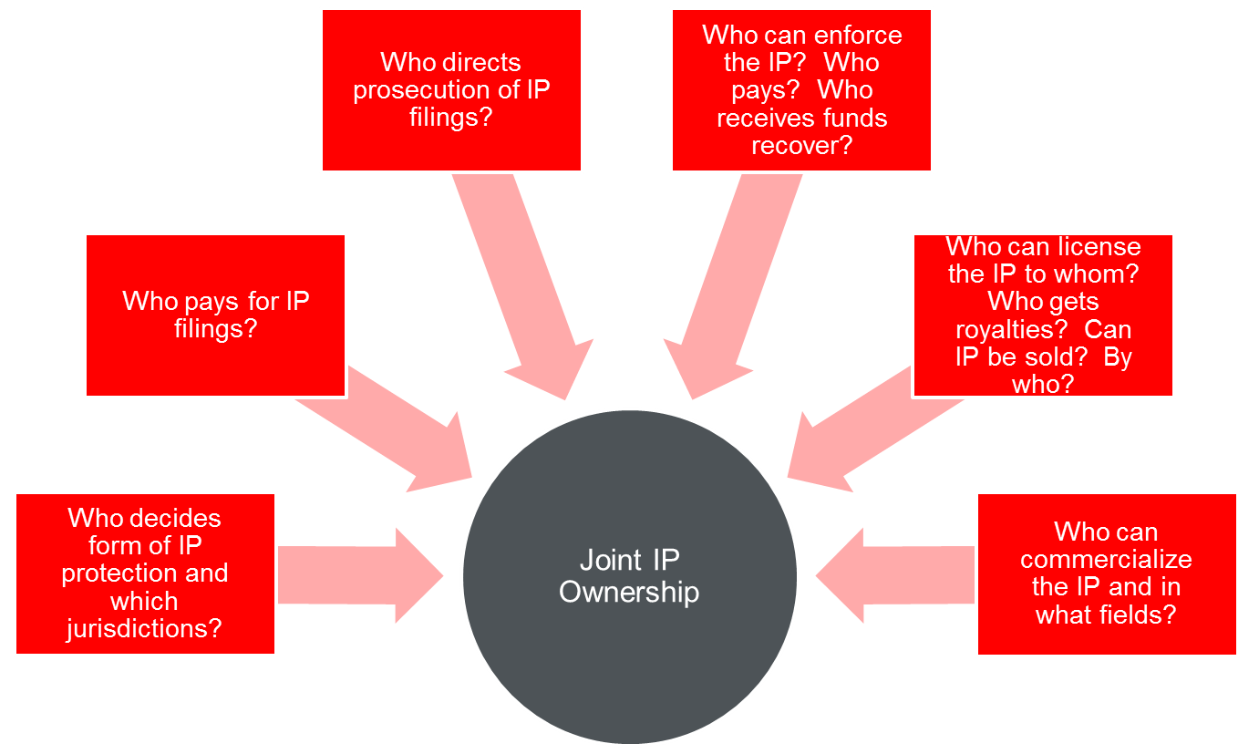
Resolving ownership/rights of use in IP or data

