Slide 1

IT.CAN Teleconference Roundtable Are You Ready to Comply with the EU General Data Protection Regulation (GDPR)?
Dr Sam De Silva
Partner
CMS Cameron McKenna Nabarro Olswang LLP, London
25 September 2017

Slide 2
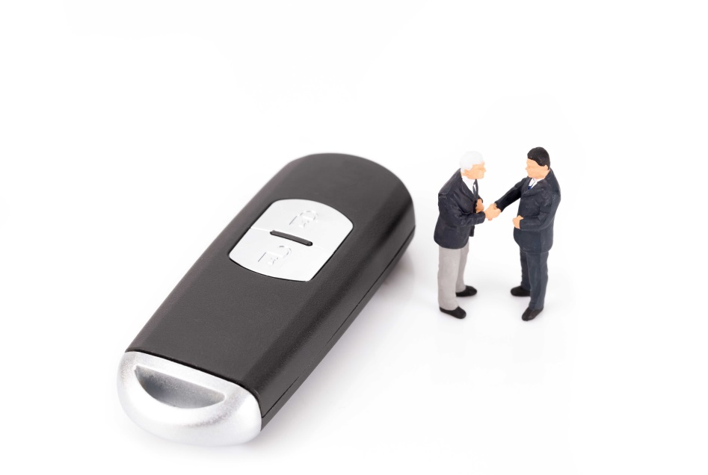
Overview of session
The General Data Protection Regulation
Key changes from the current law and practical application to Multiplex
Fines and Enforcement
Territorial Reach and Scope
Scope of Personal Data
Special Categories of Personal Data
Consent
Information Requirements
Rights of Data Subjects
Accountability
Data Processing Agreements
Data Protection Officers (DPOs)
Security and Breach Notification
Data Protection Impact Assessments and Prior Consultation
Data Protection by Design and Default, Anonymisation and Pseudonymisation
International Transfers

Slide 3
The General Data Protection Regulation (GDPR)
Regulation (EU) 2016/679 of the European Parliament and of the Council of 27 April 2016 on the protection of individuals with regard to the processing of personal data and on the free movement of such data (General Data Protection Regulation)
Applies to all Member States from 25 May 2018
Directly effective – replaces EU Directive and local implementing legislation
Follows spirit and principles of the current legislation but imposes extensive additional new obligations

Slide 4

Fines and Enforcement (Article 83)
Directive
Wide differences between Member States regarding sanctions and enforcement
GDPR
Sets out the fines that can be awarded against controllers and processors who infringe data protection legislation
Proposed fines are significant:
First tier fine – up to €10 million, or in the case of an undertaking up to 2% of total worldwide annual turnover of the preceding financial year (whichever is higher); or
Second tier fine – up to €20 million, or in the case of an undertaking up to 4% of total worldwide annual turnover of the preceding financial year (which ever is the higher).

Slide 5
Fines and Enforcement (Article 83)
Comment and Practical Application:
Factors relevant to the imposition of a fine and relevant amount:
nature, gravity and duration of infringement;
intentional or negligent character of the infringement;
action taken by the controller or processor to mitigate damage suffered by data subjects;
degree of responsibility of the controller or processor having regard to technical and organisation measures implemented;
any relevant previous infringements by the controller or processor;
the degree of co-operation with the supervisory authority;
the categories of personal data affected by the infringement;
the manner in which the infringement became known to the supervisory authority;
compliance with previous corrective powers ordered (concerning the same subject matter);
adherence to approved codes of conduct or certification mechanisms; and
any other aggravating or mitigating factor applicable to the circumstances of the case.

Slide 6

Territorial Reach and Scope (Articles 3 and 27)
Directive
Applies to controllers only:
processing carried out in the context of the activities of an establishment of a controller on the territory of a Member State; or
Extra-territorial effect if:
Controller not established in EU but uses “equipment” on the territory of that Member State, save for pure transit
GDPR
Wider application:
Controllers and processors that process personal data in the context of an establishment in the EU will be caught
Extra-territorial effect if processing activities are related to:
offering of goods and services, (irrespective of whether a payment of the data subject is required); or
monitoring of the behaviour of data subjects in the EU.

Slide 7

Scope of Personal Data (Article 4)
Directive
Personal data is defined in the Directive as:
“any information relating to an identified or identifiable natural person (‘data subject’); an identifiable person is one who can be identified, directly or indirectly, in particular by reference to an identification number or to one or more factors specific to his physical, physiological, mental, economic, cultural or social identity”
GDPR
‘Personal data’
Identified or identifiable person
Identified directly or indirectly
In particular, by reference to:
an identifier, e.g. name, number, location, online ID; or
one or more factors specific to a person (physical, physiological, genetic, mental, economic, cultural or social identity of person)
‘Pseudonymisation’
Processing of personal data so that data can no longer be attributed to an individual without further information (kept securely and separately)

Slide 8
Scope of Personal Data (Article 4)
Comment and Practical Application:
Anonymous data versus pseudonymous data
To mitigate compliance risk:
Ensure that only data absolutely necessary is collected
Ensure that data is only collected and processed for a legitimate purpose
Use pseudonymous data wherever possible
Do not store data for longer than necessary

Slide 9

Special Categories of Personal Data (Article 9)
Directive
Personal data revealing:
racial or ethnic origin
political opinions
religious or philosophical beliefs
trade-union membership
Data concerning:
health data
sex life
GDPR
As the Directive, plus:
Processing of:
genetic data
biometric data
Data concerning:
sexual orientation

Slide 10
Special Categories of Personal Data (Article 9)
Comment and Practical Application:
General prohibition on processing of special categories of personal data
Processing of special categories of personal data is lawful only and to the extent that a justification applies.
Member States may maintain or introduce further conditions
Ensure privacy enhancing measures are in place (e.g. pseudonymisation)

Slide 11

Consent (Article 7)
Consent, freely given, specific informed, unambiguous, indication of wishes by clear affirmative action and controller must demonstrate
Written declaration: consent clearly distinguishable, intelligible and easily accessible, clear and plain language
Right to withdraw consent at any time (not retrospective withdrawal)
Must be informed of right and as easy to withdraw as to give

Slide 12

Information Requirements (Articles 12 - 14)
Directive
Data subjects have (subject to certain exemptions) the right to certain information from the controller in relation to the processing of their personal data, including:
the identity of the controller
the purposes of the processing
any further information in so far as such information is necessary to guarantee fair processing in respect of the data subject
GDPR
Information requirements include:
Concise, transparent, intelligible easily accessible, clear and plain language;
In writing (including electronic where appropriate) orally on request
New information requirements (much broader list)

Slide 13
Rights of Data Subjects (Articles 15 - 22)
Directive
Under the Directive data subjects have the right to obtain from the controller:
Rights of access to their personal data
the rectification, erasure or blocking of data the processing of which does not comply with the Directive, in particular because of the incomplete or inaccurate nature of the data
No specific right to portability or right to be forgotten
GDPR
Rights of Access, Rectification, Right to be Forgotten Restriction, Portability, Object to Automated Decision Making (including profiling))
Controller to facilitate, must not refuse (unless cannot identify)
One month time period (extendable up to two months)
Free of charge (except unfounded or excessive)

Slide 14

Consents/Information Requirements/Rights of Data Subjects (Articles 12 - 22)
Comment and Practical Application:
Review who needs to rely on privacy notices / consents
Check grounds for lawful processing (particularly if relying on “legitimate interests”)
Review adequacy of / refine privacy notices, ensure they are given at correct time
Review if consents properly obtained / adequate
Check IT system readiness and ability to comply with format obligations
Data subjects can withdraw consent and request erasure of their personal data at any time if there is no other legal ground for processing. This could be disruptive.
Profiling which produces legal effects based on special categories of personal data is only permitted under specific conditions (unless explicit consent or substantial public interest on basis of Union/Member State Law apply and suitable safeguards).

Slide 15

Accountability (Article 24 and 30)
Directive notification requirements abolished
Requirement on controllers and processors to keep relatively detailed records of processing activities:
Must make record available to Supervisory Authority on request
Exemption if <250 staff and processing occasional, does not include special categories of data and is not high risk
Requirement to demonstrate compliant processing activities:
Implement appropriate policies
Identify and consider adherence to publicly published code of conduct / approved certification mechanism

Slide 16
Accountability (Article 24 and 30)
Comment and Practical Application:
Identify means to demonstrate compliance; implement a compliance programme
Review reporting lines
Develop and trial a system for documenting processing activities and updating that record
Review / revise / implement new policies, procedures and training
Review and update contracts with suppliers

Slide 17
Data Processing Agreements (Article 28)
Under the Directive and the GDPR, Data controller – processor agreements must be in writing.
The extent of provisions to be set out in the agreement are much greater under the GDPR.
Provisions include:
setting out details of the processing, in terms of the subject matter, duration, nature, type of personal data, and the categories of the data subjects
stipulating that the processor should:
ensure that persons authorised to process personal data have committed themselves to confidentiality
assist the controller with:
security measures
data breach notifications
impact assessments (where relevant)
make available to the controller all information to demonstrate compliance
provide for the processor to allow and contribute to audits
inform the controller if in its opinion an instruction infringes the GDPR or other data privacy law

Slide 18
Data Processing Agreements (Article 28)
Comment and Practical Application:
No grandfathering provisions in the GDPR.
Existing controller-processor contracts should be identified, reviewed and amended to ensure compliance.
For contracts being negotiated now, think of including provisions that will ensure compliance with the GDPR in due course.
With standard form contracts that are used with suppliers and that contain data protection provisions, consider future proofing them now to save time and trouble in the future.

Slide 19

Data Protection Officers (Articles 37 - 39)
Directive
No mandatory requirement under the Directive to appoint a DPO
In certain EU countries e.g. Germany, Hungary, there is a legal requirement if certain factors apply
GDPR
Only compulsory for controller and processor (subject to Union or Member State law) if:
Public authority
Regular systematic large scale monitoring
Large scale processing of special categories of data

Slide 20
DPOs (Articles 37 - 39)
Comment and Practical Application:
A group of undertakings may appoint a single DPO provided that such person is easily accessible from each establishment
DPO to be designated on the basis of his professional qualities, expert knowledge of data protection law and practices and ability to fulfil statutory tasks
DPO may be a staff member of controller or processor, or fulfil the tasks on the basis of a service contract
Controller or processor to publish the contact details of the DPO and communicate these to the supervisory authority
DPO to be properly and in a timely manner involved in all issues which relate to protection of personal data
Controller or processor to support DPO with resources necessary for tasks, access to personal data and operations and to maintain expert knowledge
Independent, protected role and to report directly to highest management level of controller/processor

Slide 21

Security and Breach Notification (Articles 32 - 34)
Directive
Under the Directive:
“Appropriate technical and organisational measures to protect personal data against accidental or unlawful destruction or accidental loss, alteration, unauthorised disclosure or access”
There is no express obligation under the Directive to notify the relevant regulator of security breaches
GDPR
Data security breach notification:
Without undue delay
72 hours after aware (where feasible)
Unless unlikely to result in risk to the data subject
Notify supervisory authority
Notify data subject too (if high risk) without undue delay unless:
personal data is unintelligible;
subsequent measures mean risk unlikely to materialise; or
involve disproportionate effort (but could be made via public communication)

Slide 22
Security and Breach Notification
(Articles 32 - 34)
Comment and Practical Application:
Controller and processor both responsible for data security
Duty on controller to provide notification of breach to supervisory authority/data subject
Notification to supervisory authority must as a minimum:
Describe nature of personal data breach including (where possible) categories/approximate number of data subjects concerned and categories/number of records
Communicate the name and contact details of DPO or other contact point
Describe likely consequences of breach
Describe measures taken or proposed to be taken by controller to address breach and to mitigate its possible adverse effects
Where not possible to provide above information at same time, information may be provided in phases without undue delay
Controller to document any personal data breaches, comprising facts of breach, effects and remedial action taken to enable supervisory authority to verify controller’s compliance
Controllers and processors would be advised to:
Review, test (regularly) and refine breach management procedures and reporting
Update contractual provisions to require notification and co-operation

Slide 23

Data Protection Impact Assessments and Prior Consultation (Articles 35 and 36)
Directive
No formal requirement for a data protection impact assessment
GDPR
Data protection privacy impact assessment (“PIA”) required for:
High risk
Prior to processing (can be generic)
Profiling/special categories/systematic monitoring e.g. CCTV
Prior Consultation
If the result of the PIA is high risk (notwithstanding mitigation measures)
Consult with supervisory authority
Supervisory authority will decide within 8 weeks (extendable) and may prevent processing or impose conditions

Slide 24

Data Protection Impact Assessment and Prior Consultation (Articles 35 and 36)
Comment and Practical Application:
Review profiling and automated decision-taking to verify compliance
PIA should contain at least:
A systematic description of envisaged processing operations and the purposes of the processing
Assessment of the necessity and proportionality of the processing operations in relation to the purposes
Assessment of the risks to the rights and freedoms of the data subjects
Measures envisaged to address the risks, including safeguards, security measures and mechanisms to ensure protection of personal data and to demonstrate compliance with the GDPR
Compliance with codes of conduct can be take into account for PIA
Where appropriate, controller to seek views of data subjects or their representatives on intended processing

Slide 25

Data Protection by Design and Default, Anonymisation and Pseudonymisation
(Article 25)
Data protection by design and default:
Implement appropriate technical and organisational measures
Anonymisation and pseudonymisation
Anonymous data ╪ personal data
Pseudonmyisation
Processing personal data in a way that means it cannot be attributed to an individual without the use of other separate information
Technical and organisational measures to ensure no attribution / identification

Slide 26
Data Protection by Design and Default Anonymisation and Pseudonymisation
(Article 25)
Comment and Practical Application:
Time to:
Review and refine internal processes
Engage with IT, product development and compliance teams

Slide 27

International Transfers (Articles 44 - 50)
GDPR
White list of ‘third countries’ retained
Privacy Shield
Appropriate safeguards and enforceable by data subjects:
Binding Corporate Rules (“BCRs”)
Standard Clauses (Commission or supervisory authority)
Approved Code of Conduct
Certification Mechanism
Bespoke contract approved by the competent supervisory authority (subject to consistency mechanism)
Derogations for specific situations

Slide 28
Questions
?

Slide 29
Dr Sam De Silva
Partner, Technology
T +44 20 7524 6223
E sam.desilva@cms-cmno.com

